Slide 1
SLIDE DECK 8: The Voting Process

Slide 2
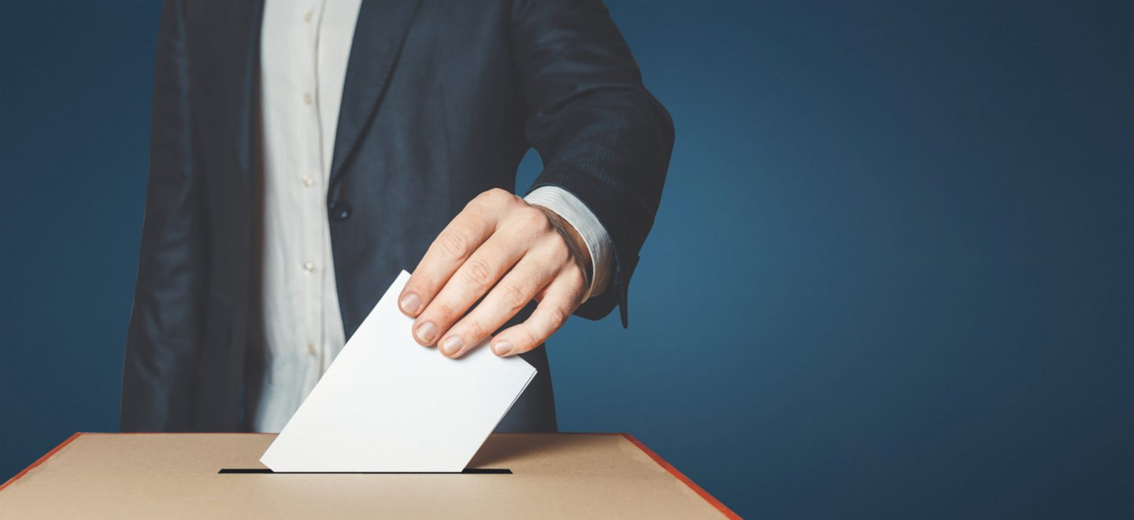
Voting by secret ballot
Voting in local elections is done by secret ballot.
Voters mark their ballot behind a privacy screen and fold their ballot to hide their choice.

Slide 3
Who organizes local elections?
The provincial government sets out common rules that all voters and candidates must follow.
However, municipalities and regional districts are responsible for conducting the elections.
Every municipality and regional district has a chief election officer who is in charge of running the election.

Slide 4
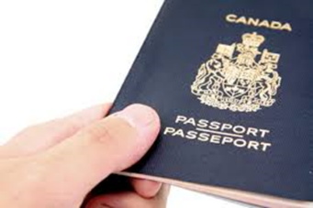
Who is qualified to vote?
To be able to vote in B.C. local elections, you must be:
18 years of age
A Canadian citizen
A resident of B.C. for six months
Live or own property where you plan to vote

Slide 5
What is the voters list?
In most cases, a local government must maintain and use its own list of electors (voters list).
The local government-maintained voters list includes the names of resident electors and the names of non-resident property electors.
A resident elector is required to show two pieces of identification or sign a solemn declaration if their name does not already appear on the voters list.

Slide 6
What are different ways a person can vote?
Each municipality is responsible for conducting their election and determining the methods used.
Options can include:
In person
By mail
Special voting opportunities held in hospitals

Slide 7
Where do I vote?
You can find your voting place on your municipality or regional district website and through documentation mailed to voters.
Electors who are away, busy or unable to vote on voting day, have the option of participating in advance voting.

Slide 8
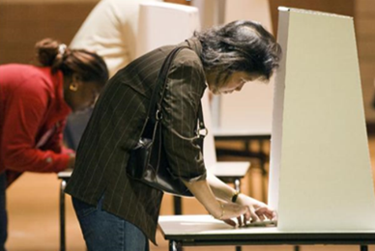
What is the process for voting?
Once you confirm your eligibility, you are given a ballot.
Go behind a voting screen and mark your ballot.
Hand your folded ballot back to the voting clerk.
Your ballot is recorded and counted.

Slide 9
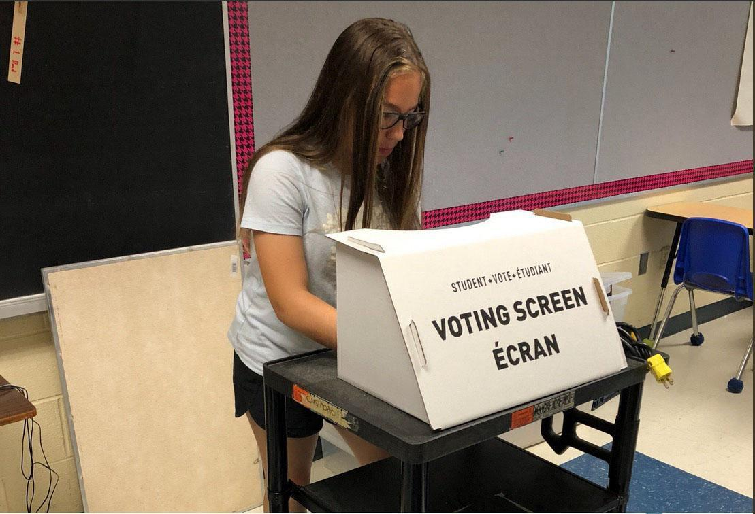
How do I mark my ballot?
A ballot lists the names of the candidates running for each position in your local elections.
As long as you appropriately mark the ballot according to the number of choices, your votes will be counted.

Slide 10
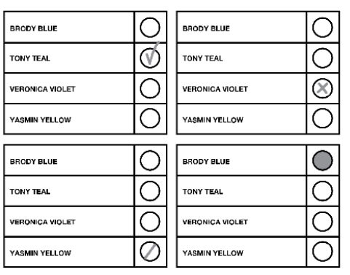
Valid ballots
A valid ballot clearly indicates the preference of the voter.
You may vote for more than one candidate if there is more than one person elected in the race.

Slide 11
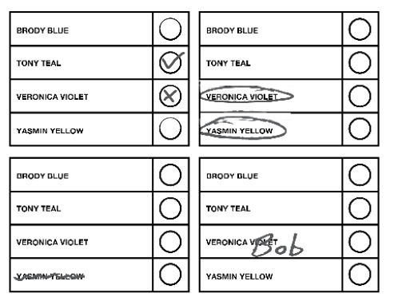
Rejected ballots
A rejected ballot is a ballot that cannot be counted because the voter’s choice is not clear.

Slide 12
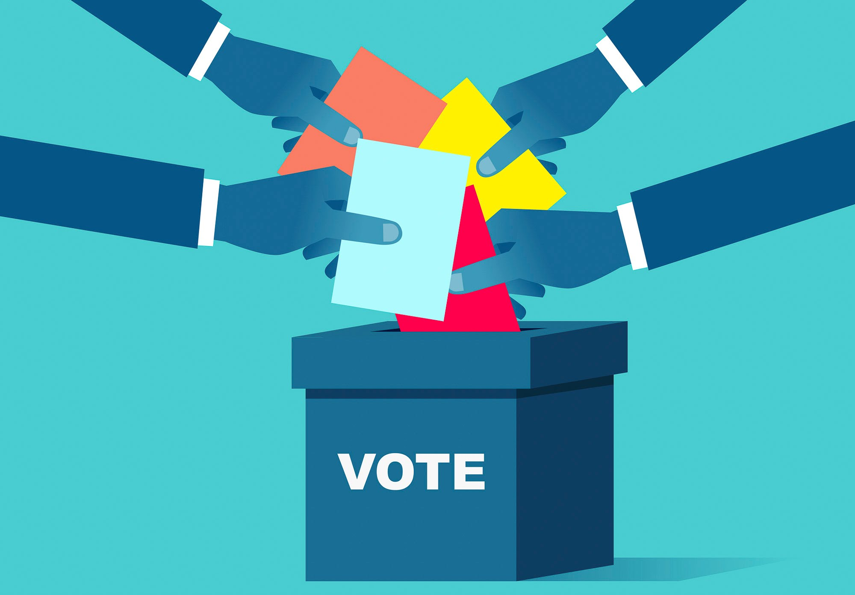
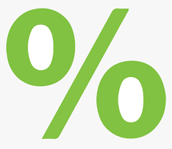
Voter turnout
Voter turnout is the percentage of eligible electors or registered voters that cast ballots in an election.

Slide 13
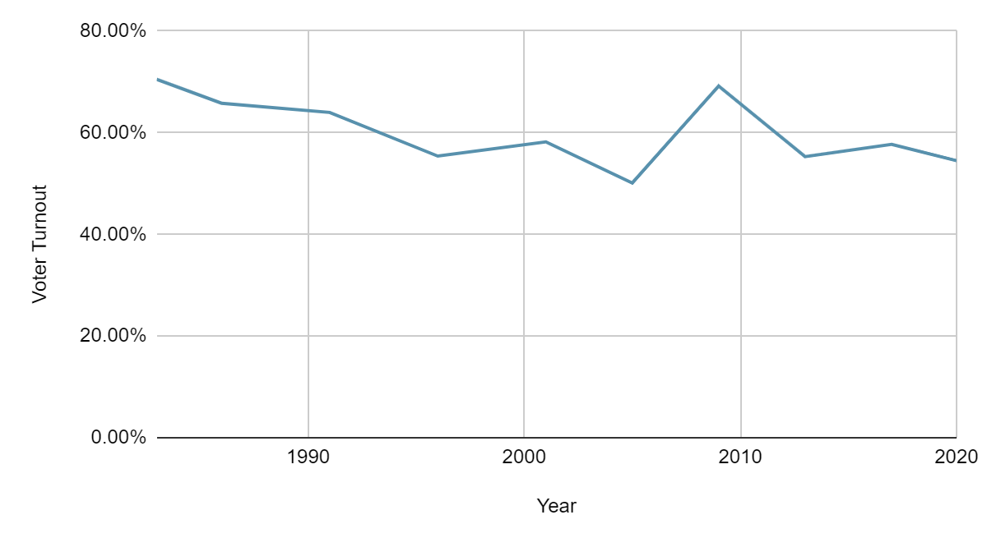
Provincial voter turnout (1983-2020)
Year | Turnout
1983 | 70.5%
1986 | 65.8%
1991 | 64.0%
1996 | 55.4%
2001 | 58.2%
2005 | 50.1%
2009 | 69.2%
2013 | 55.3%
2017 | 57.7%
2020 | 54.5%
Source: Elections BC

Slide 14
Discussion
•How has voter turnout changed over time?
•What factors do you think may lead to an increase in turnout?
•What groups do you think might have lower voter turnout? What barriers might they face?

Slide 15
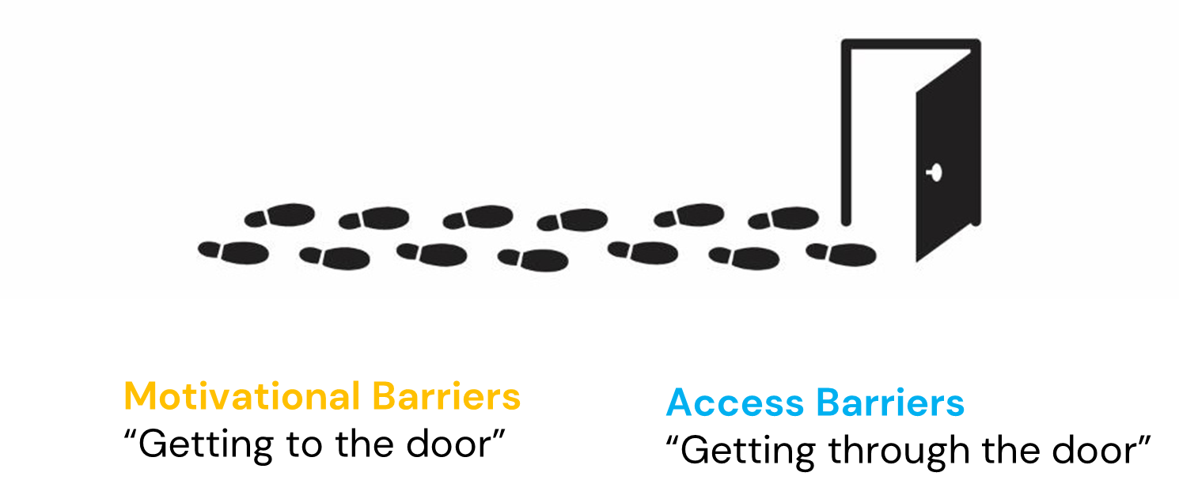
Barriers to voting

Slide 16
Motivational barriers

Slide 17
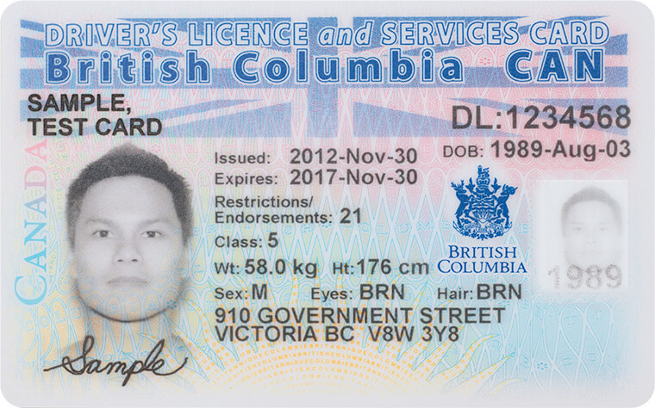
Access barriers

Slide 18
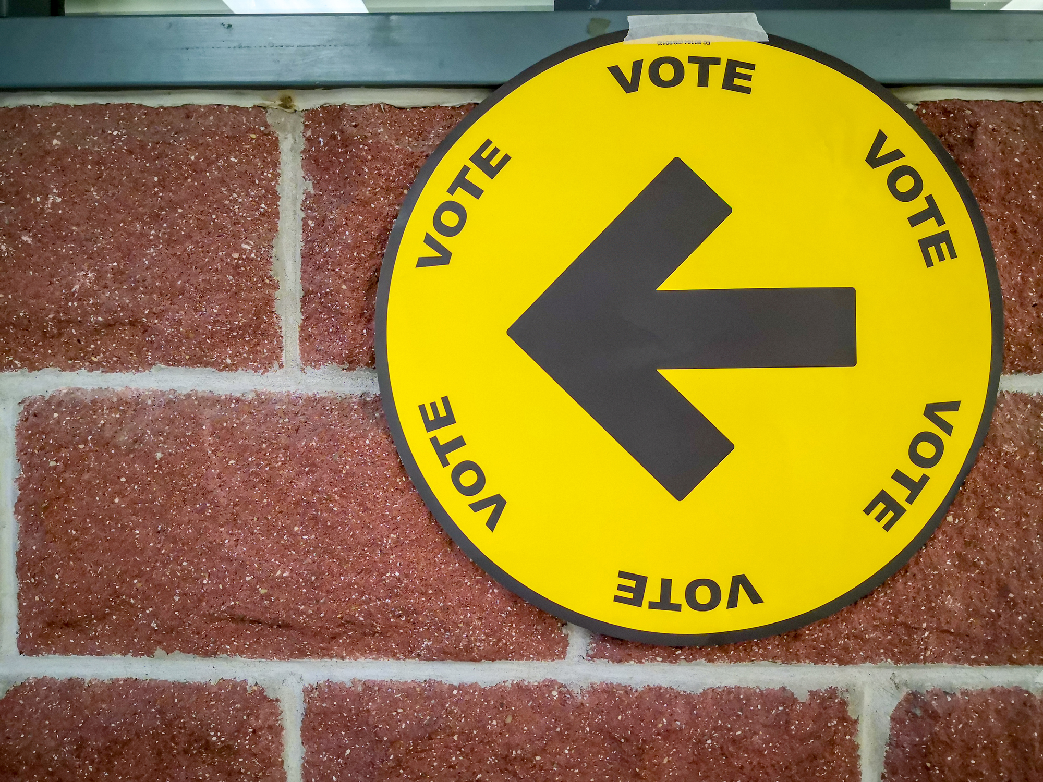
Reflection

Slide 19
Discussion
Should eligible citizens vote in local elections?
Does voting matter?
Do you plan to vote in the future? Why?

