Slide 1
SLIDE DECK 3A:
Who am I? What am I?

Slide 2
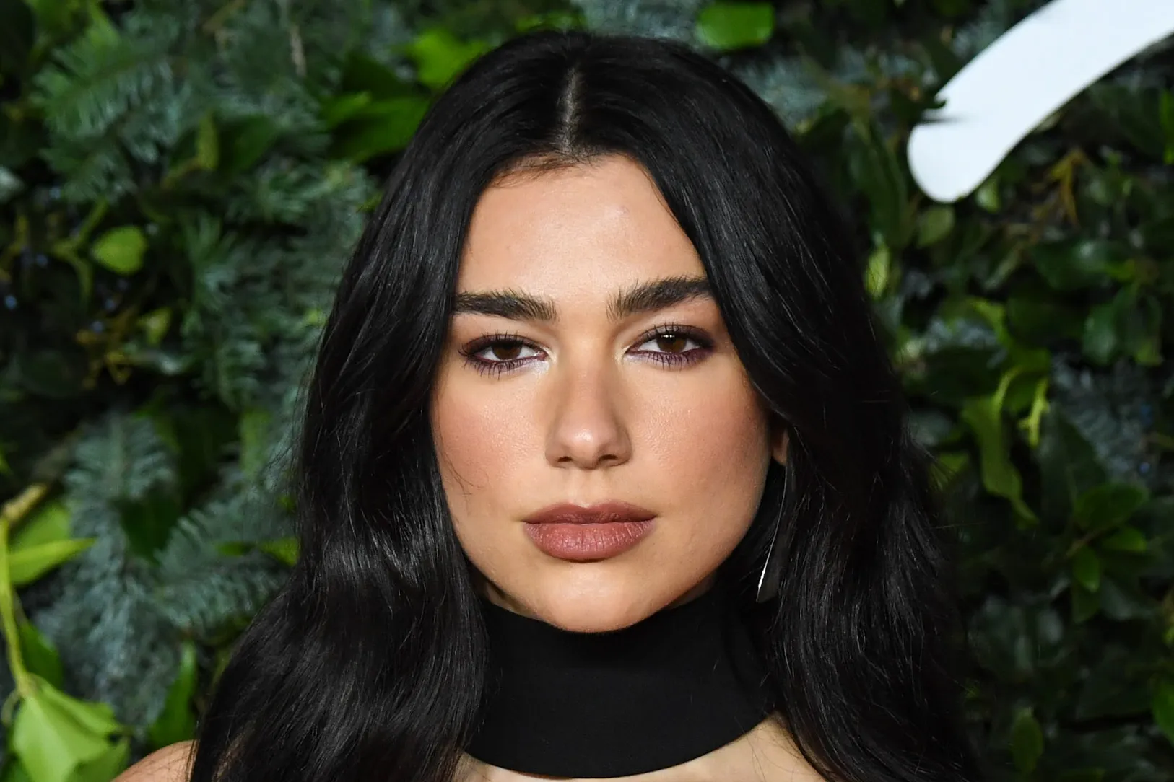
Notes:
Dua Lipa (singer)

Slide 3
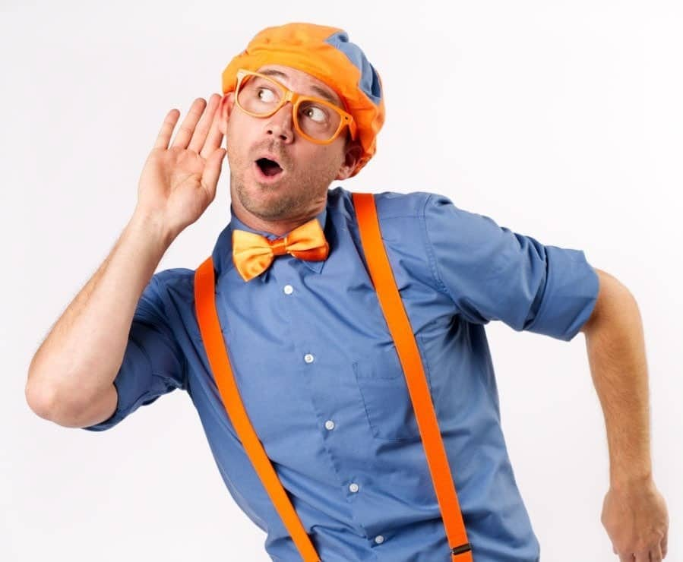
Notes:
Blippi (entertainer)

Slide 4
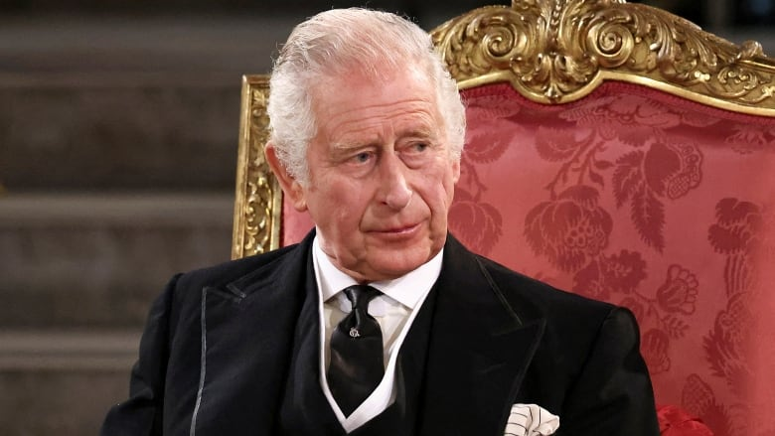
Notes:
King Charles III

Slide 5
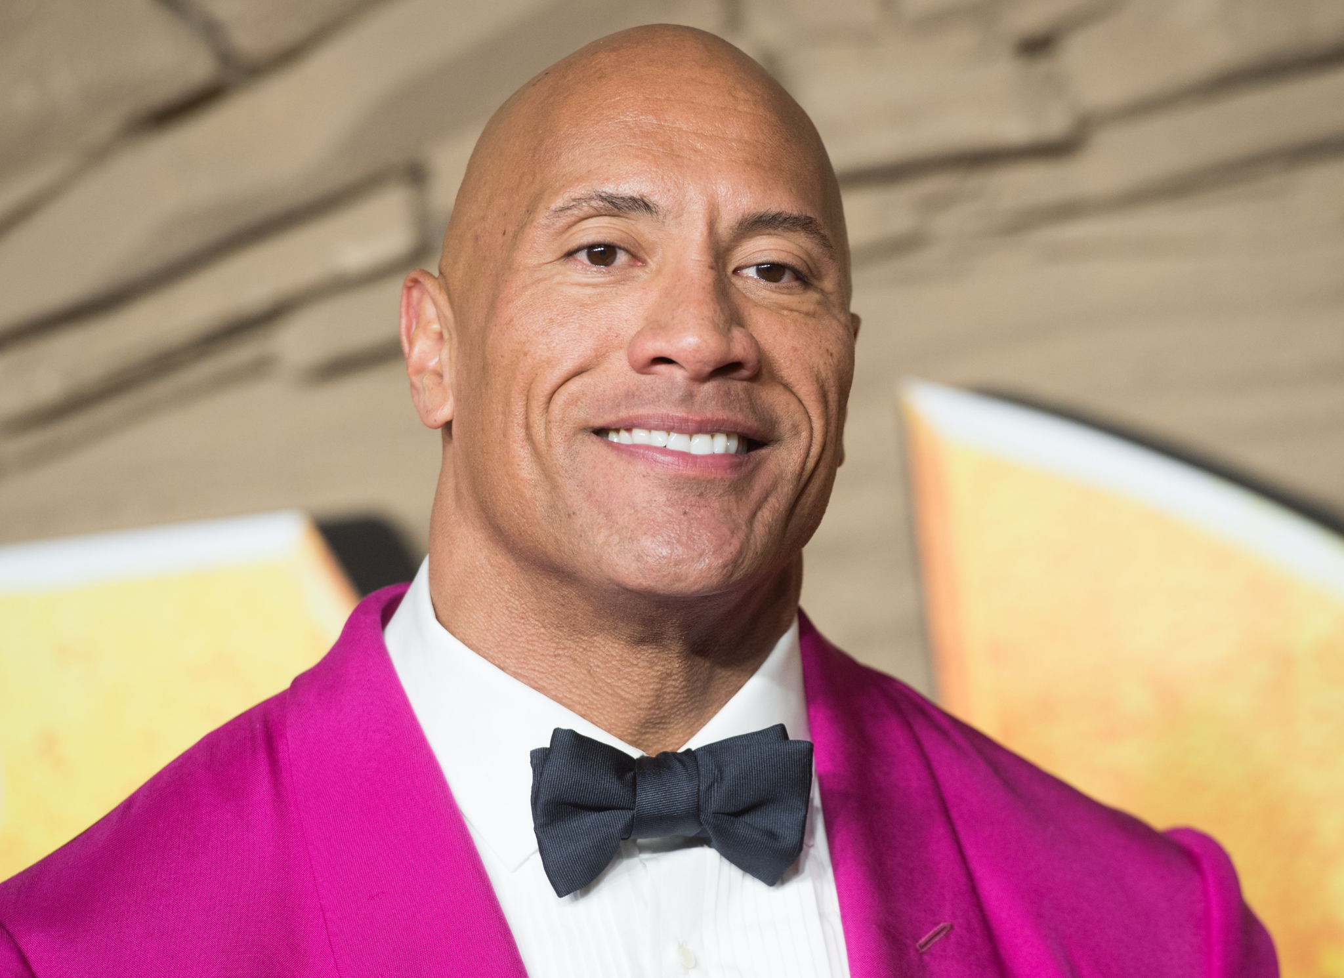
Notes:
Dwayne Johnson (The Rock) - American actor, businessman, and former professional wrestler.

Slide 6
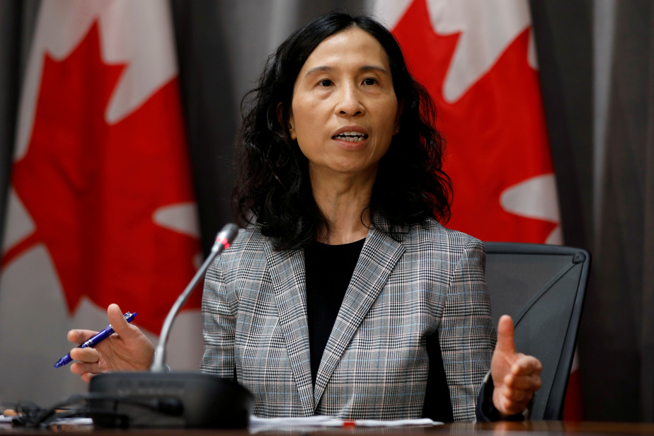
Notes:
Theresa Tam - Chief Public Health Officer of Canada

Slide 7
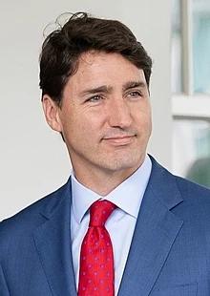
Notes:
Justin Trudeau - Canadian Prime Minister

Slide 8
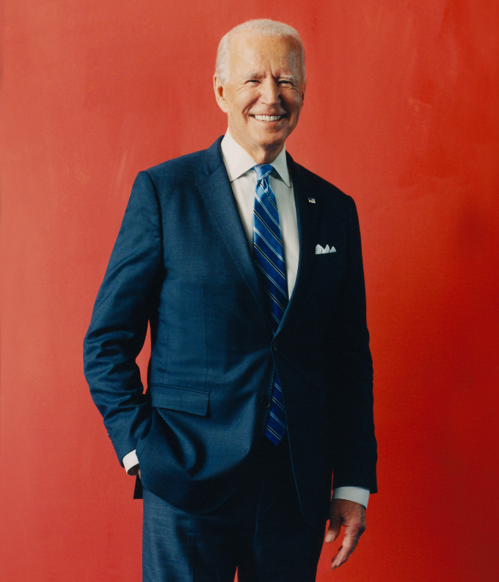
Notes:
Joe Biden - President of the United States

Slide 9
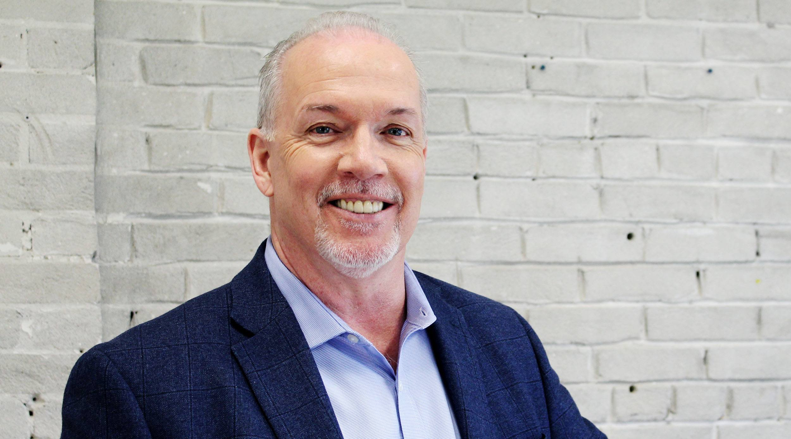
Notes:
John Horgan – Premier of BC; Leader of the BC NDP

Slide 10
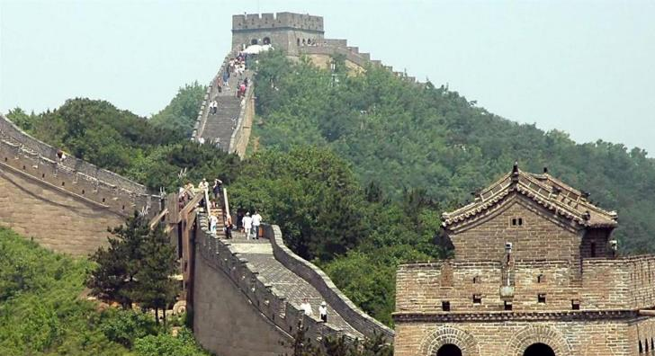
Notes:
Great Wall of China

Slide 11
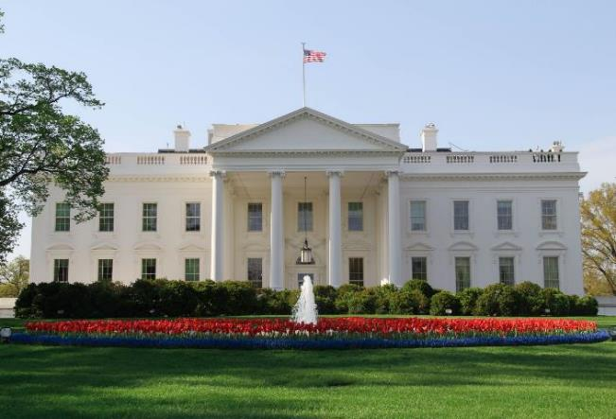

Slide 12
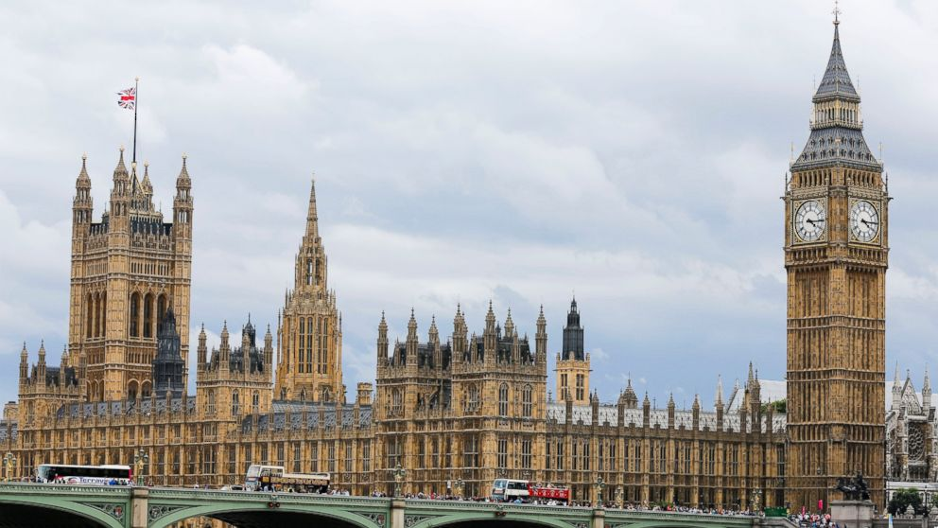

Slide 13
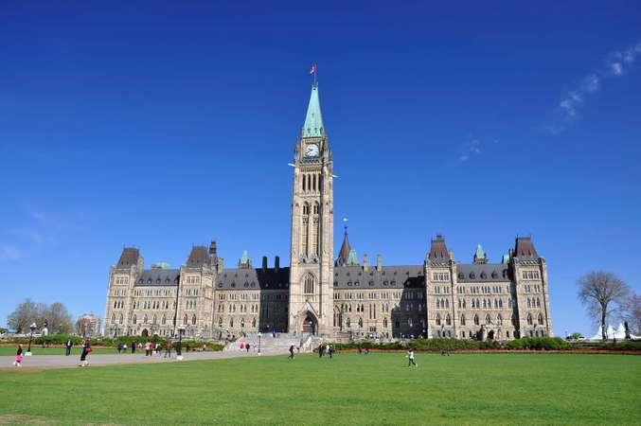

Slide 14
