Slide 1
SLIDE DECK 3B: Levels of Government

Slide 2
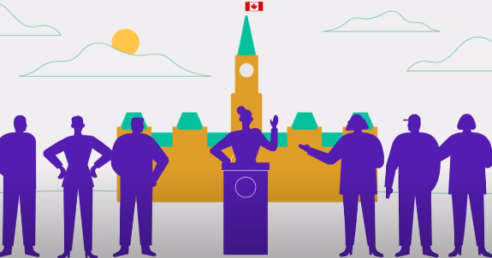
Discussion
What is a representative democracy?

Slide 3
Representative democracy
Representatives (or politicians) are chosen by people through elections.
Each representative is responsible for a different geographic area or community.
Representatives gather together to debate issues and pass laws.

Slide 4
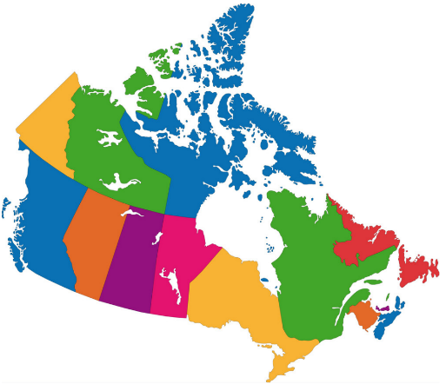
Trivia
How many levels of government do we have?
A
AA
B
A
2
B
3

Slide 5
Trivia
How many levels of government do we have?
A
AA
B
Each level has its own group of elected representatives.
Federal
Provincial/Territorial
Local
Some First Nations, Inuit, and Métis communities have their own systems of governance. They share certain responsibilities with other levels of government.
B
3

Slide 6
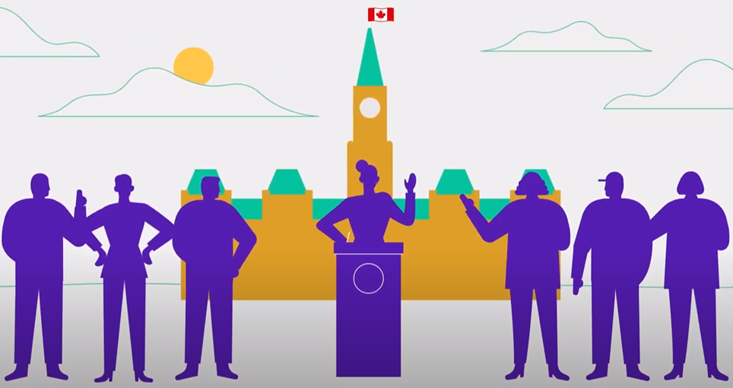
Trivia
What is the title given to the elected representative at the federal level?
A
AA
B
A
Senator
B
Councillor
C
Member of Parliament
D
Member of the Legislative Assembly

Slide 7
Trivia
What is the title given to the elected representative at the federal level?
A
AA
Each level has a different name for its representative.
C
Member of Parliament (MP)
Level | Name
Federal | Member of Parliament (MP)
Provincial (BC) | Member of the Legislative Assembly (MLA)
Local | Councillor

Slide 8
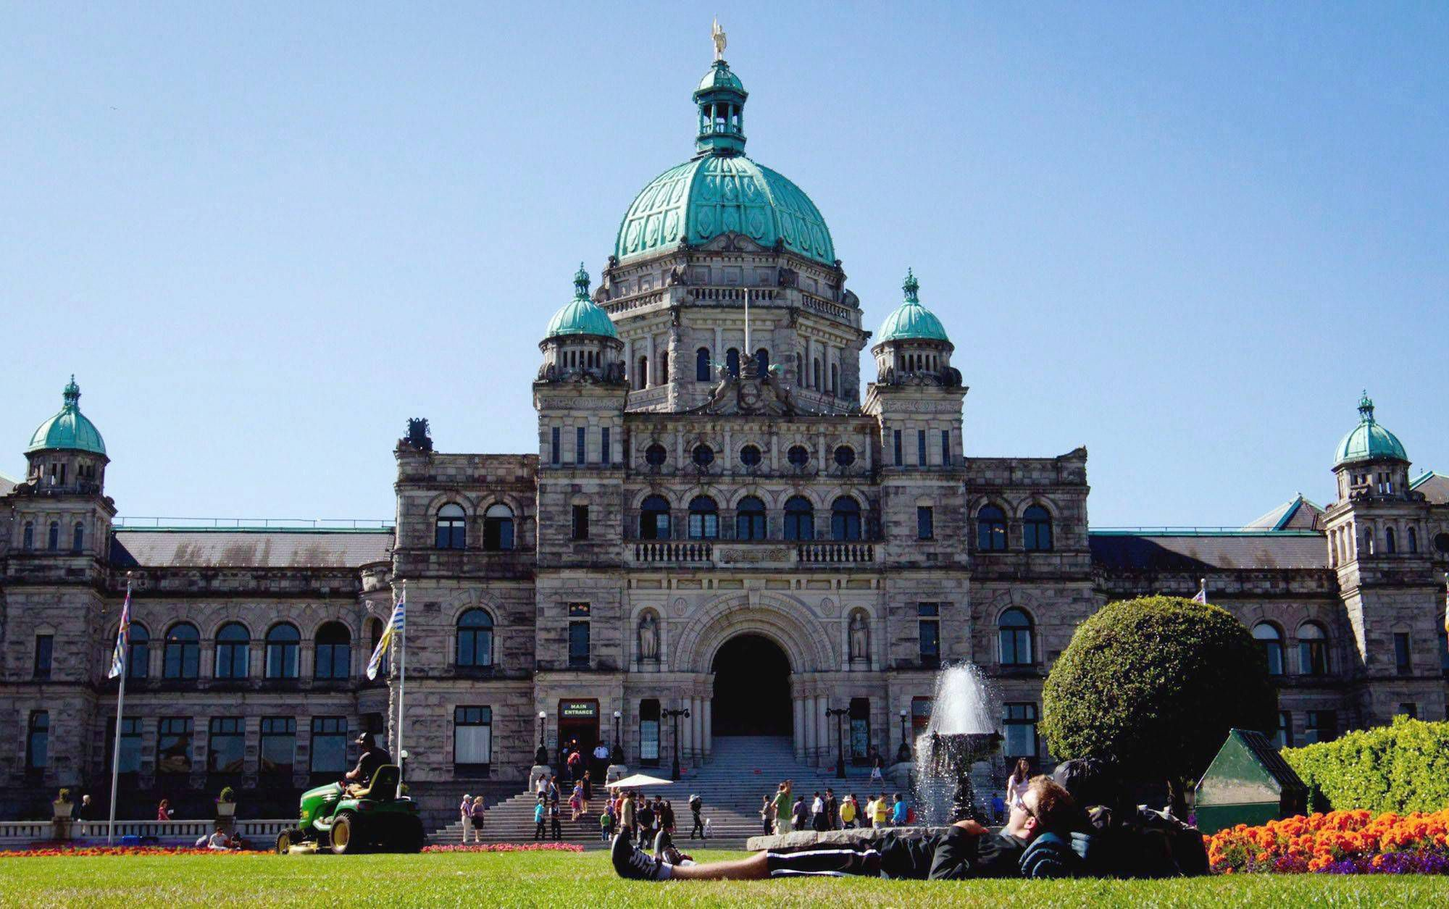
Trivia
Where is the Legislative Assembly of British Columbia located?
A
AA
B
A
Richmond
B
Victoria
C
Burnaby
D
Surrey

Slide 9
Trivia
Where is the Legislative Assembly of British Columbia located?
A
AA
Each level has its own building where representatives gather to debate and pass laws.
B
Victoria
Level | Building | Location
Federal | House of Commons | Ottawa
Provincial | Legislative Assembly | Victoria
Local | City or town council | The city/town

Slide 10
Trivia
What is the title of the leader of the provincial government?
A
AA
B
A
President
B
Prime Minister
C
Mayor
D
Premier

Slide 11
Trivia
What is the title of the leader at the provincial level?
A
AA
B
Each level of government has a different name for its leader.
D
Premier
Level | Leader’s Title
Federal | Prime Minister
Provincial | Premier
Local | Mayor

Slide 12
Whose responsibility is it?
Federal, provincial or local government?
Water supply and treatment
National defence
Natural resources
Driver’s licensing and highways
Education
Citizenship and passports
Hospitals and healthcare
Road maintenance
Local parks
Indigenous lands and rights
Criminal law
International trade
Local police and fire protection

Slide 13
Government responsibilities
Federal
Citizenship and passports
National defence
Criminal law
Foreign affairs and international trade
Indigenous lands and rights
Provincial
Education
Hospitals and healthcare
Natural resources
Social services
Drivers’ licensing and highways
Local
Water supply and treatment
Local parks
Road maintenance
Local police
Fire protection

