Slide 1
SLIDE DECK 5: My Community

Slide 2
Guiding questions
What are the features of municipalities and regional districts?
How has the physical environment shaped my community?
What actions can be taken to improve my community and why?

Slide 3
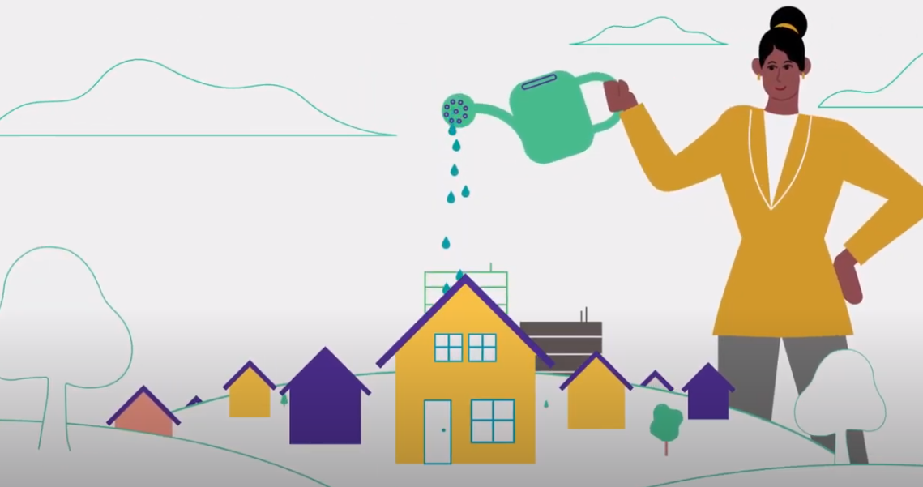
Local governments
Municipalities and regional districts are responsible for providing essential local services to their communities.
They are the most local level of government in Canada.

Slide 4
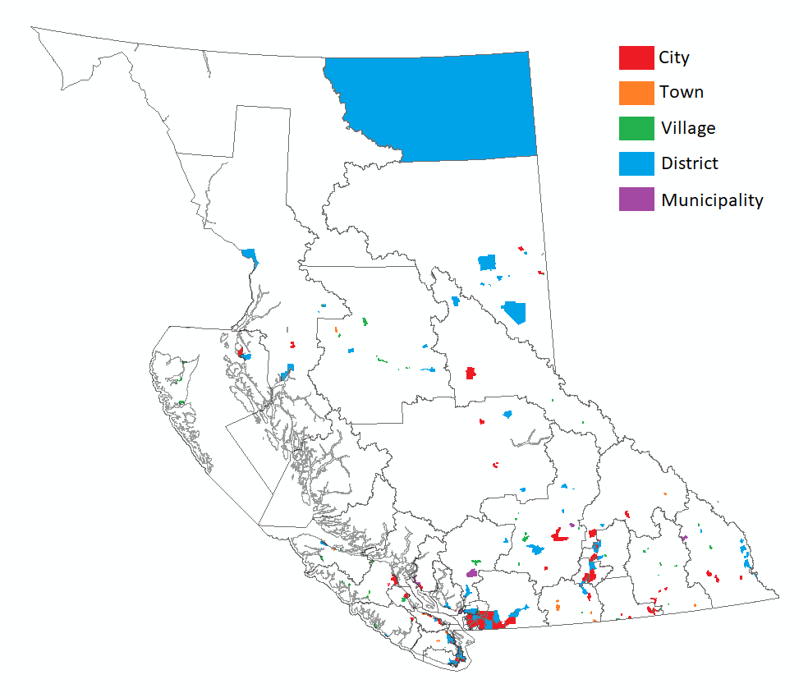
Local governments in B.C.
British Columbia is separated into 162 municipalities.
Their purpose:
Providing for good government of its community
Providing for services, laws and other matters for community benefit
Providing for stewardship of the public assets of its community
Fostering the economic, social and environmental well‑being of its community

Slide 5
Municipality types
Based on population and size, there are four types of municipalities: villages, towns, districts and cities.
Municipalities have the power to establish a wide range of services for their communities.
Property taxes are established by each municipality to contribute to the costs of services.

Slide 6
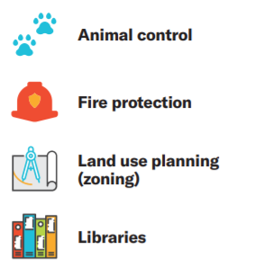
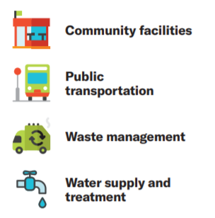
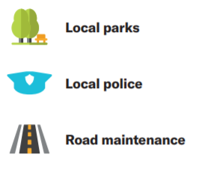
Local government responsibilities

Slide 7
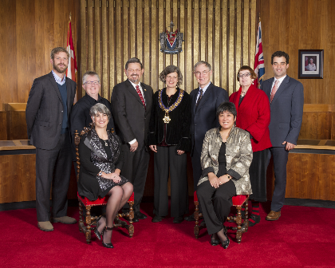
Municipal councils
Council members are chosen by citizens through an election to make decisions for the municipality
Made up of a head of council called a mayor and several councillors
The number of councillors ranges from 5 to 11, depending on population and size of the municipality.

Slide 8
A municipal council makes decisions as a whole, which means that individual council members cannot make decisions on their own.
Decisions are taken by a vote and actions are only taken if the decision has support of more than half of the council members.

Slide 9
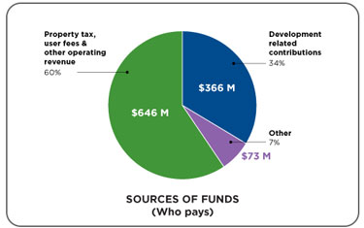
Key Functions of Council
Passing bylaws (rules and policies for the community)
Budget planning and spending decisions
Selecting people for committees and boards
Overseeing municipal government departments, services and programs
Being a voice for community members, to share their ideas and concerns

Slide 10
Regional Districts
In addition to municipalities, British Columbia also has 27 regional districts, covering almost the entire province.
Regional districts are made up of:
Municipalities
Unincorporated areas (electoral areas)
Treaty First Nations (where applicable)
Regional districts range in population from under 4,000 to over two million people.

Slide 11
Regional District Boards
Each regional district has a board of directors, which includes representatives from each community/municipality/First Nation.
Municipal councils select one or more council members to sit as representatives (regional district directors).
In small communities outside of municipalities, electoral area directors are elected by the people to represent them.
The representatives of Treaty First Nations are selected from their own decision-making body (regional district directors).
The head of regional district board is called a chair and they are selected from among and by the directors of the regional district board.

Slide 12
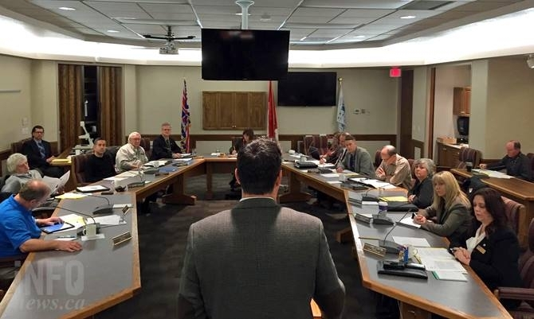
Individual directors do not have the power to make decisions. It is regional district board that make decisions as a group through resolutions and by-laws. Each decision must have the support of more than half of the board of directors.

Slide 13
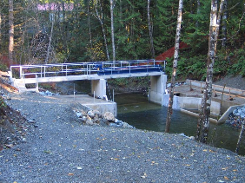
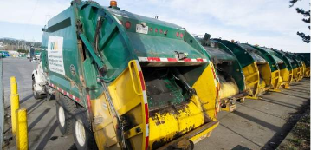
Services of Regional Districts
Like municipalities, regional districts can choose to operate any service that the board of directors decides is necessary or desirable for their communities.
Some of the more common services provided by regional districts include: water supply, sewers, solid waste management, economic development, public housing, emergency services and airports.

Slide 14
Discussion
Can you identify any problems or challenges in our community?
Do you see any opportunities for improvement?
What actions could be taken to make a positive change in our community?
How can you be an active community member?

