Slide 1
SLIDE DECK 5: Municipalities and Regional Districts

Slide 2
What municipality or regional district do you live in?
Do you like living in your municipality or regional district? Why?

Slide 3
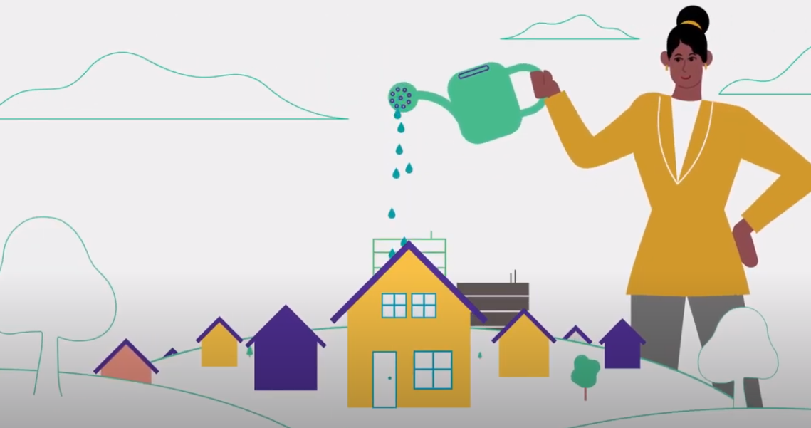
Local governments
Municipalities and regional districts are responsible for providing essential local services to their communities.
Responsible for the planning, growth and well-being of their community through legislation, by-laws and policies.

Slide 4
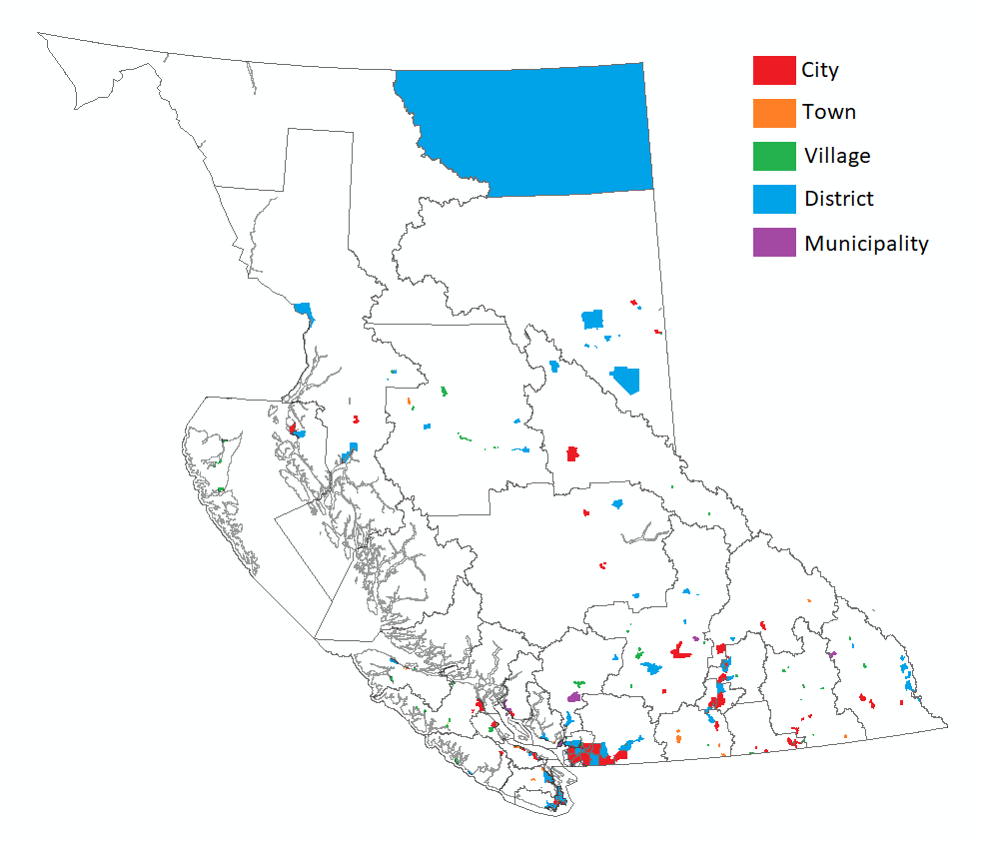
Local governments in B.C.
British Columbia is separated into 162 municipalities, covering 89% of the province.
Their purpose:
Providing for good government of its community
Providing for services, laws and other matters for community benefit
Providing for stewardship of the public assets of its community
Fostering the economic, social and environmental well‑being of its community

Slide 5
Municipality types
Based on population and size, there are four types of municipalities: villages, towns, districts and cities.
Municipalities have the power to establish a wide range of services for their communities.
Property taxes are established by each municipality to contribute to the costs of services.

Slide 6
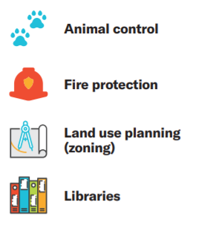
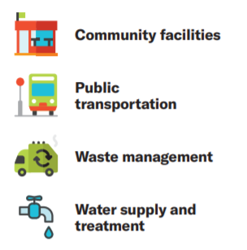
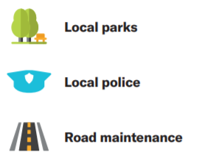
Local government responsibilities

Slide 7
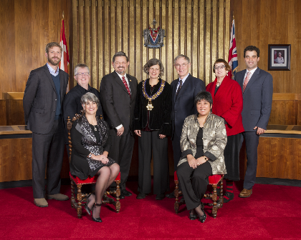
Municipal councils
Municipal councils are democratically elected bodies that make decisions on behalf of the municipality, and are accountable for those decisions.
Comprised of a head of council called a mayor and several councillors, collectively called council members.
The number of councillors ranges from 5 to 11, depending on population.

Slide 8
Municipal councils
A municipal council makes decisions collectively, meaning that it is naot individual council members that make decisions, but rather the council as a whole.
Decisions are taken by a vote and only move forward if they receive majority of support (>50%).

Slide 9
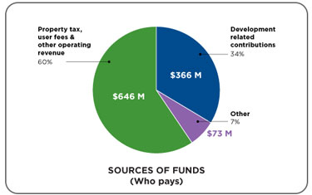
Key Functions of Council
Passing bylaws (rules and policies for the community)
Budget planning and approval
Committee, board and commission appointments
General oversight of municipal administration (departments, services and programs)
Bringing forward issues and concerns of community members for discussion for discussion

Slide 10
Regional Districts
In addition to its 162 municipalities, British Columbia is composed of 27 regional districts, covering almost the entire province.
Regional districts are modeled as a federation composed of:
Municipalities
Unincorporated areas (electoral areas)
Treaty First Nations (where applicable)
Regional districts range in population from under 4,000 to over two million people.

Slide 11
Regional District Boards
Each regional district is governed by a board of directors, which includes representatives from each community/municipality/First Nation.
Municipal councils appoint one or more council members to sit as representatives (regional district directors).
In unincorporated areas, electoral area directors are elected directly by the people.
The representatives of Treaty First Nations are selected from their own governing body (regional district directors).
The head of regional district board is called a chair and they are selected from among and by the directors of the regional district board.

Slide 12
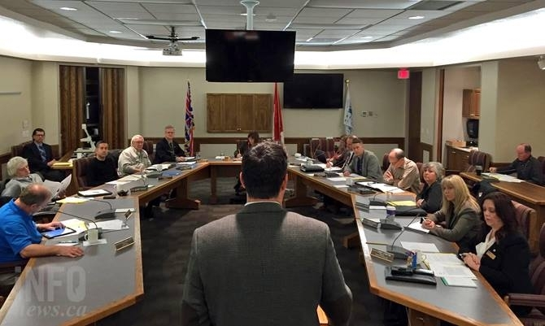
Individual directors do not have authority. Collectively, it is regional district board that make decisions through resolutions and by-laws. Each decision must have a majority of support from the board of directors.

Slide 13
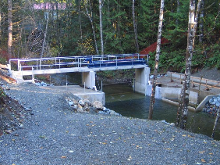
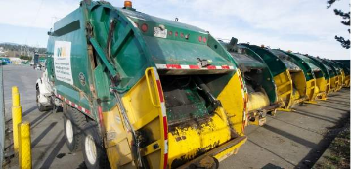
Services of Regional Districts
Like municipalities, regional districts have a similar purpose and the power to operate any service that the board of directors considers necessary or desirable for all or part of the regional district.
Some of the more common services provided by regional districts include: water supply, sewers, solid waste management, economic development, public housing, emergency services and airports.

Slide 14
Final thoughts
Why should we care about our community?
Why is it important to collaborate with others on addressing community needs?
Why is it important to have diversity in government and within groups tackling change in our communities?

