Slide 1
SLIDE DECK 6:
Local Elections

Slide 2
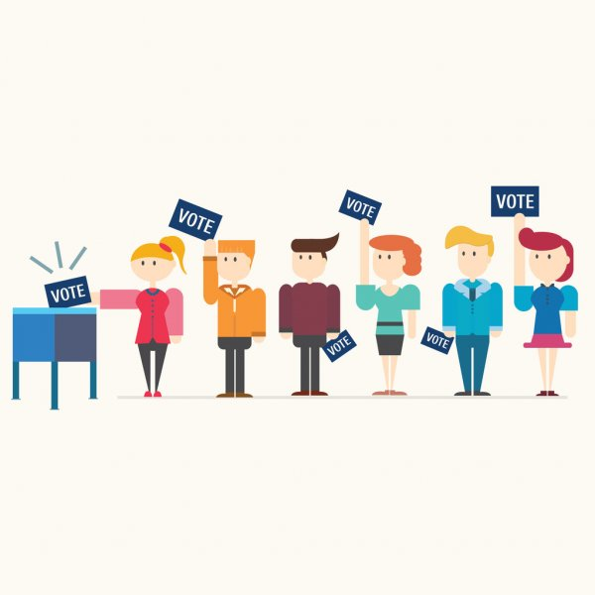
How are municipal council members or electoral area directors chosen?
How can I learn about the election candidates?
Which candidate(s) do I support, and why?

Slide 3
The purpose of elections
Elections are contests of leadership, ideas, politics and power, where interested individuals campaign for our vote.
Local elections provide citizens with an opportunity to discuss and debate the future direction of their community and choose their political representatives.

Slide 4
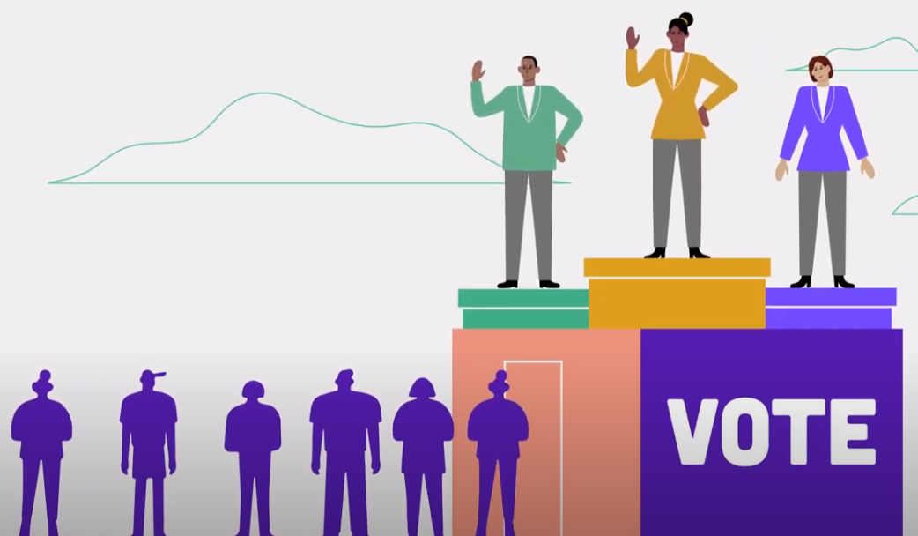
Local elections in B.C.
Local elections provide citizens with an opportunity to discuss the future direction of their community and choose their local representatives.
Local elections in New Brunswick must be held every four years, on the third Saturday in October.
The next local elections will be held on Saturday, October 15, 2022.

Slide 5
Electing local councils
The following positions are elected during local elections, but not all apply to every community:
Municipal council members
Electoral area directors (unincorporated areas)
Park Board representatives
Island Trust trustees
In most municipalities, councillors and mayors are elected at large. This means that all voters in the municipality get to vote for each position.

Slide 6
A voting system is the way in which voters are able to express their choices and how the winners are determined.
Different voting systems exist around the world.

Slide 7
First-Past-the-Post
British Columbia use a system called First-Past-the-Post (FPTP) for local elections.
Voters can make their choice(s) for as many candidates as there are positions.
For example:
Six councillors = Select six candidates
One mayor = Select one candidate

Slide 8
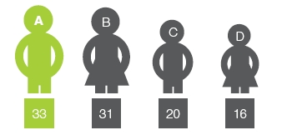
First-Past-the-Post
A successful candidate must receive the most votes in order to be elected in their area.
In a single-member race (i.e. mayor), only one candidate wins because there is only one position.
In a multi-member race, where five councillors are elected at large, it is the five candidates with the most votes that win a seat on council.

Slide 9
Acclamation
The number of candidates running for a position can range from one to more than ten.
If a candidate has no opponents, or if the number of candidates match the number of council seats to be filled, the candidate(s) win automatically and there is no election. This is called acclamation

Slide 10
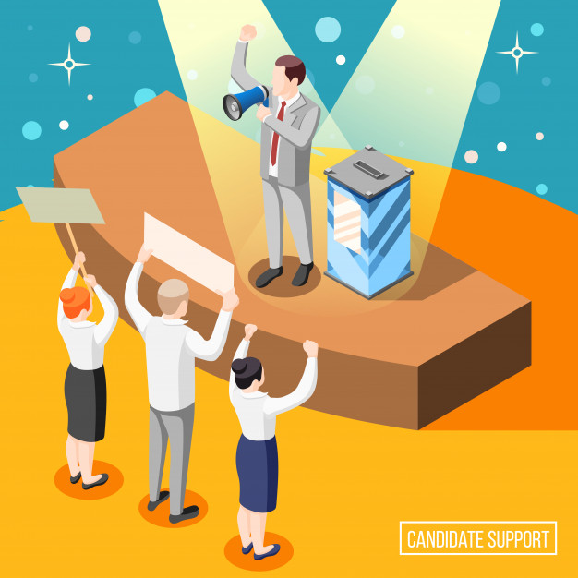
Candidates
A candidate is an individual who competes for the job of elected representative.
Candidates campaign during elections to share their ideas and try to convince fellow citizens to vote for them.
At the local level, some larger municipalities have political parties, but many do not.

Slide 11
Political Parties
At the federal level and the provincial level, most candidates are associated with a political party.
For local elections, it depends on your municipality.
In Vancouver, Richmond, Surrey and Victoria, some candidates are associated with political parties or election slates (where candidates run on a common vision).
In other municipalities, political parties or election slates do not exist.
Candidates that run without an affiliation to a political party are called independent candidates.

Slide 12
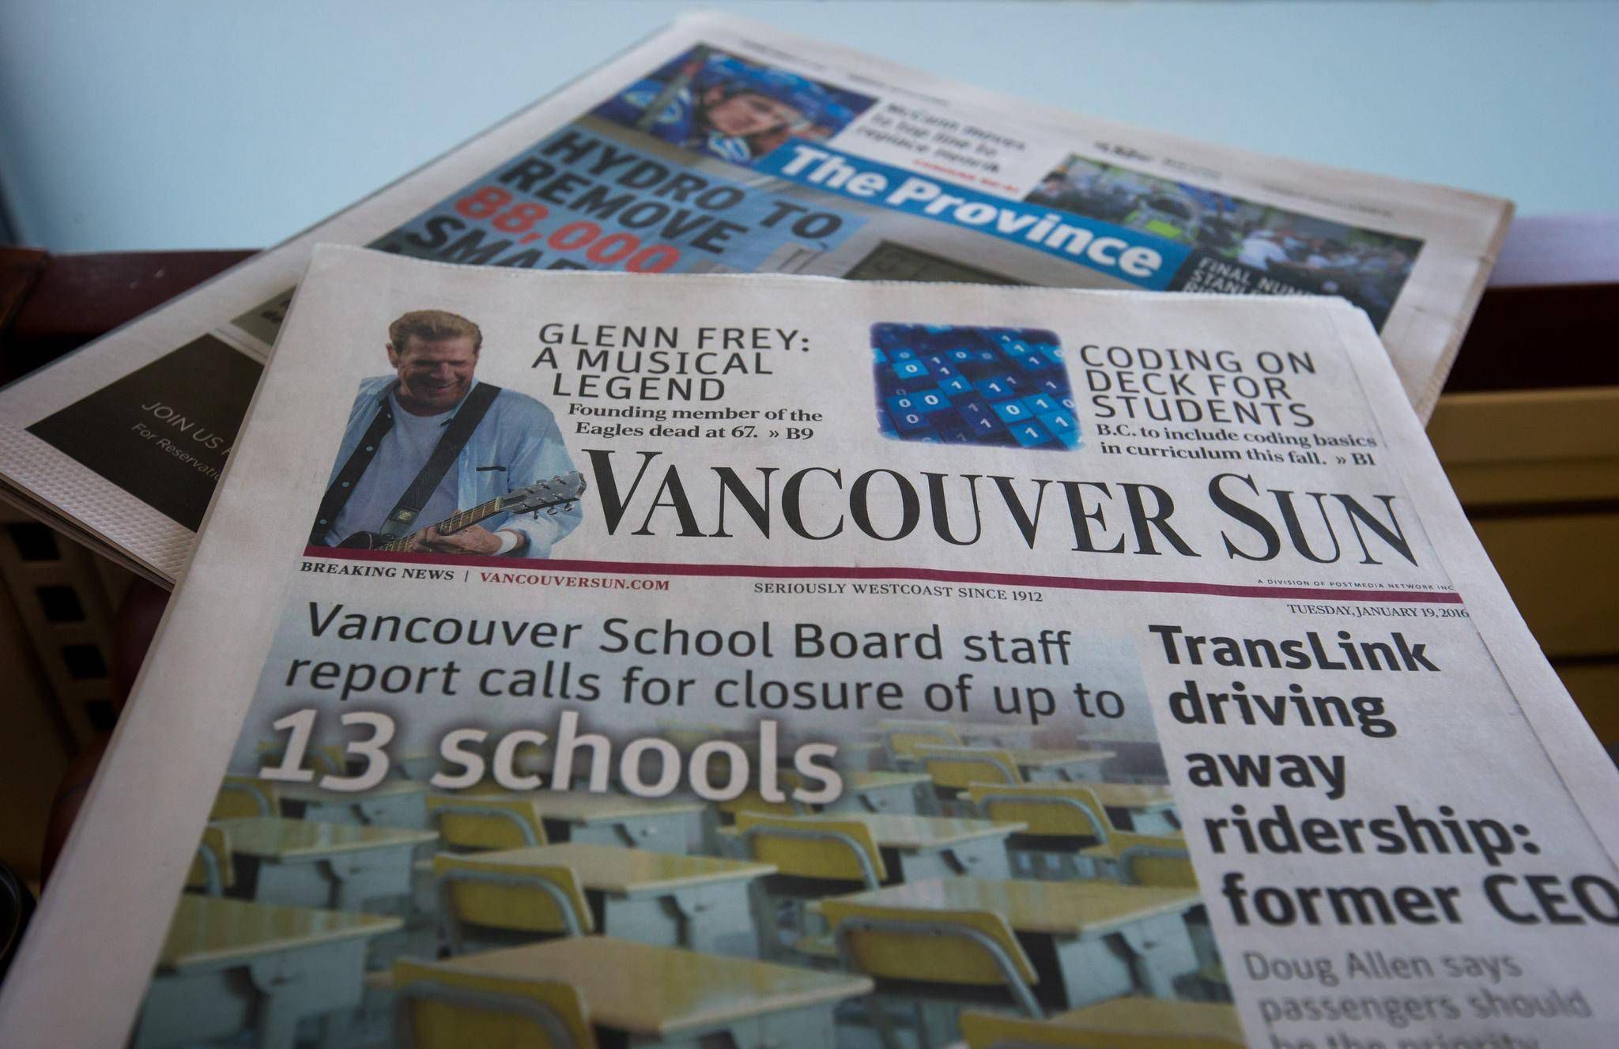
Getting to know the candidates
There are many ways to learn about the election candidates:
Candidate websites or social media pages
Candidate campaign literature or advertisements
Election coverage in the news (local newspapers, media websites, news broadcasts)
In-person or virtual town halls or debates
As a result of the COVID-19 pandemic, there will be a much greater focus on virtual outreach and social media campaigns.

Slide 13
Final thoughts
Which candidate do you prefer and why?
Which candidate do you think will best address the issues that matter most to you?

