Slide 1
SLIDE DECK 7: School Trustees

Slide 2
What are school districts?
How do the decisions
made by school districts affect me?

Slide 3
School Districts
British Columbia’s school districts operate the province’s publicly funded schools and administer the funding they receive from the provincial government.

Slide 4
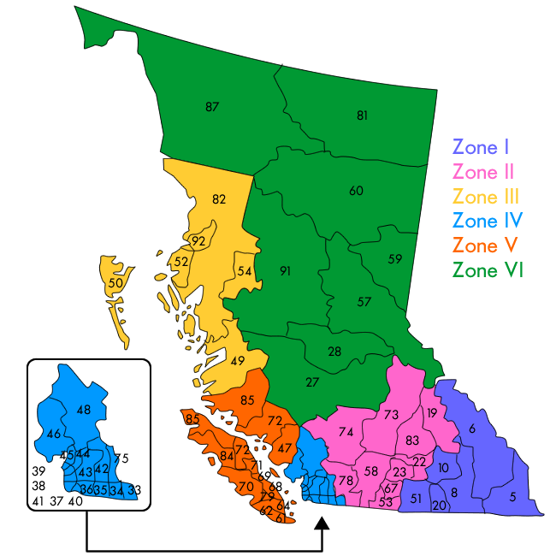
B.C. school districts
The province is divided into 60 school districts.
Each district represents a designated geographic area or, in the case of francophone education, the province as a whole.

Slide 5
School Trustees
Each school district has a group of locally elected representatives known collectively as the board of education (also known as the school board).
On their own, members have no individual authority, it is the board that makes decisions as a whole.

Slide 6
The Role of School Trustees
Attending meetings
Setting local school policies
Employing school staff and ensuring a safe workplace
Preparing and approving the school district’s operating budgets
Listening to concerns from parents and students regarding school decisions that affect their education, health or safety

Slide 7
The role of School Trustees
The trustee’s role is to maintain a focus on student achievement and well-being, and to participate in making decisions that benefit the entire district while representing the interests of their local area.
School trustees listen to their constituents, guide the work of their school district and set plans, policies and the annual budget.

Slide 8
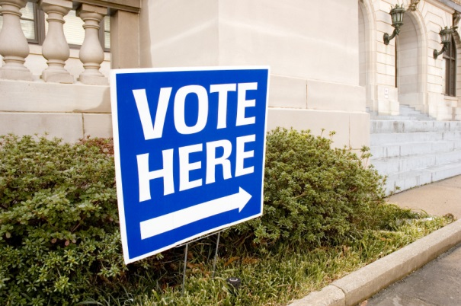
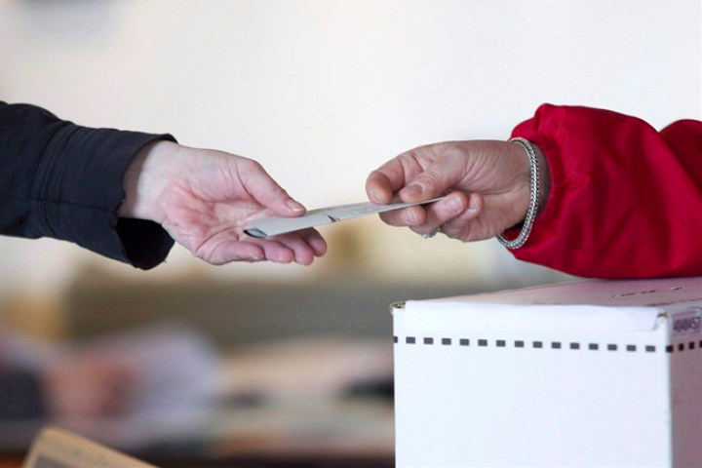
How are school trustees elected?
School trustees are elected every four years during local elections.
Each school district is composed of one or more electoral areas from which trustees are elected.
The number of trustees per board varies to reflect the communities and population of each school district.

Slide 9
Final Thoughts
What is most important to you when evaluating the trustee candidates and deciding who to vote for? Why?
What advice would you give your family members about learning about the school trustee candidates?

