Slide 1
SLIDE DECK 7: School Trustees

Slide 2
What is the name of our school district?
Who sets the goals and makes strategic decisions for our school district?
Who oversees operations and makes management decisions for our school district?

Slide 3
School Districts
British Columbia’s school districts operate the province’s publicly funded schools and administer the funding they receive from the provincial government.

Slide 4
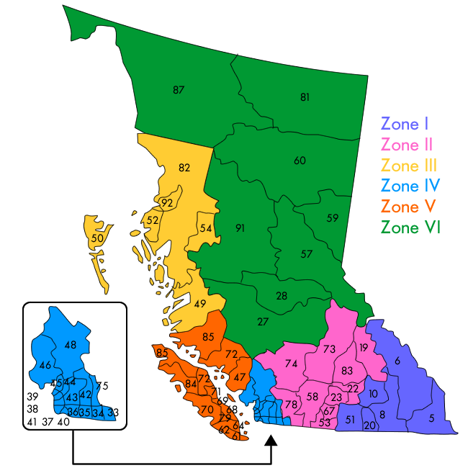
B.C. school districts
The province is divided into 60 school districts.
Each district represents a designated geographic area or, in the case of francophone education, the province as a whole.

Slide 5
School Trustees
Each school district has a group of locally elected representatives known collectively as the board of education (also known as the school board).
On their own, members have no individual authority, it is the board that makes decisions as a whole.

Slide 6
The Role of School Trustees
Attending meetings;
Setting local policy for the effective and efficient operation of schools;
Employing the staff necessary for school district operations;
Establishing conditions of employment for employees;
Preparing and approving the school district’s operating budgets and capital plans; and
Hearing appeals from parents and students where a staff decision significantly affects the education, health or safety of the student.

Slide 7
The role of School Trustees
The trustee’s role is to maintain a focus on student achievement and well-being, and to participate in making decisions that benefit the entire district while representing the interests of their local area.
School trustees listen to their constituents, guide the work of their school district and set plans, policies and the annual budget.

Slide 8
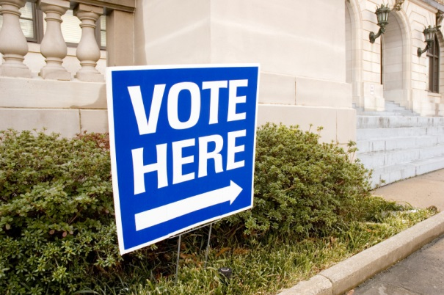
How are school trustees elected?
School trustees are elected every four years during local elections.
Each school district is composed of one or more electoral areas from which trustees are elected.
The number of trustees per board varies to reflect the communities and population of each school district.

Slide 9
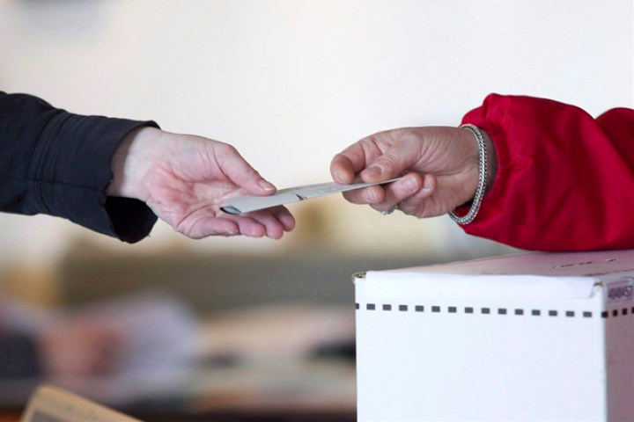
Electing school trustees
In some school districts, all trustees are elected at large and there is only one electoral area (the entire school district) from which all trustees are elected. In other school districts, there are multiple electoral areas.
There may be more than one trustee elected from each electoral area.
Following the election, the trustees elect one of their members to act as chair of the board.

Slide 10
Final Thoughts
Which candidate(s) do you think would make the best school trustee and why?
What advice would you give your family members about learning about the school trustee candidates?

