Slide 1
SLIDE DECK 8: The Voting Process

Slide 2
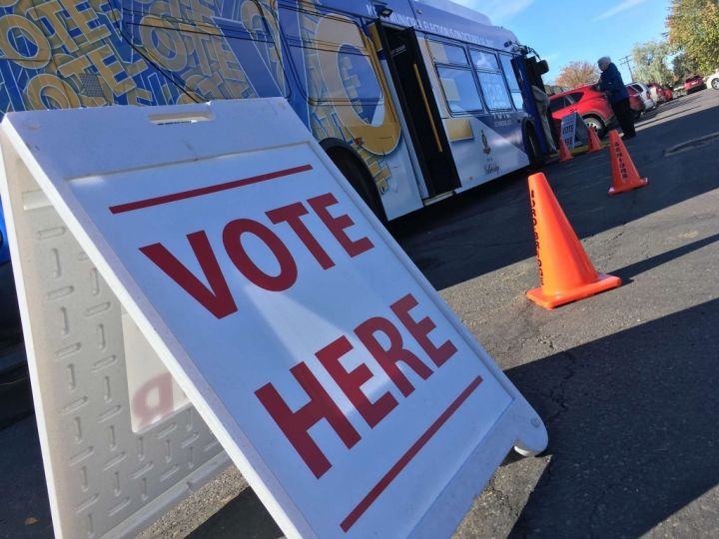
How do I vote in local elections?

Slide 3
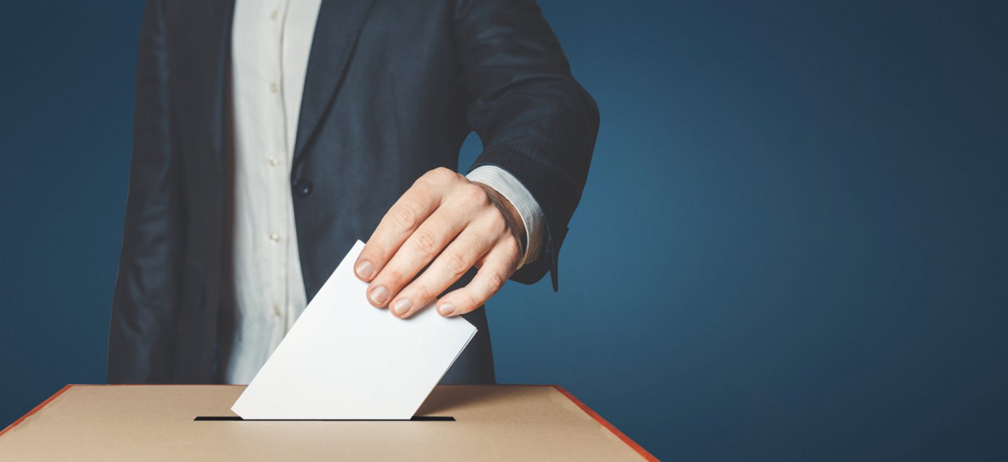
Voting by secret ballot
Voting in local elections is done by secret ballot.
Voters mark their ballot behind a privacy screen and fold their ballot to hide their choice.

Slide 4
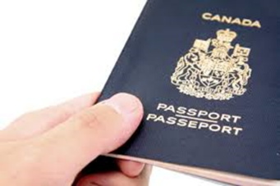
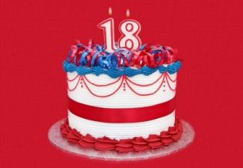
Who is qualified to vote?
To be able to vote in B.C. local elections, you must be:
18 years of age
A Canadian citizen
A resident of B.C. for six months
Live or own property where you plan to vote

Slide 5
Who organizes local elections?
The provincial government sets out common rules that all voters and candidates must follow.
However, municipalities and regional districts are responsible for conducting the elections.
Every municipality and regional district has a chief election officer who is in charge of running the election.

Slide 6
What are different ways a person can vote?
Each municipality is responsible for conducting their election and determining the methods used.
Options can include:
In person
By mail
Special voting opportunities held in hospitals

Slide 7
Where do I vote?
You can find your voting place on your municipality or regional district website and through documentation mailed to voters.
Electors who are away, busy or unable to vote on voting day, have the option of participating in advance voting.

Slide 8
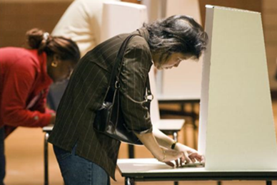
What is the process for voting?
Once you confirm your eligibility, you are given a ballot.
Go behind a voting screen and mark your ballot.
Hand your folded ballot back to the voting clerk.
Your ballot is recorded and counted.

Slide 9
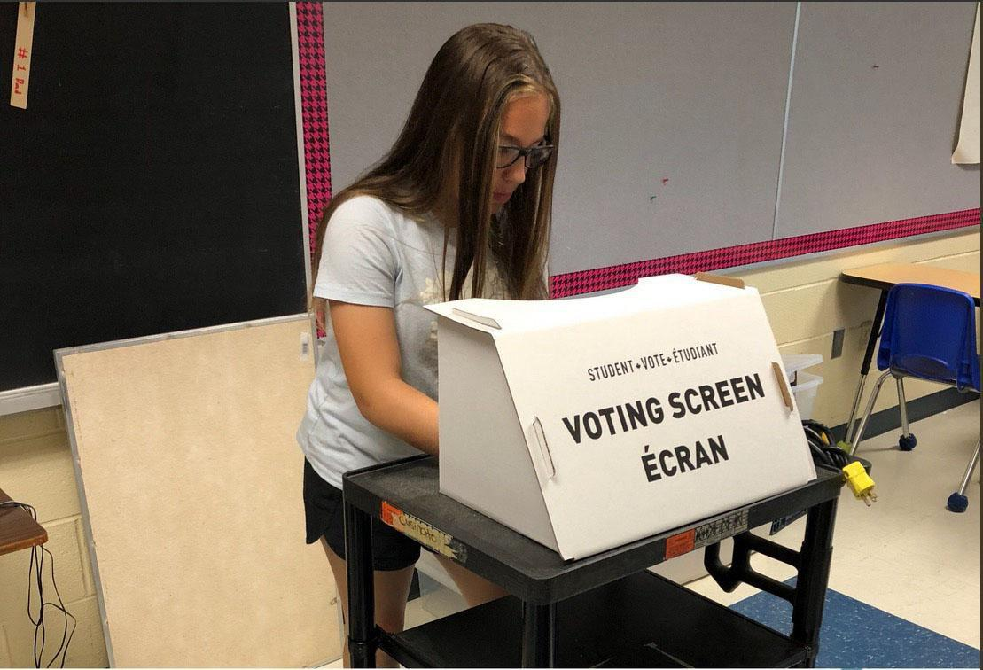
How do I mark my ballot?
A ballot lists the names of the candidates running for each position in your local elections.
As long as you appropriately mark the ballot according to the number of choices, your votes will be counted.

Slide 10
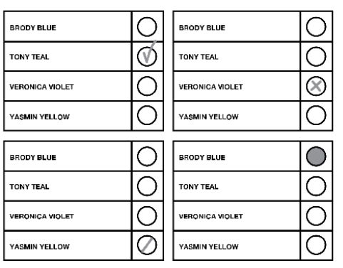
Valid ballots
A valid ballot clearly indicates the preference of the voter.
You may vote for more than one candidate if there is more than one person elected in the race.

Slide 11
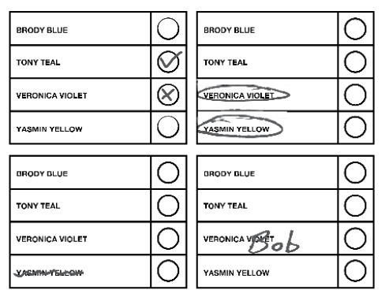
Rejected ballots
A rejected ballot is a ballot that cannot be counted because the voter’s choice is not clear.

Slide 12
Discussion
• Do you think voting is easy or challenging? Why?
• Do you feel ready to vote in the Student Vote
election? Why or why not?
• Will you vote in elections when you turn 18 years old?

