Slide 1
SLIDE DECK 5: Political Parties

Slide 2
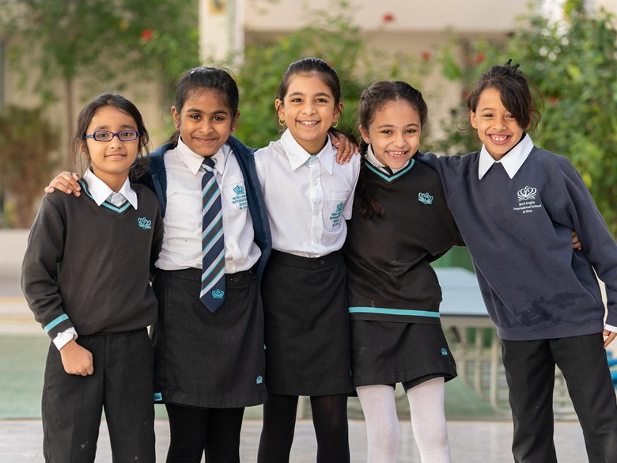
Do you agree or disagree? Why?
School uniforms should be mandatory for students.

Slide 3
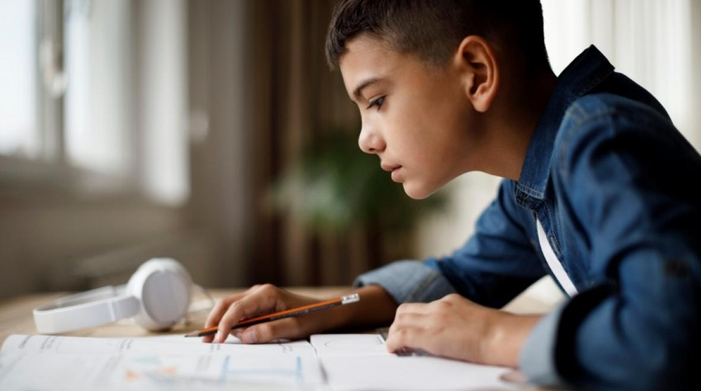
Do you agree or disagree? Why?
Homework should be banned.

Slide 4
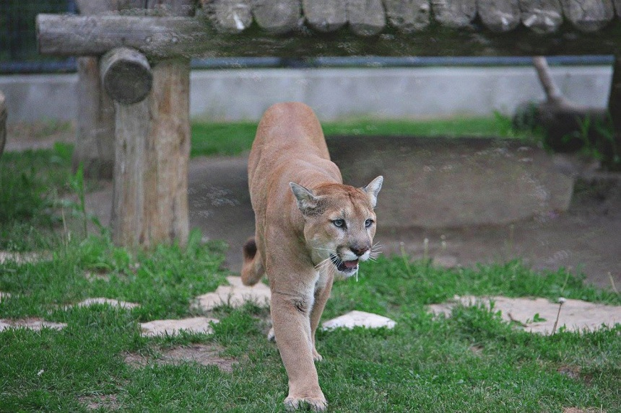
Do you agree or disagree? Why?
Zoos should be abolished.

Slide 5
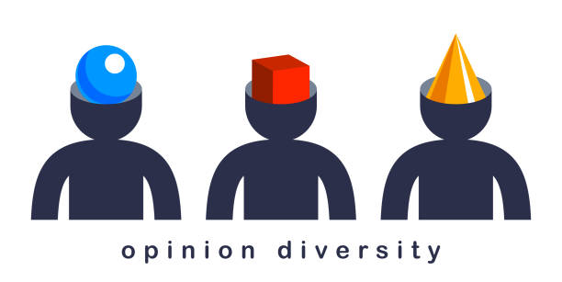
Political views
In any community, where rules and decisions affect everyone, there will be different opinions about how things should work and how best to take action.

Slide 6
Discussion
Why is it important to respect others’ opinions?

Slide 7
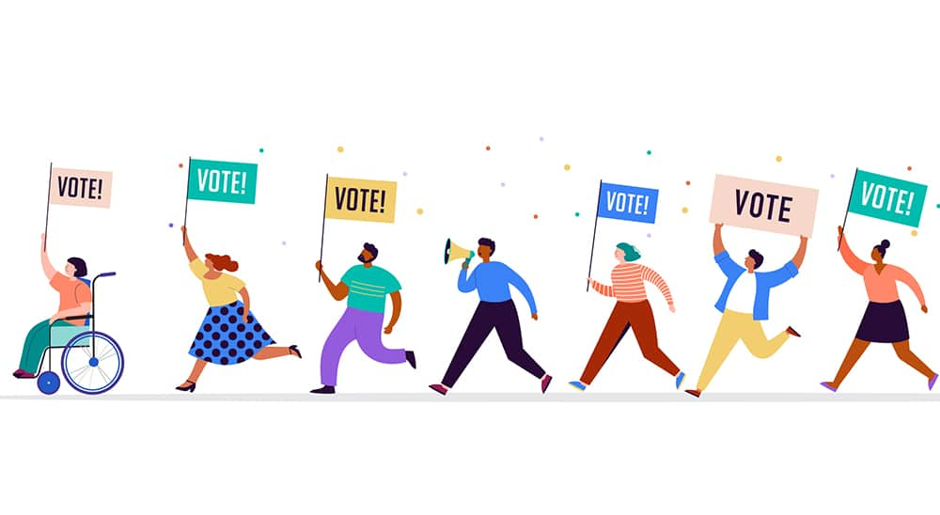
Politics
Politics can be described as the activities related to achieving power in society or influencing the actions of government.

Slide 8
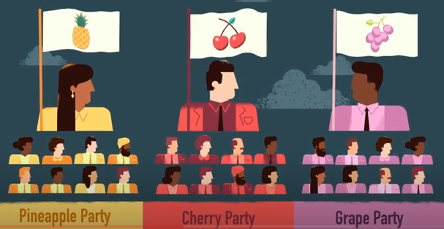
Political parties
A political party is made up of a group of people who share similar political views and goals about society.
Each political party has a leader, chosen by the party members.

Slide 9
Political platforms
A party platform is a summary of actions a party will take if they are elected.
It also reveals which issues are most important to a political party.

Slide 10
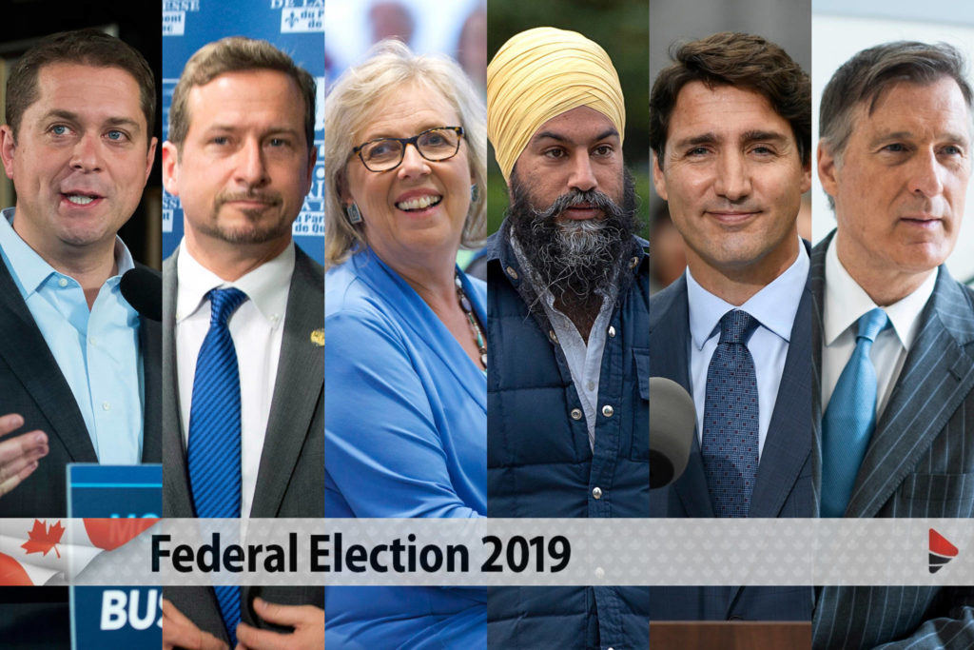
Do you know?
Can you name any political parties at the federal level?
Do you know which party won the last federal election?

Slide 11
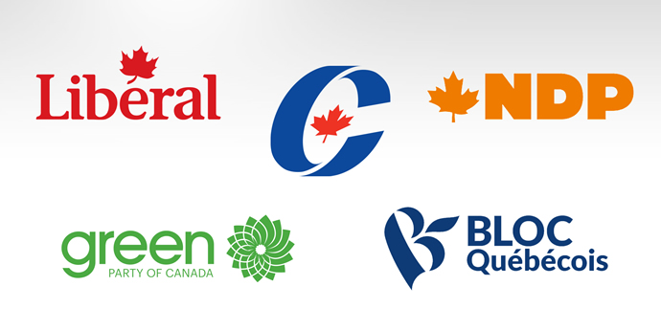
Political parties in Canada
Bloc Québécois
Conservative Party
Green Party
Liberal Party
New Democratic Party
These are the five major parties with elected representatives in the House of Commons, but there are many more political parties.
There are different parties at the provincial level with similar names but they are not related to the federal parties.

Slide 12
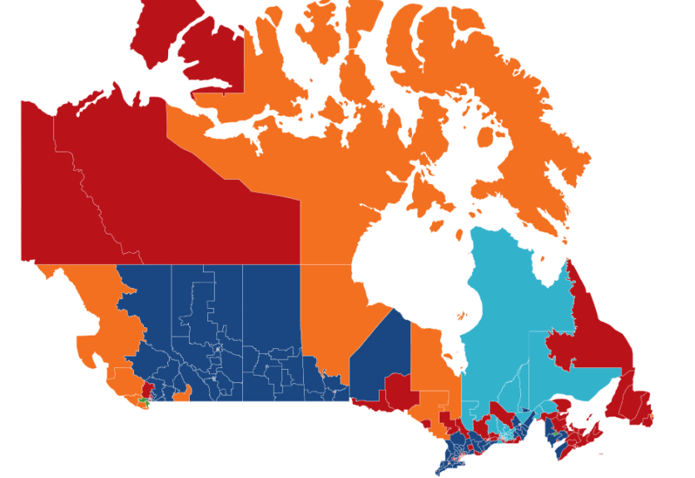
How does a party form government?
The party that elects the greatest number of representatives (or has the most seats in the House of Commons) usually forms government.
The leader of this party becomes the prime minister.

Slide 13
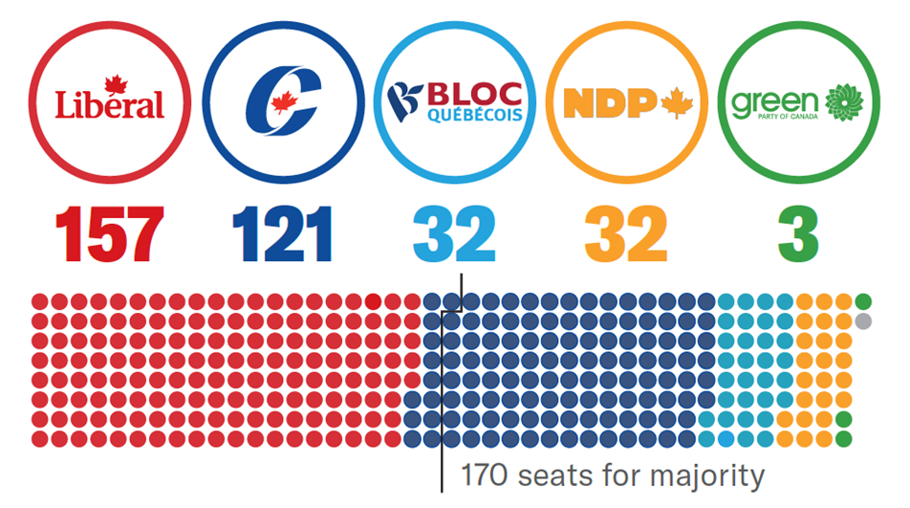
2019 federal election results

Slide 14
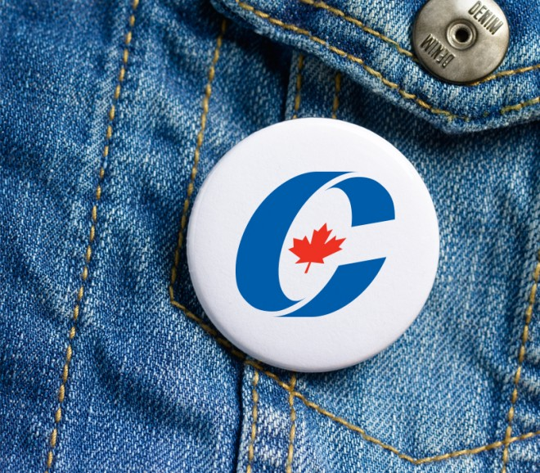
Discussion
How can I learn about the political parties?
Which political party will address the issues that matter to me?

