Slide 1
SLIDE DECK 1: Democracy

Slide 2
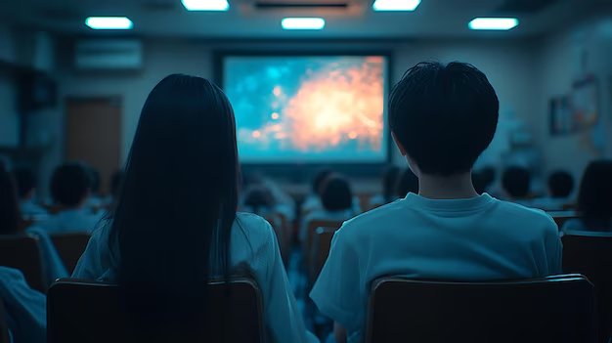

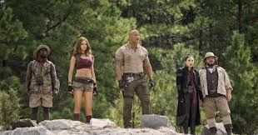
Scenario
It’s the last day of school and your class is watching “Jumanji: The Next Level''. Twenty minutes into the movie, the screen starts flickering. Suddenly, a black hole appears from within the projector screen and your class is sucked into the hole and transported to the jungle in Jumanji.

Slide 3
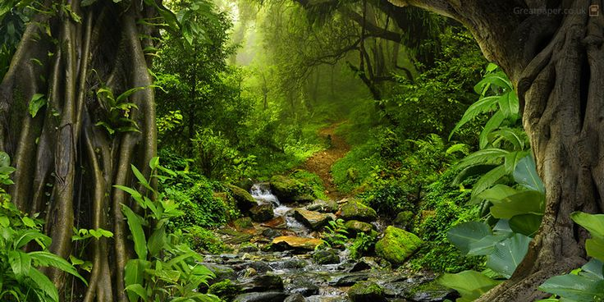
Scenario
Since your teacher was out of the classroom, only students were transported to the jungle. There are no adults. Your challenge is to decide how to live together as a community.

Slide 4
Surviving Jumanji
Explain how you will organize yourselves. Will you work together, in groups or independently? Will there be roles?
What is your plan for finding food and setting up shelter? What other needs will you have?
Who will be responsible for making decisions for the group? Describe the process involved in deciding who will be in charge.
Will you establish any rules or code of conduct? If yes,
list some examples.

