Slide 1
SLIDE DECK 1:
Democracy

Slide 2
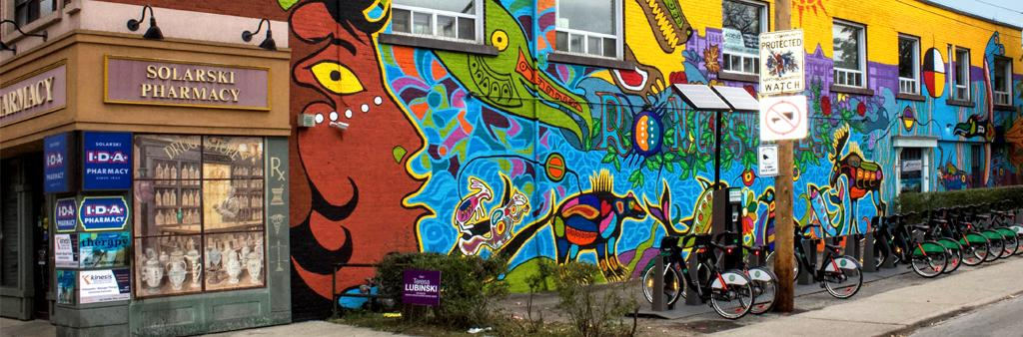
Identify the democratic principles

Slide 3
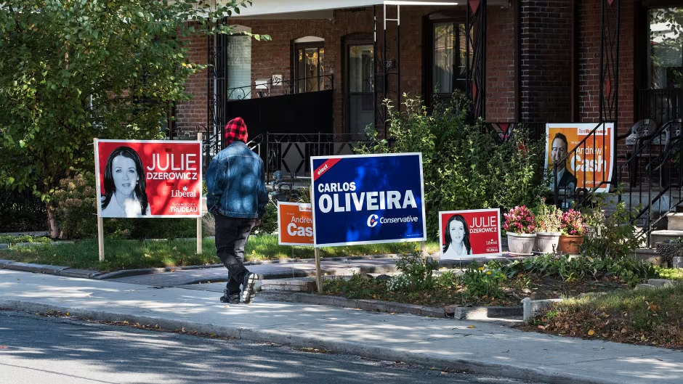
Identify the democratic principles

Slide 4
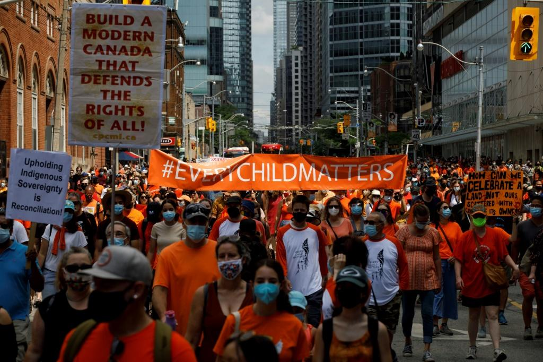
Identify the democratic principles

Slide 5

Identify the democratic principles

Slide 6
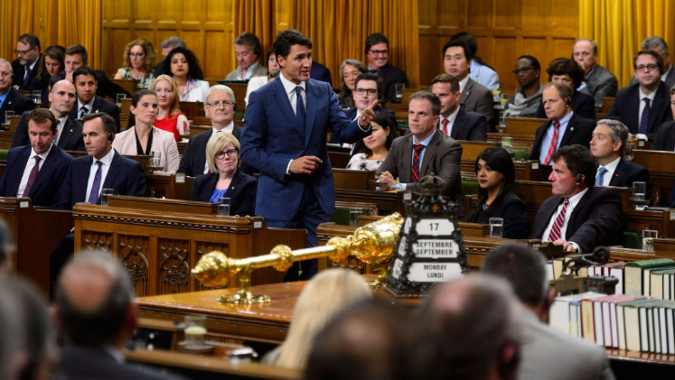
Identify the democratic principles

Slide 7

Identify the democratic principles

Slide 8

Identify the democratic principles

Slide 9

Identify the democratic principles

Slide 10
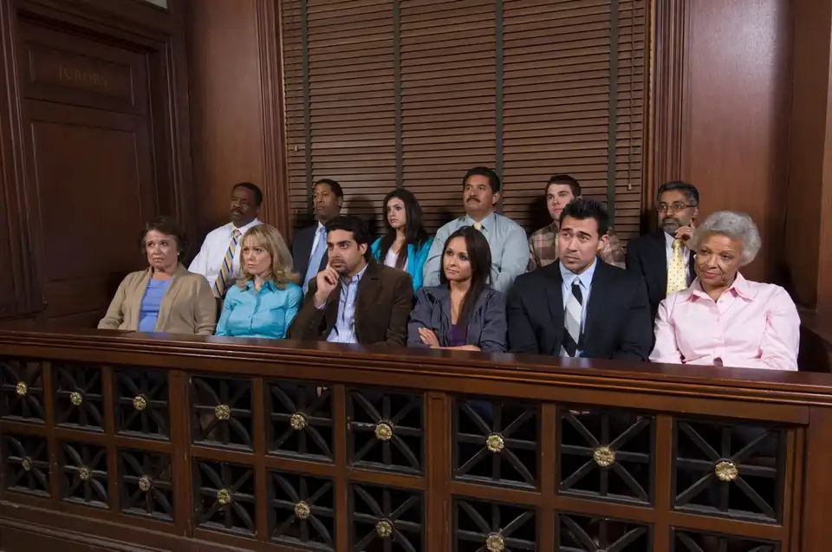
Identify the democratic principles

Slide 11
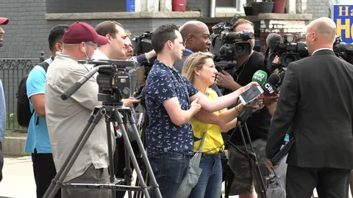
Identify the democratic principles

Slide 12

Identify the democratic principles

Slide 13
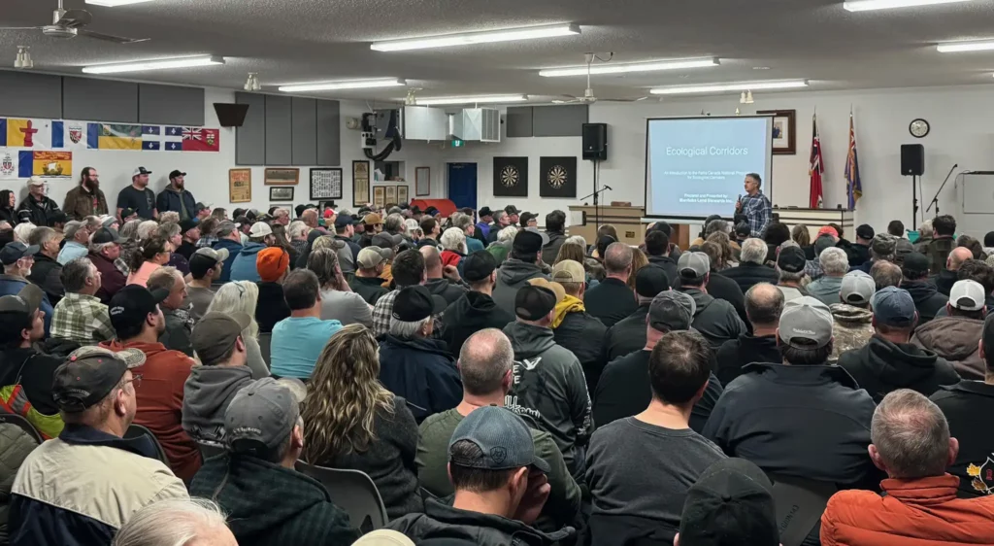
Identify the democratic principles

Slide 14

Reflection
Which principle do you think is the most important and why?
What is one action you can take this year to support democracy?

