Slide 1
SLIDE DECK 8: Post-Election Analysis

Slide 2
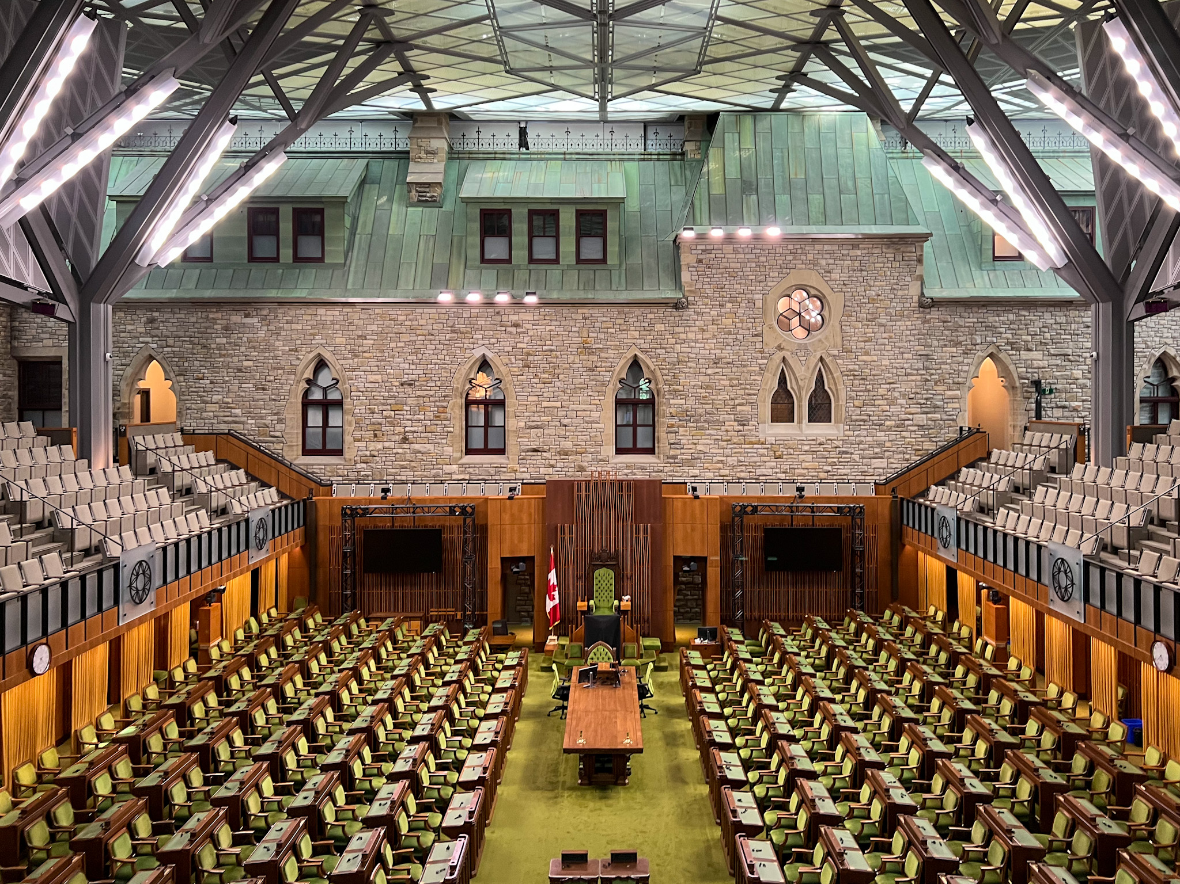

Guiding questions
How can we examine election results?
What do election results tell us?
Notes:
Added more focus questions.

Slide 3
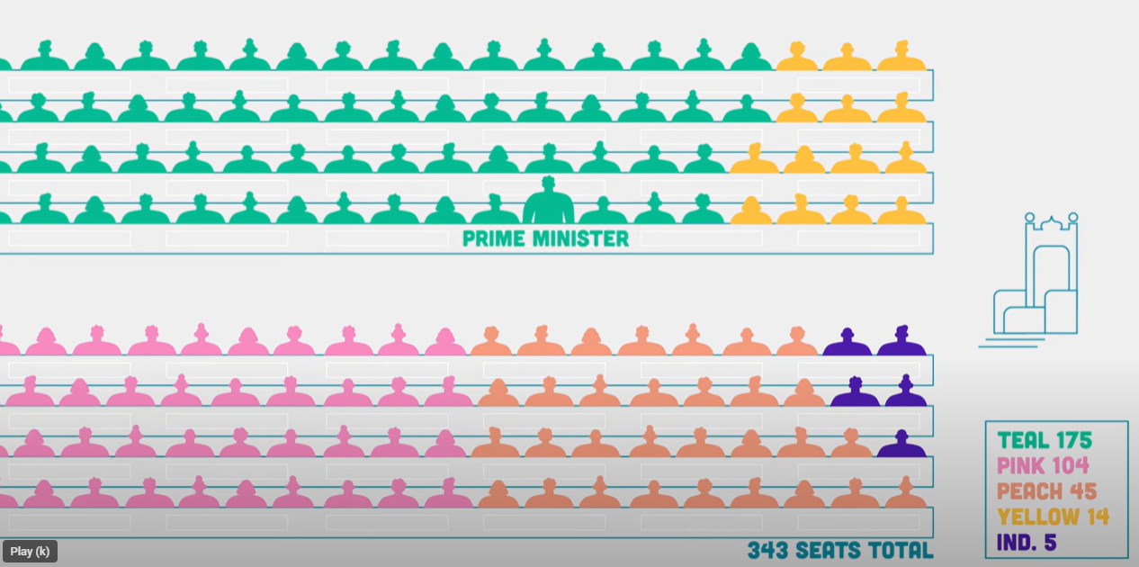
Seat count
Seat count is the number of seats that each party will have in the House of Commons.
It represents the number of local election races won by each party: each win = 1 seat
343 races
=
343 seats

Slide 4
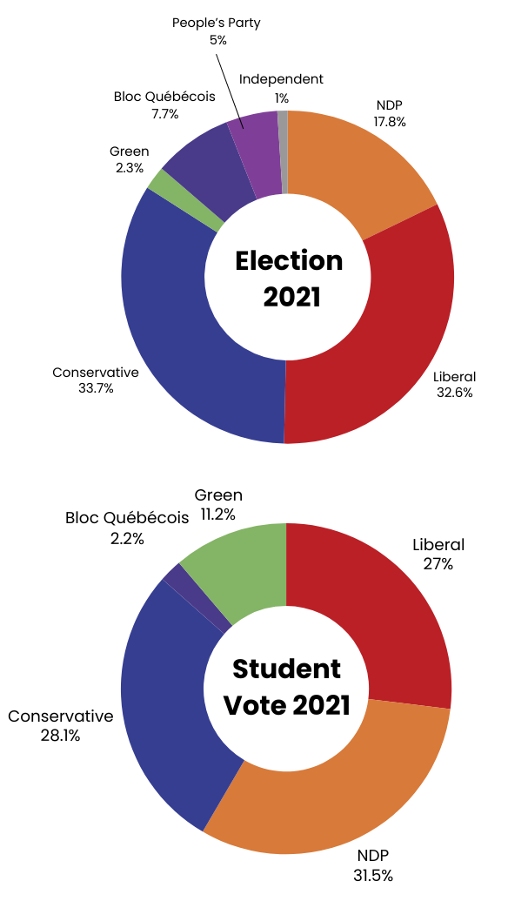
Popular vote
The popular vote refers to the total number of votes each party received across all ridings.
This is usually shown as a percentage of all votes cast in the election.
Who won the popular vote in the 2021 federal election? Who won the popular vote in the 2021 Student Vote?
Notes:
Updated graphics.

Slide 5

The winning party
Even though the popular vote shows how many people voted for each party, it doesn’t decide who forms the government.
So, how does a political party form government?
Notes:
New slide

Slide 6
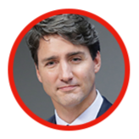
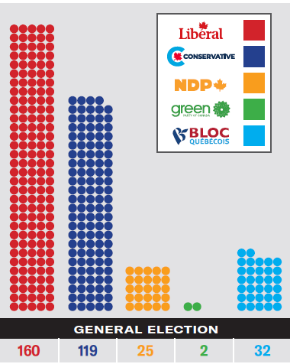
The governing party
The political party with the most number of seats or members in the House of Commons usually forms government.
The leader of the governing party becomes the prime minister.
2021 Federal Election Results
Notes:
New images and text.

Slide 7

The official opposition
The party with the second most number seats or members in House of Commons becomes the official opposition.
The leader of this party becomes the Leader of the Official Opposition.
The opposition parties are responsible for questioning the government’s decisions and actions.
2021 Federal Election Results
Notes:
New images and text.

Slide 8
Do you know?
Who is the governing party and official opposition?

Slide 9
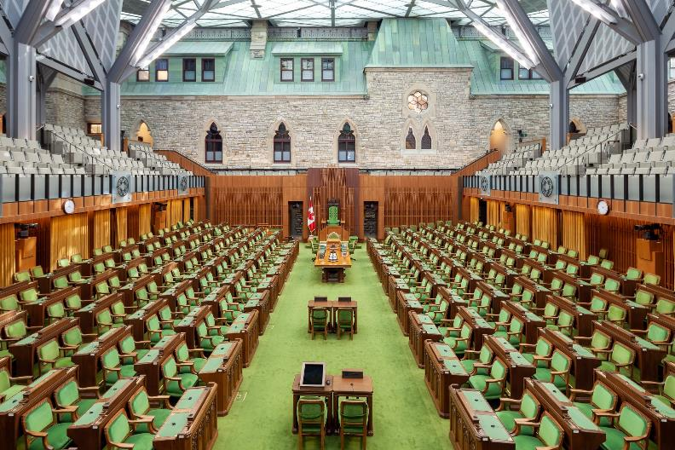
Majority vs. Minority government
A majority government = the winning party has more than half of all seats (172 or more)
A minority government = the winning party has less than half of all seats (171 or less)

Slide 10
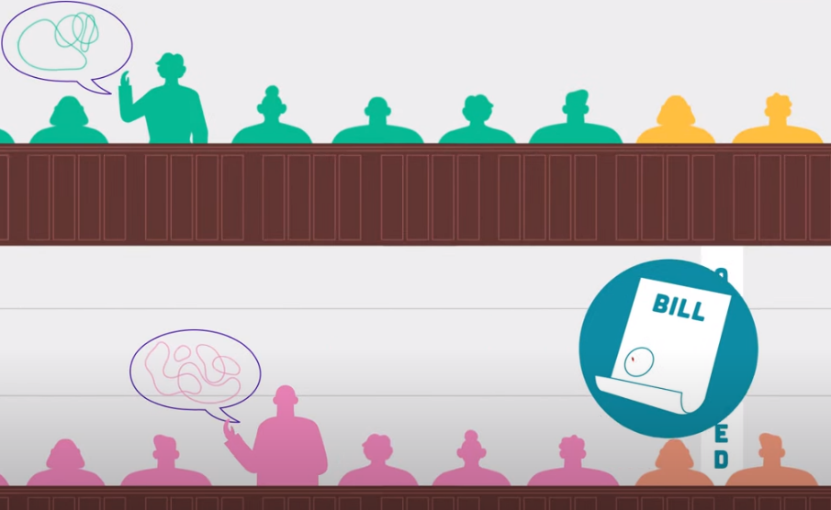
Discussion
To pass a bill or law, the government must have support from more than half of the members of the House of Commons.
What does this mean for a minority government?

Slide 11
Final reflection
What did we learn from our Student Vote experience?
How do elections help shape our country?
What can we do as young citizens to stay active in our communities before we can vote?
Notes:
‹#›

