Slide 1
2025 Federal Election Exit Survey Results

Slide 2
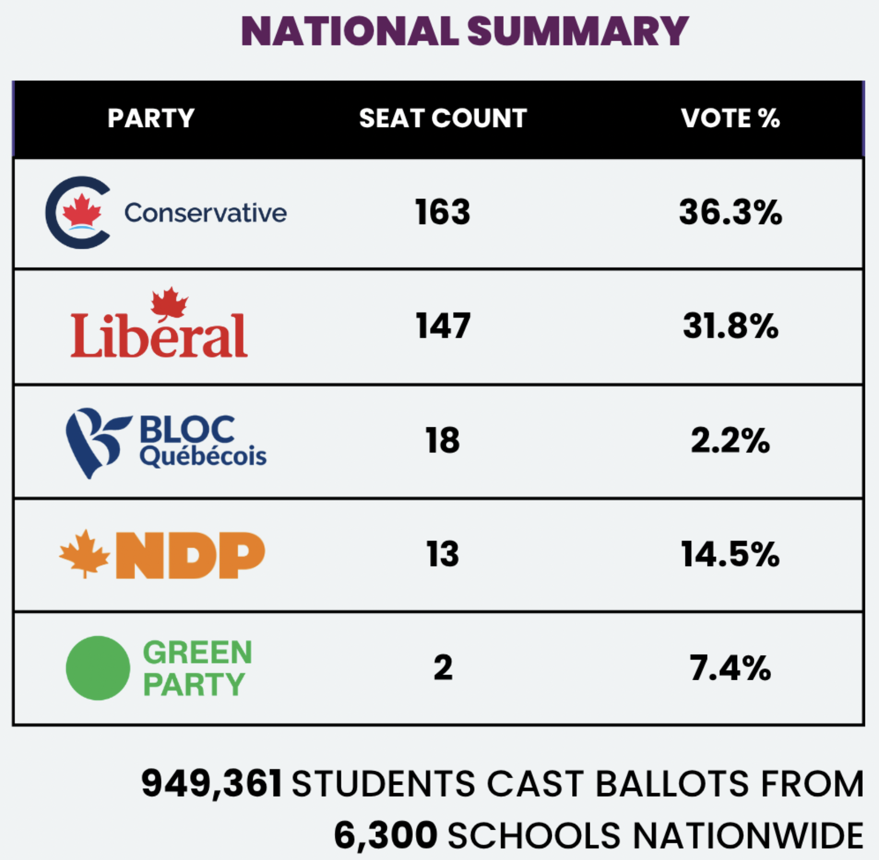
Student Vote Canada Results

Slide 3
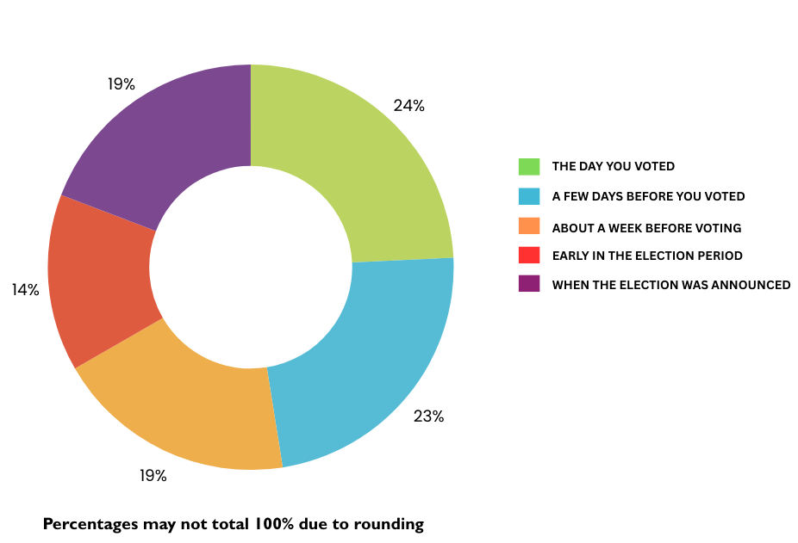
When did you make up your mind about who you were going to vote for?

Slide 4
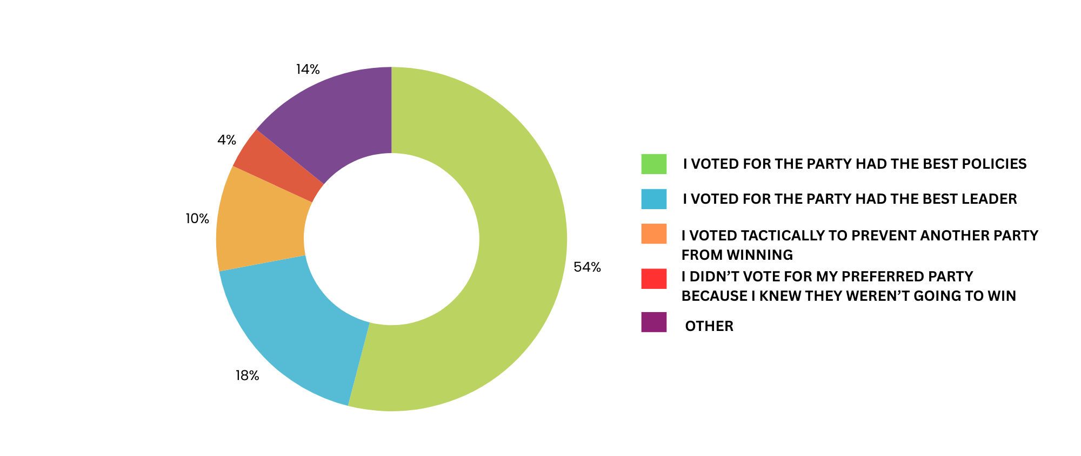
People give different reasons for why they vote for one candidate or party rather than another. Which of the following BEST describes your reasons?

Slide 5
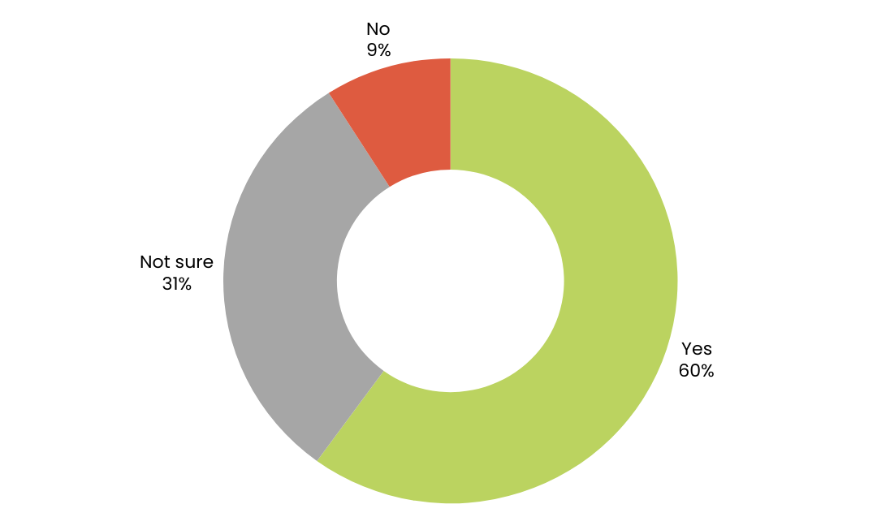
Would you have voted the same in the actual general election?

Slide 6
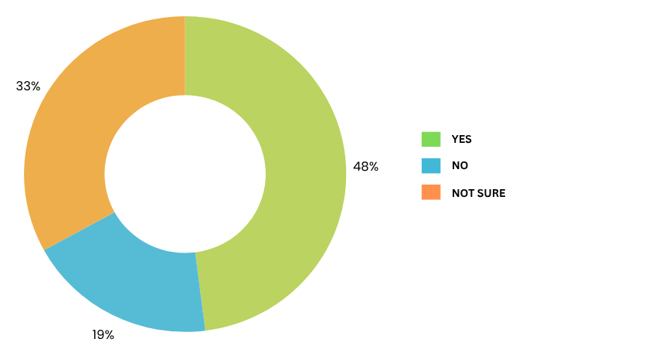
Did you vote for the same candidate/party as at least one of your parents/caregivers?

Slide 7
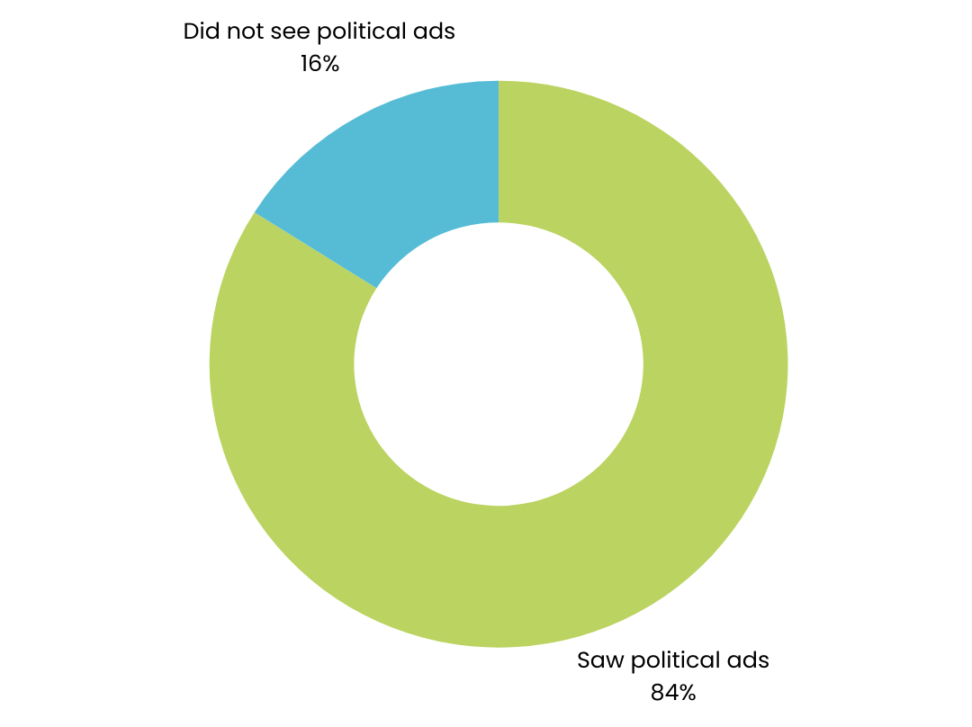
Did you see political ads during the campaign?

Slide 8
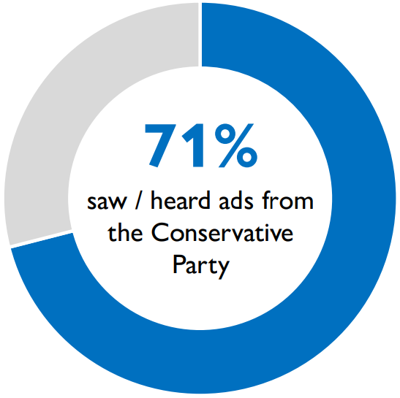
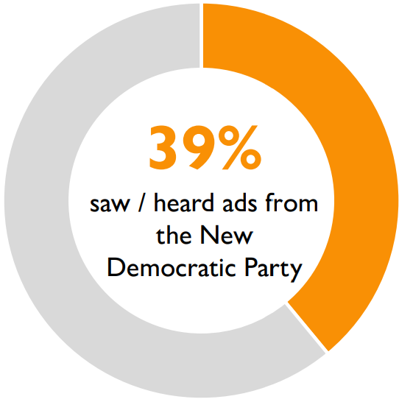
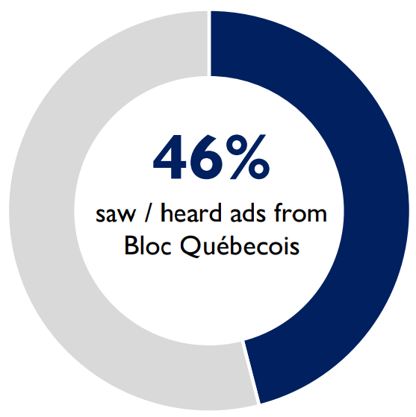
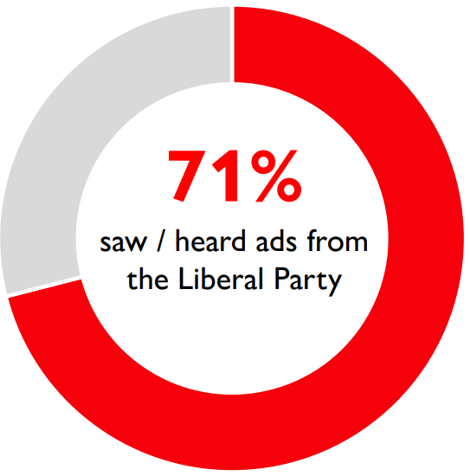
During the election, did you see or hear ads from...
QC students only

Slide 9
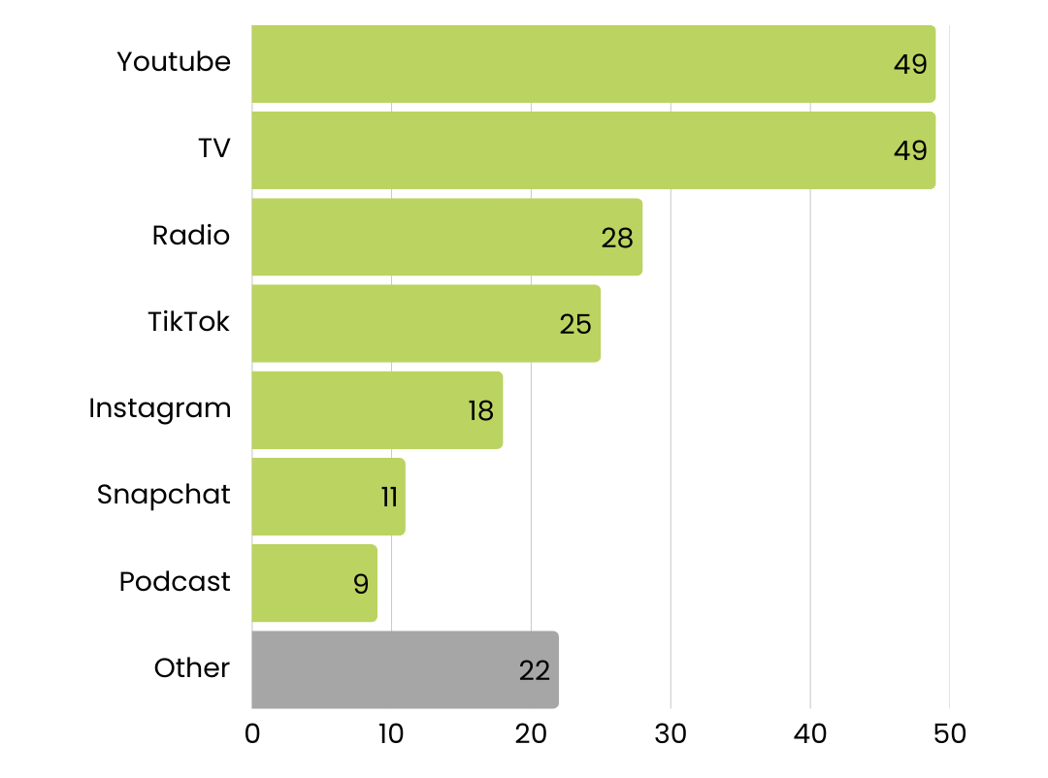
Where did you see or hear the ads? Select all that apply.
% of students who say they saw/heards ads in each format

Slide 10
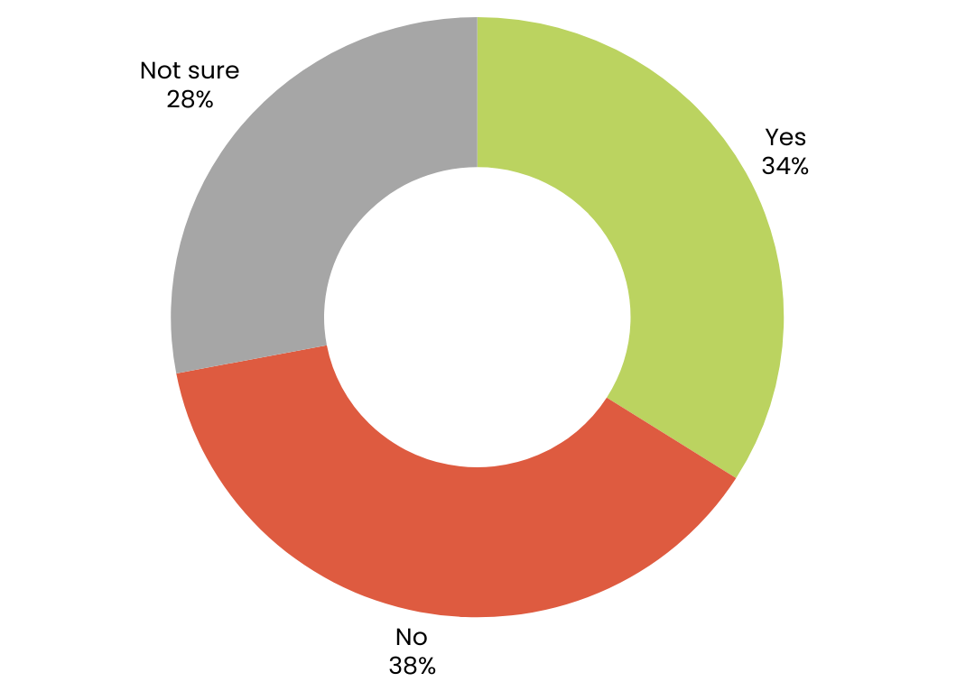
Did the candidate/party you voted for in Student Vote win in your electoral district in the actual election (not Student Vote)?

Slide 11
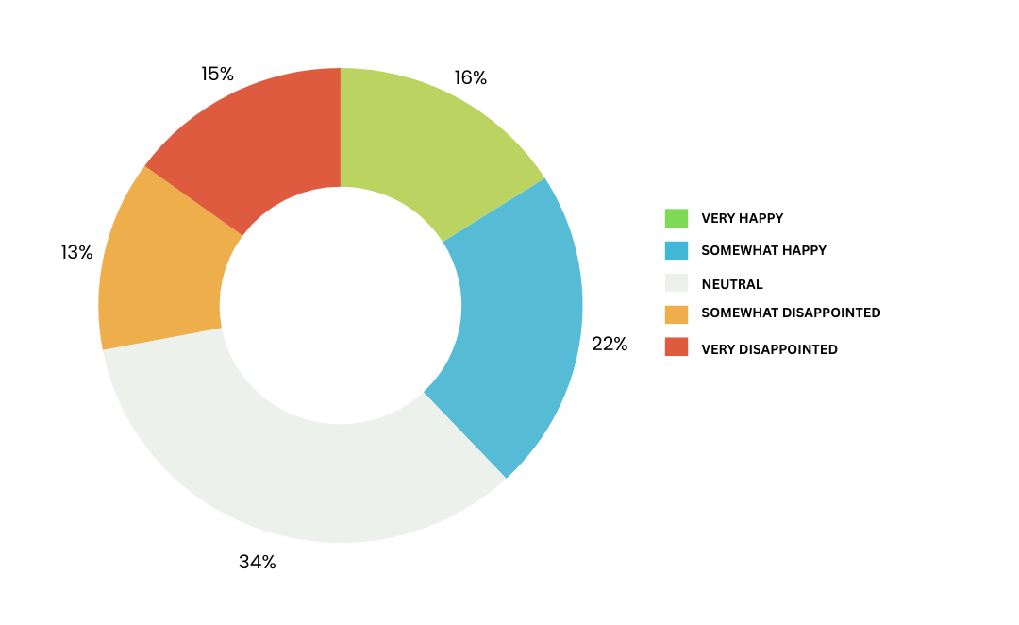
Would you say you are at the result of the election?

Slide 12
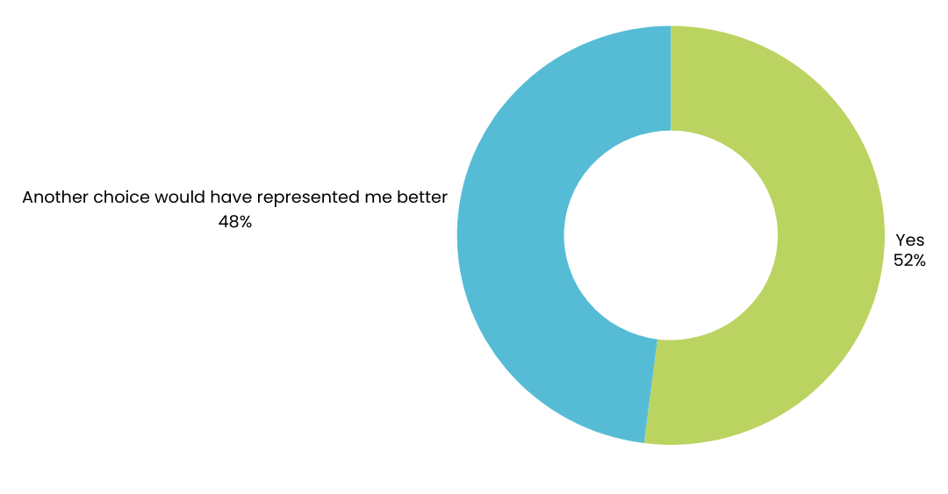
Do students think the local candidate that was elected will represent them and their concerns?

Slide 13
Do students think the party leader that was elected will represent them and their concerns?

Slide 14
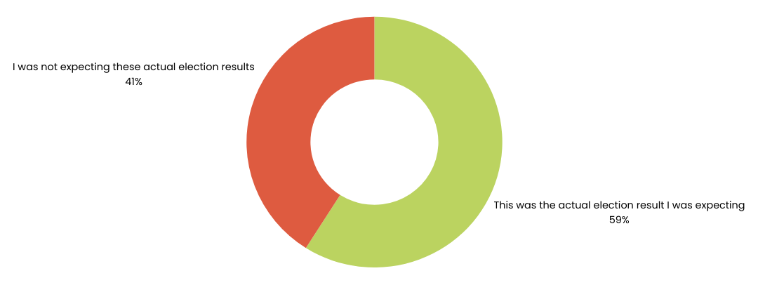
And would you say…

Slide 15
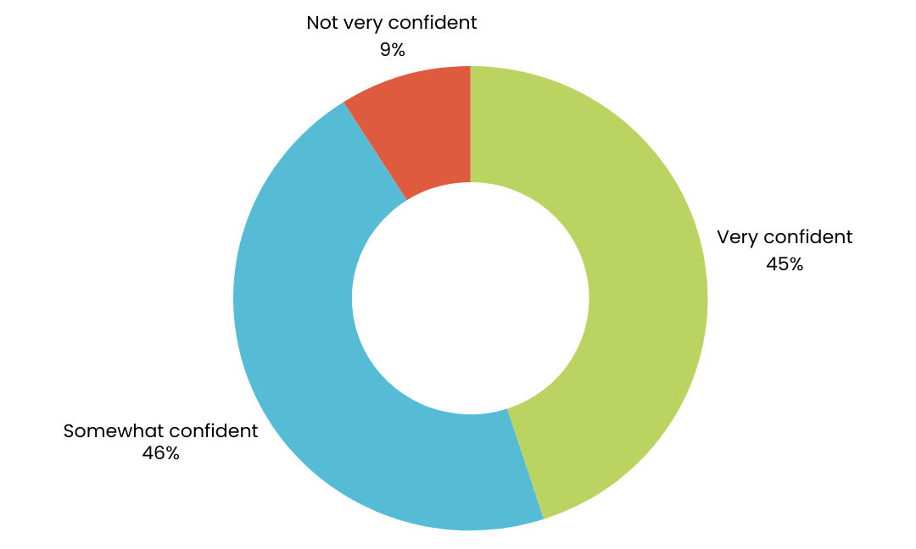
I feel about voting in the future.

Slide 16
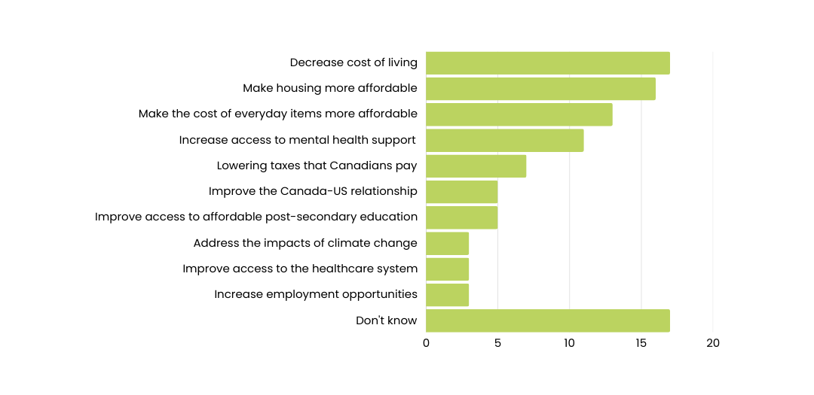
What is the most important step that the federal government can take to support young Canadians over their next term?
% of students who chose each option

