Slide 1
Slide Deck 1: Government and Democracy

Slide 2
Discussion
Why do we have government?
What is the role of government?

Slide 3
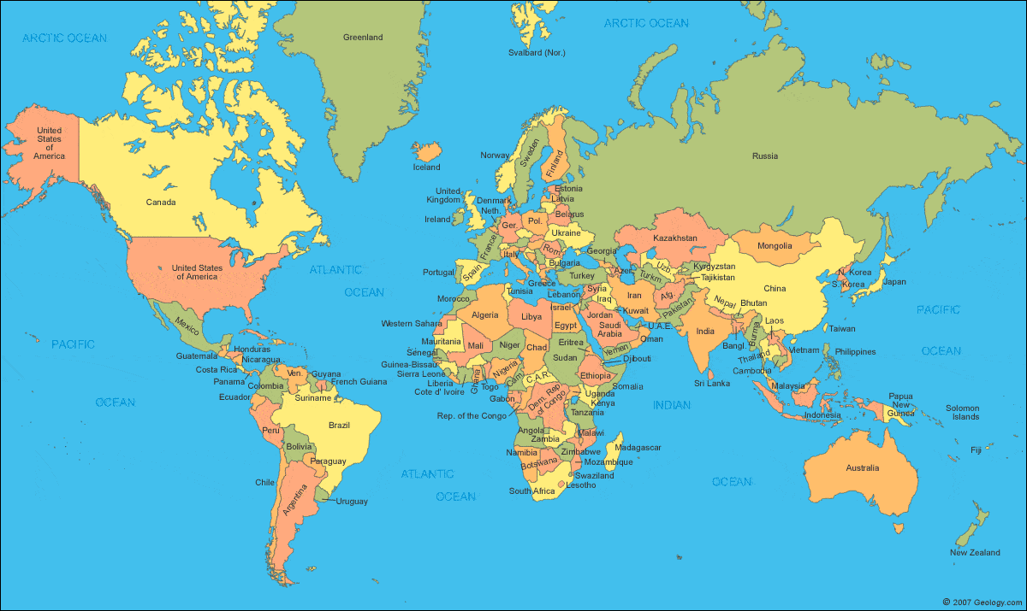
The role of government
Governments manage the land, resources and people living within its borders.

Slide 4
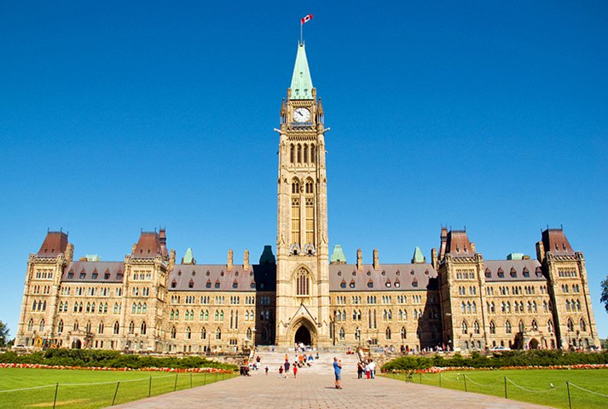
The role of government
Create and enforce laws
Provide programs and services
Make decisions on behalf of the people

Slide 5
Discussion
What types of services does the government provide?
What would happen if there were no government responsible for creating laws and ensuring order in society?

Slide 6
Anarchy
A country with no functioning government
The country may be at war or experiencing civil unrest
Laws are not upheld and there is civil disobedience
No one is in charge

Slide 7
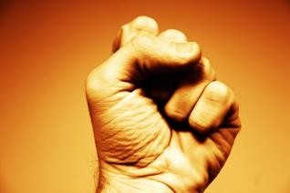
Different types of government
Governments from around the world differ from one another.
They can be compared in the following ways:
Who has power?
Are leaders chosen by the people?
Who has access to power?
What rights do individuals have?

Slide 8
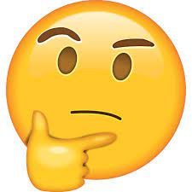
Discussion
Do you know an example
of a type of government?

Slide 9
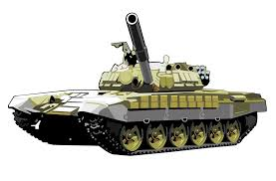
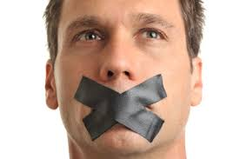
Dictatorship
One person has all the power (called a dictator)
The dictator often takes control without permission of the people (not chosen by the people)
All decisions are made by the dictator
Citizens do not have access to power; they cannot run for political office or become a government official
Limited rights and freedoms for citizens

Slide 10
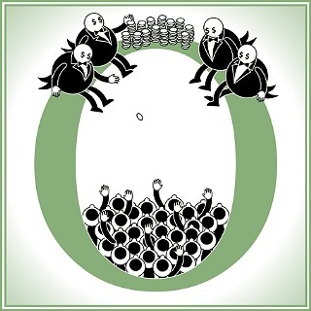
Oligarchy
A small group of people has all the power
They make all the decisions and usually in ways that benefit them personally
This group could have power because of ties to: royalty, wealth, family or the military
Citizens do not have access to power; they cannot run for political office or become a government official
Limited rights and freedoms for citizens

Slide 11
Democracy
Power is shared by all – “government by the people”
Citizens have a say in their government by electing politicians to make decisions on their behalf
Citizens can also choose to run for political office or compete for the job of an elected official (they have access to power)
Citizens have many rights. Individual rights and freedoms are protected such as freedom of speech, religion and assembly, free and fair elections

Slide 12
Discussion
Would you prefer to live in a democracy, oligarchy or dictatorship?
Why?

Slide 13
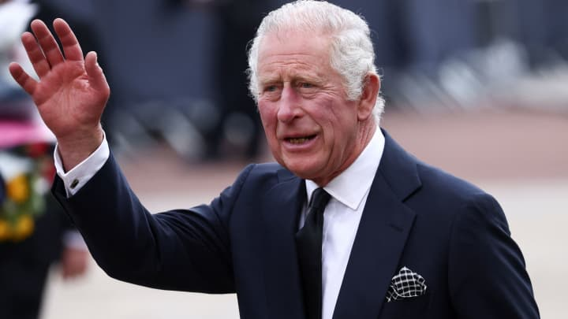
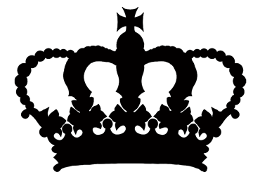
Monarchy
A monarch (king or queen) or royal family holds political power that is inherited and usually lasts until death
A monarchy can be a democracy or dictatorship

Slide 14
Constitutional Monarchy
A monarch (king or queen) or royal family shares power with a constitutionally elected government (DEMOCRACY)
The monarch can be the head of state or a ceremonial leader
Citizens elect politicians to make decisions on their behalf
Citizens can also choose to run for political office or compete for the job of an elected official (they have access to power)
Many rights. Individual rights and freedoms are protected such as freedom of speech, religion and assembly, free and fair elections

