Slide 1
SLIDE DECK 1: Democracy

Slide 2
Starter activity
What words or concepts come to mind when you look at the following images?

Slide 3
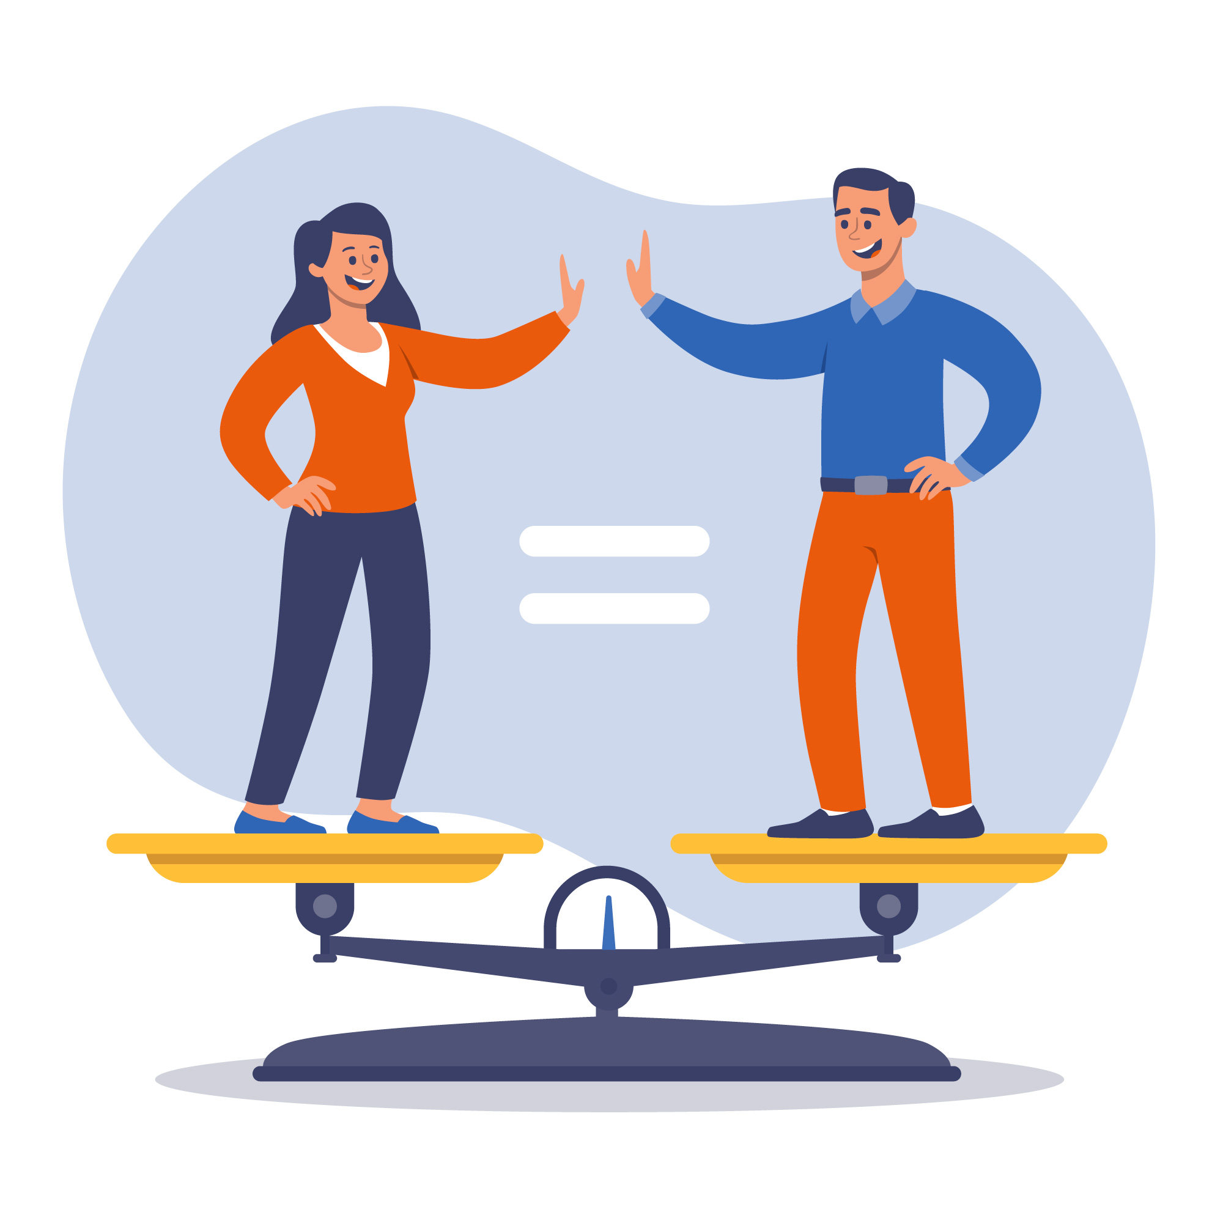

Slide 4
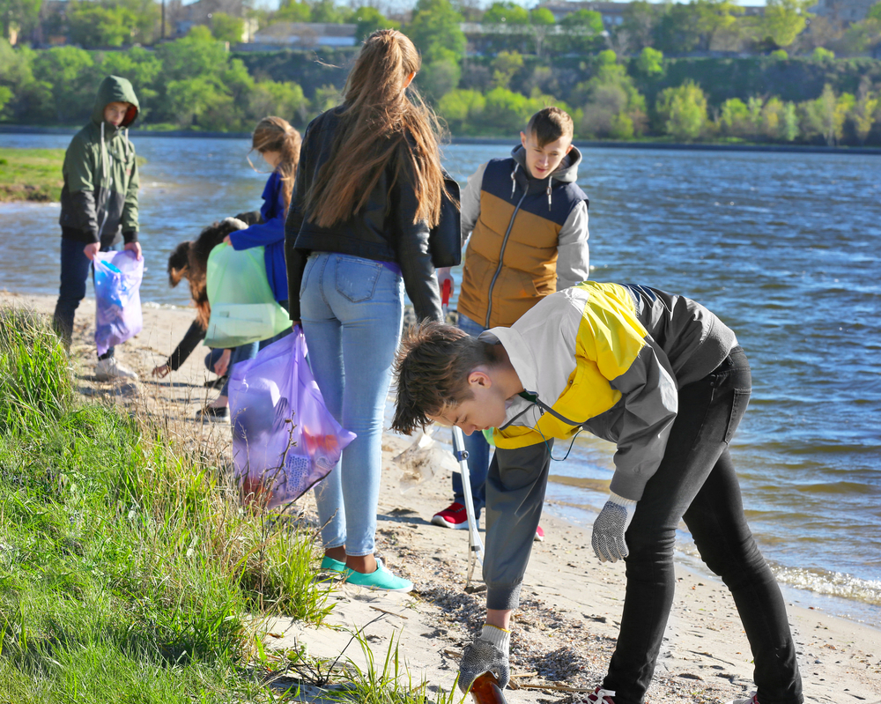

Slide 5
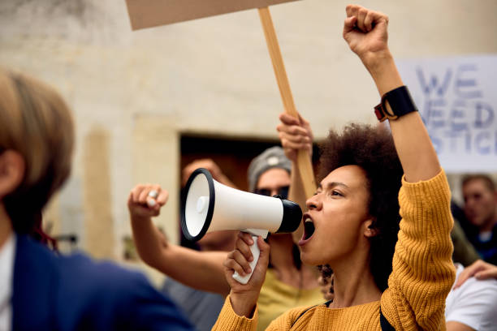

Slide 6
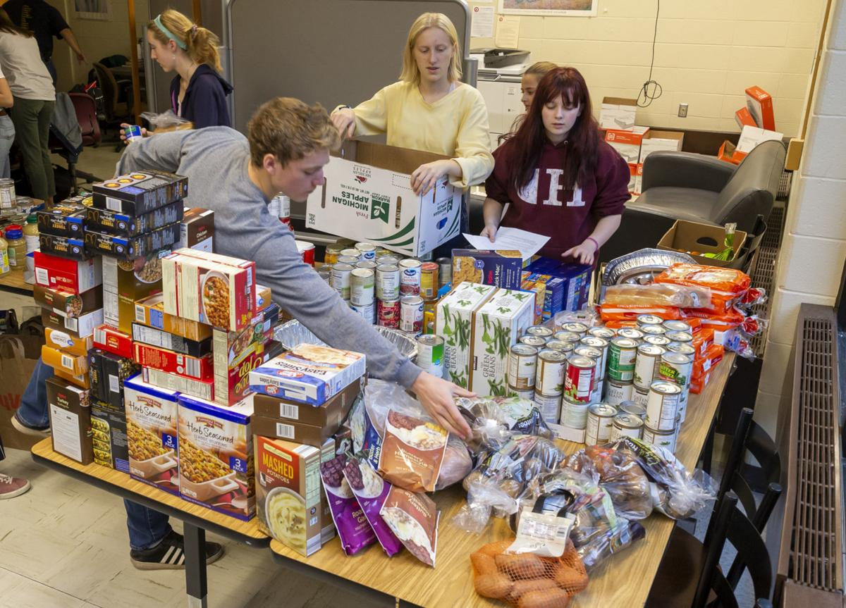

Slide 7
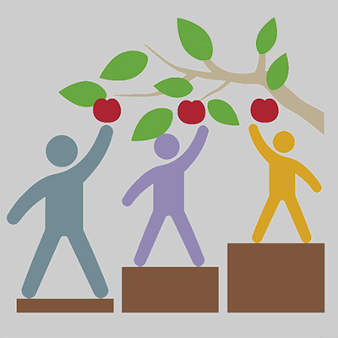

Slide 8
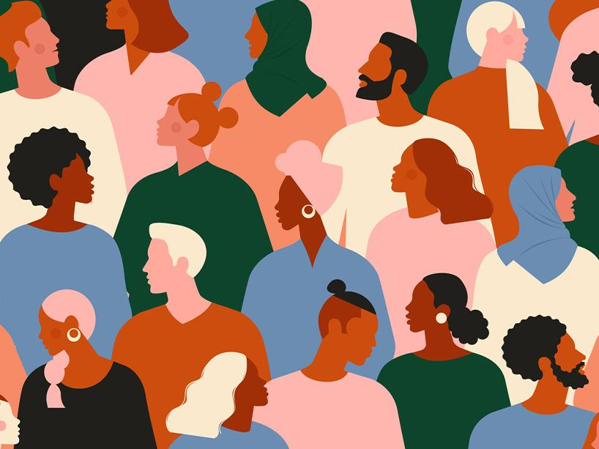

Slide 9
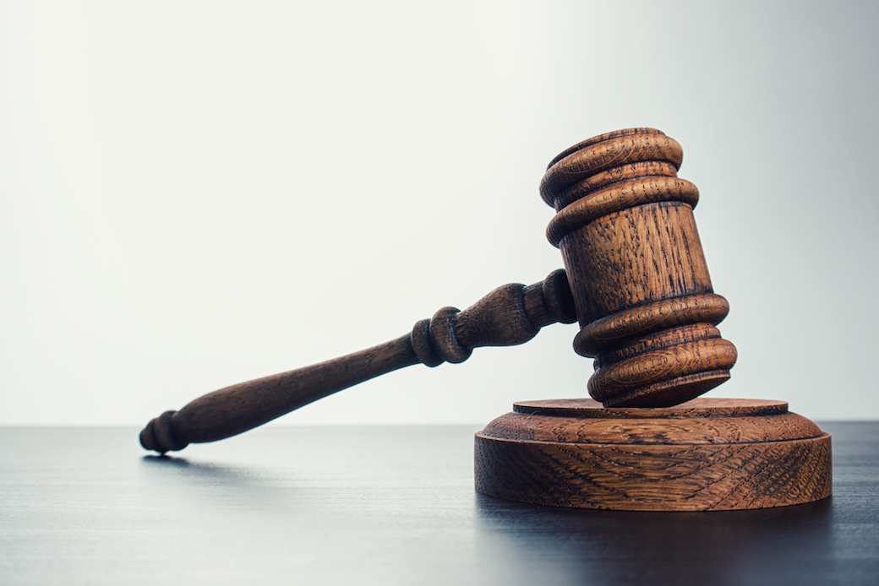

Slide 10
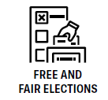
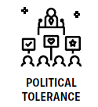
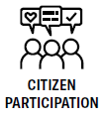
Democratic principles

Slide 11
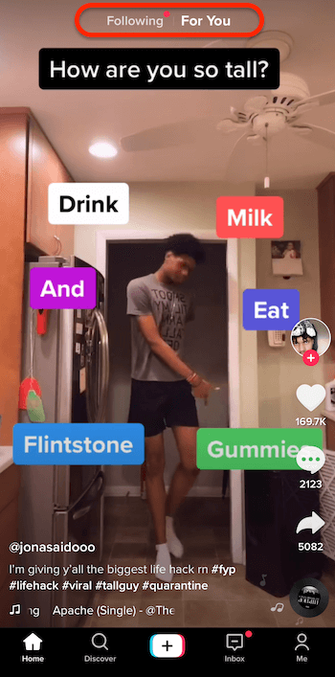
Identify the principles

Slide 12
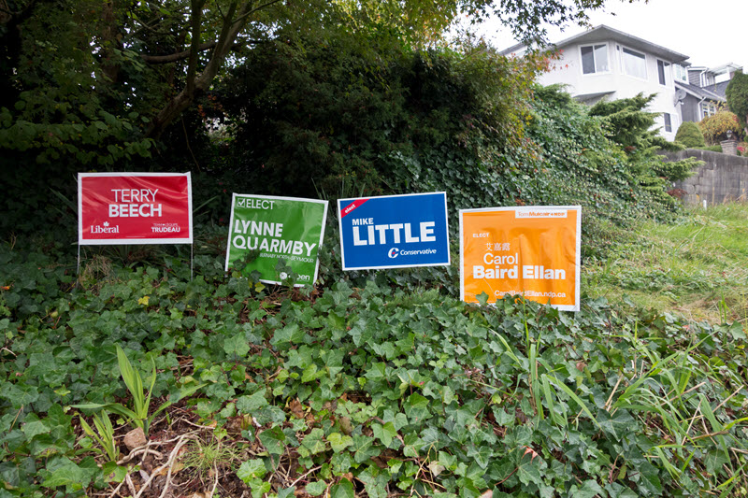
Identify the principles

Slide 13
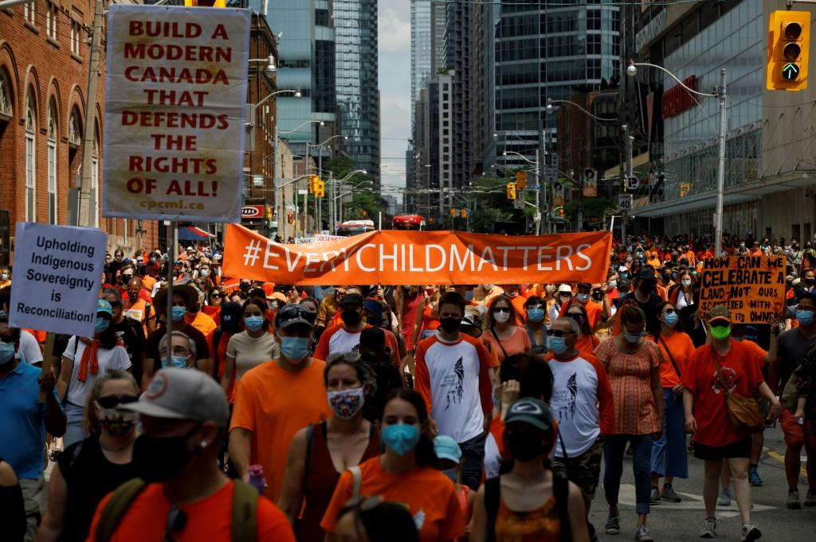
Identify the principles
Notes:
Human rights and equality (freedom of expression), citizen participation.

Slide 14
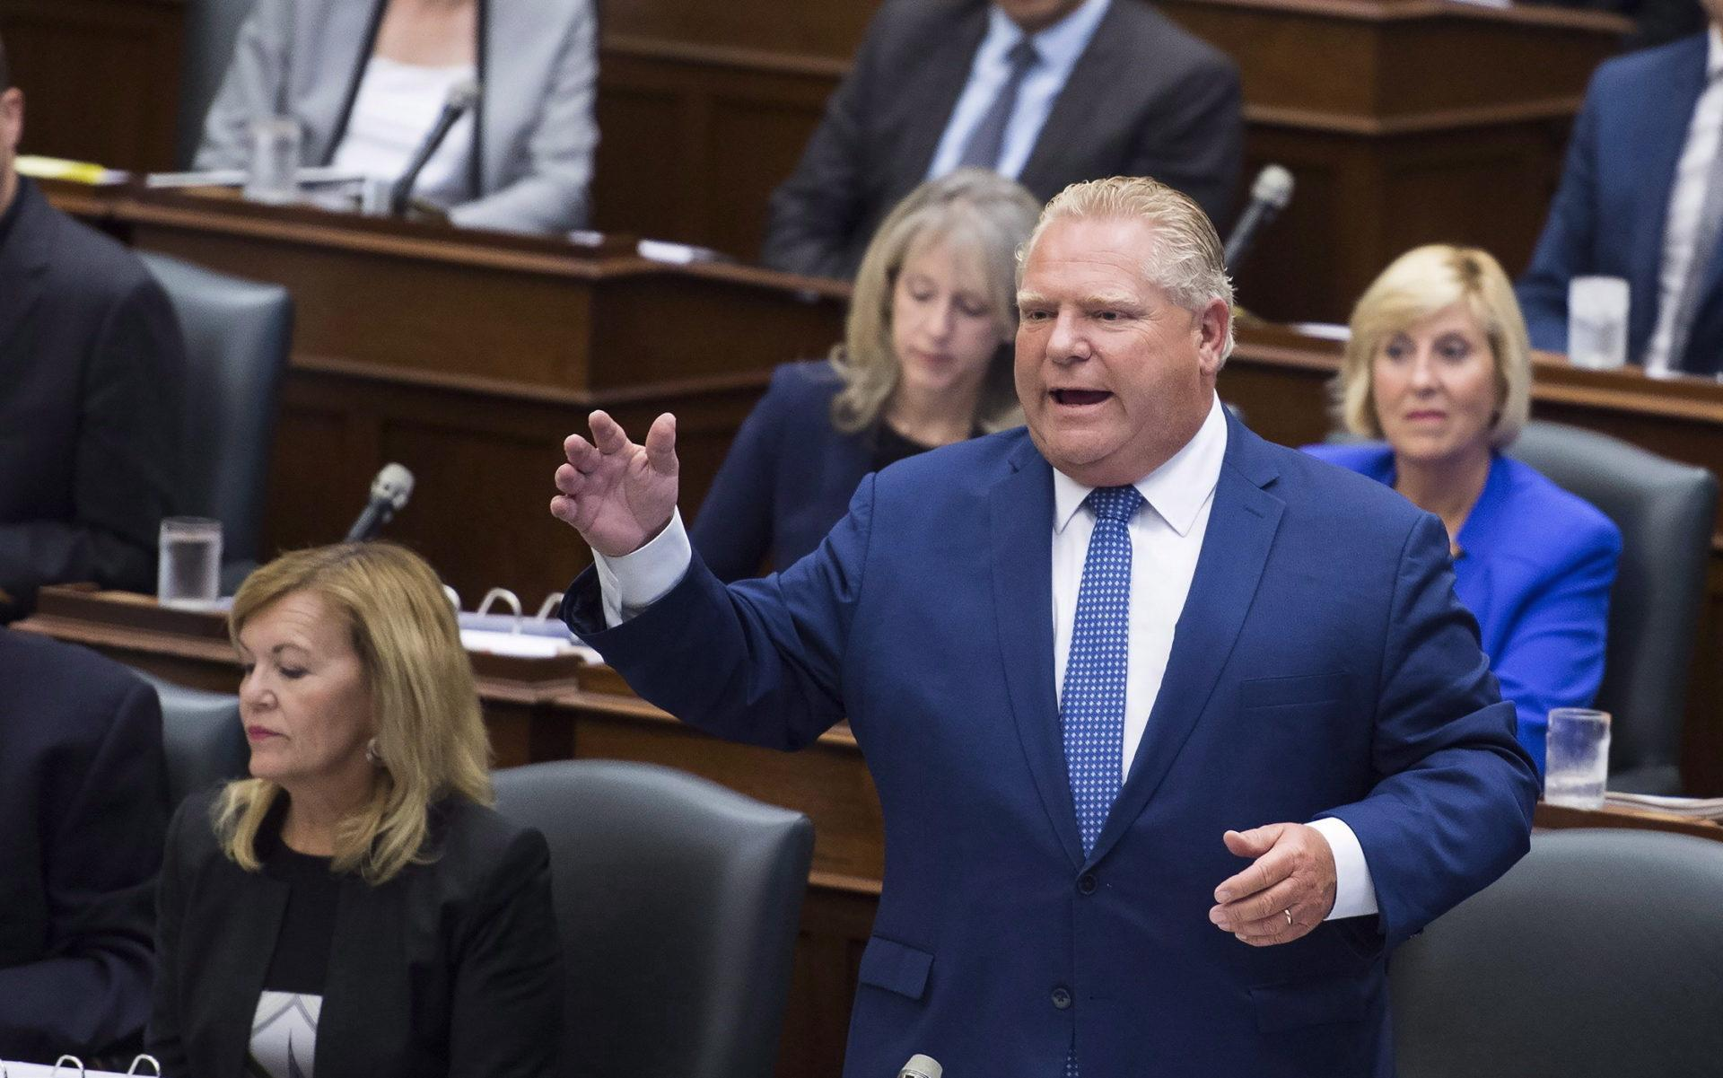
Identify the principles

Slide 15
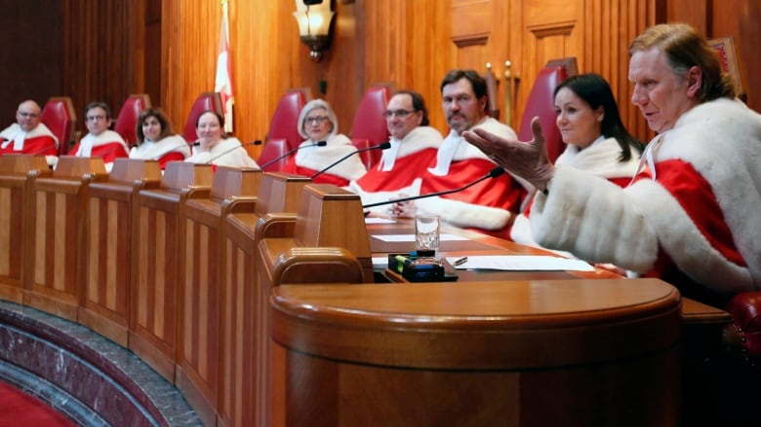
Identify the principles

Slide 16
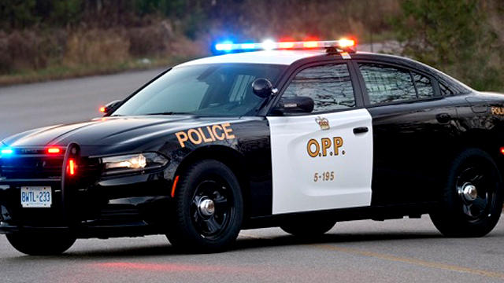
Identify the principles

Slide 17
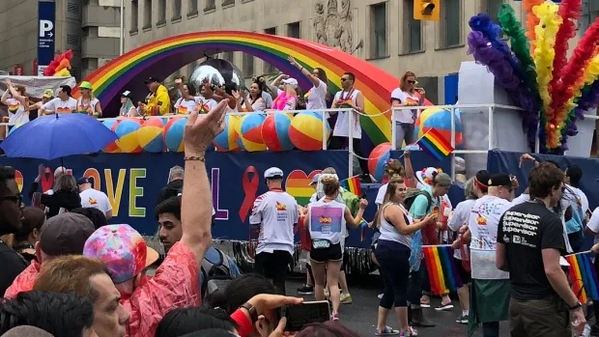
Identify the principles

Slide 18
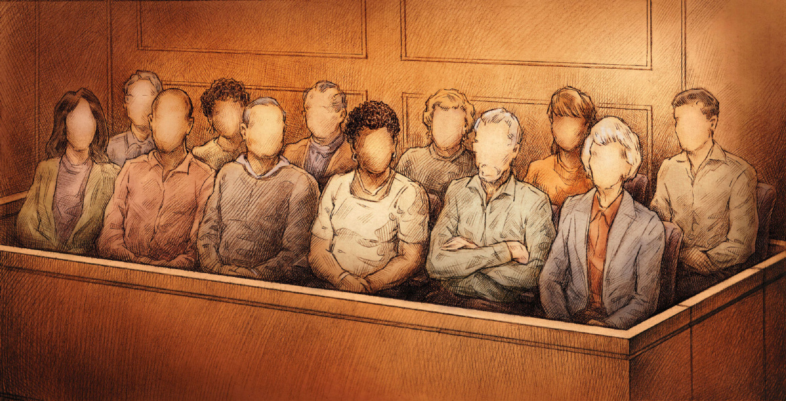
Identify the principles

Slide 19
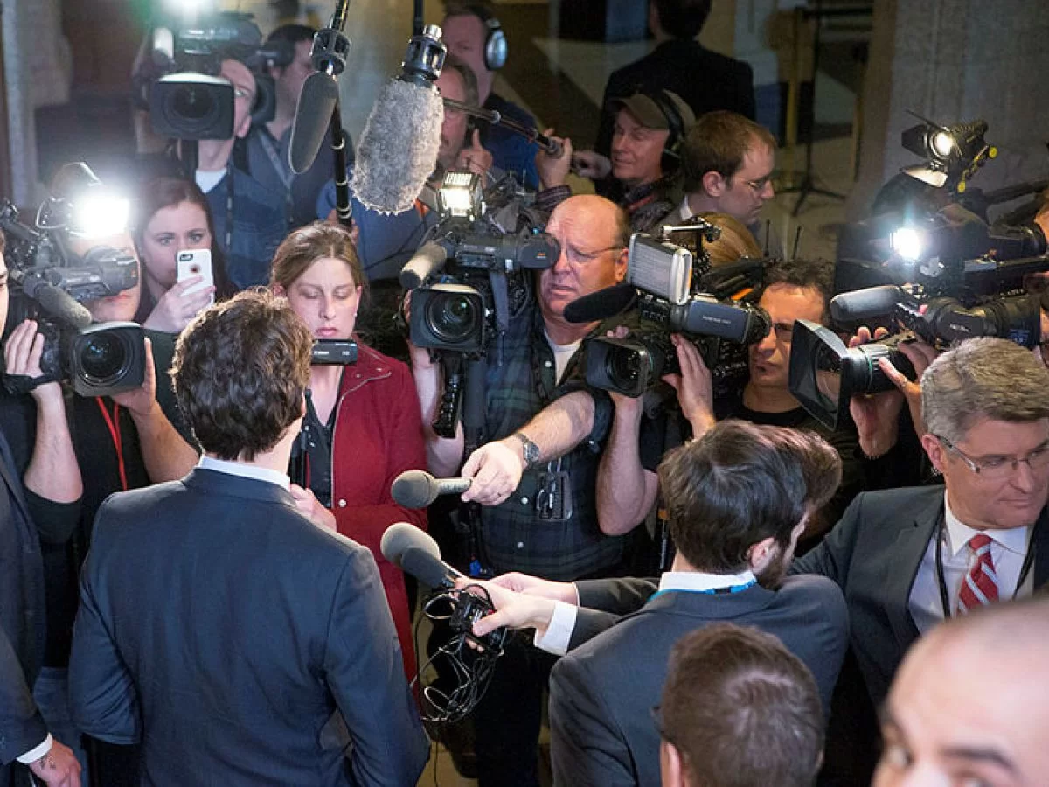
Identify the principles

Slide 20
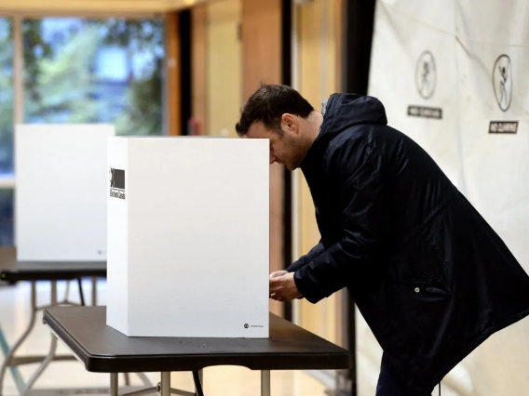
Identify the principles

Slide 21
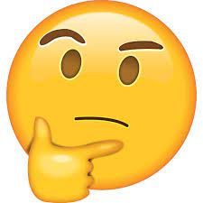
Discussion
Is it important for citizens to support and uphold these principles? What would happen if no one cared?
Do our rights come with responsibilities? For example, the right to protest comes with the responsibility to do so peacefully and without violence.

