Slide 1
SLIDE DECK 2: Rights and Responsibilities

Slide 2
Guiding Questions
What rights do we have in Canada?
What responsibilities go along with my rights?

Slide 3
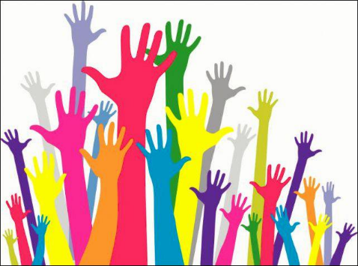
Rights
A right is something that we are morally or legally allowed to do or have.
In a democracy, citizen rights and freedoms are protected, which means they are written down in a legal document. If your rights are violated, you can complain.

Slide 4
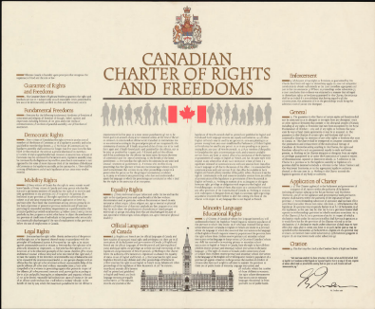
The Canadian Charter of Rights and Freedoms
The Charter has seven categories that define our rights as Canadians:
Fundamental freedoms
Democratic rights
Mobility rights
Legal rights
Equality rights
Official languages of Canada
Minority language education rights

Slide 5
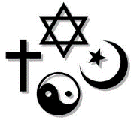
Fundamental freedoms
You have the freedom to pray & worship in your own way, or not to pray or worship at all.
You have the freedom to shape your own opinions.
You have the freedom to express your opinions (within limits).
The media is free to report on anything in Canada.
You can hold rallies to express your disagreements.
You can choose your own friends.

Slide 6
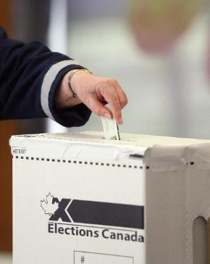
Democratic Rights
If you are a Canadian citizen and 18 years old, you can…
vote in elections
compete for the job of a politician
Other rules:
Governments must have elections every five years or less
Elected governments must meet at least once every year

Slide 7
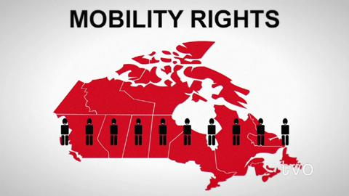
Mobility rights
You can live and work in any province or territory in Canada.

Slide 8
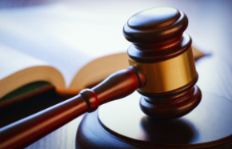
Legal rights
Everyone is considered innocent until proven guilty under the law.
If you are arrested, you must be told of your ability to see a lawyer.

Slide 9
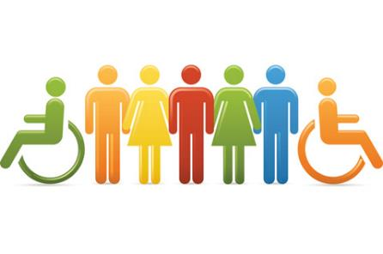
Equality rights
You cannot be treated unfairly for many reasons. This includes your race, background, religion, gender, age, or mental or physical ability.

Slide 10
Official languages of Canada
You have the right to talk and write to the federal government in English or French in Canada.

Slide 11
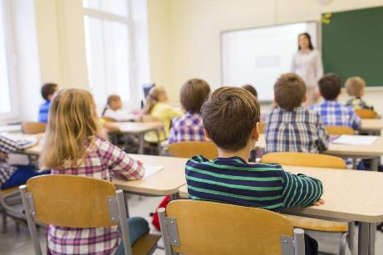
Minority language education rights
You can learn in English or French in certain situations (based on history, population numbers and your own background).

Slide 12
Responsibilities in a democracy
A responsibility is a duty, obligation or an expectation of how you should act.
It is the responsibility of all Canadians to respect and follow the rules outlined in the Constitution.

Slide 13
Final thoughts
Which rights and responsibilities do you think are most important and why?
What does it mean to be a responsible citizen?
What does it meant to not be a responsible citizen?

