Slide 1
SLIDE DECK 2: Perceptions, Perspectives and Pluralism

Slide 2
What do you see?

Slide 3
What do you see?

Slide 4
What do you see?

Slide 5
Discussion
Is there a “correct” way to see the images? Is someone right and someone else wrong?
How do you feel towards people that saw the same image as you, versus those who did not?
What is the main takeaway?

Slide 6
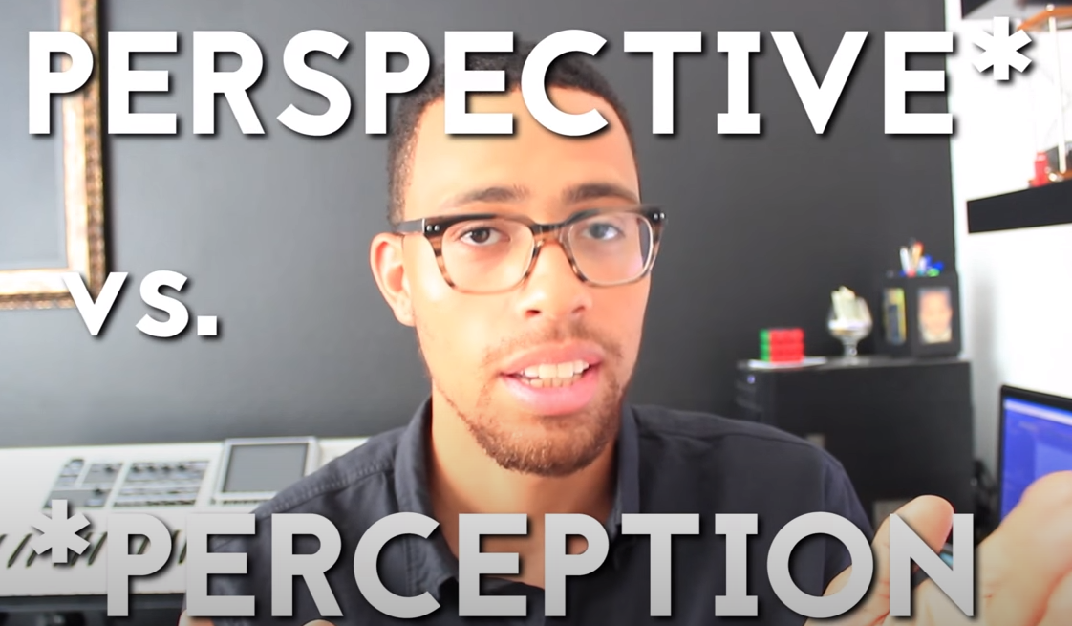
Perception vs. Perspective video, Genie Deez

Slide 7
Perception
Perception is our interpretation of something.
It is the ability to see, hear or become aware of something using one of our senses.
People perceive things differently.
We choose to select different aspects of something to focus our attention based on what interests us, what is familiar to us, or what we consider important.

Slide 8
Perspective
Perspective is the way we see something: our point of view.
Our perspectives are shaped by who we are, as well as our environment and life experiences.
For example, people living in different countries may have different priorities in life, based on their beliefs and perceptions of happiness.

Slide 9
Pluralism
(Source: Caribbean Muslims)

Slide 10
Pluralism
What is pluralism? Inspirit Foundation video

Slide 11
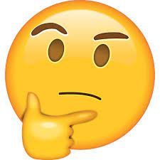
Discussion
“I don’t think that tolerance and diversity are enough.”
What did they mean?
What does this mean to you?

