Slide 1
SLIDE DECK 3:
Informed Citizenship

Slide 2
Online Platforms
Most information comes to us through online platforms such as
Search engines
Social media sites
Because they filter or control the flow of information we see, platforms have a lot of power.

Slide 3
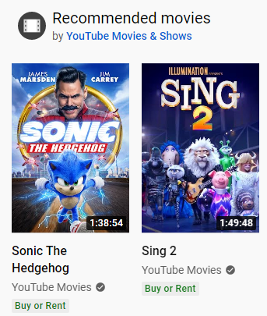
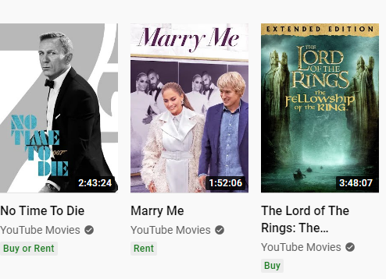
Algorithms
Algorithms are programs that tell computers or online platforms how to perform tasks, such as sorting information.

Slide 4
Discussion: Algorithms
You have probably observed information or advertisements online that were based on your previous internet searches or content that you read or watched.
Can you share an example from your own life of when this has happened?
Are there other times you have noticed algorithms personalizing your internet experience?
What is your understanding of how recommendation algorithms work?

Slide 5
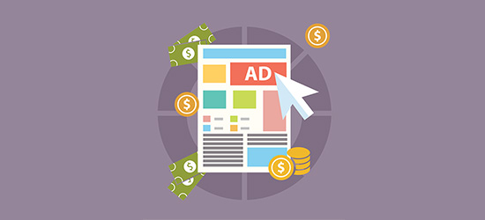
Holding your attention
Online platforms want to keep you online as long as possible by displaying posts that are popular, new or interesting to you.
The more time you spend on a social media site, the more ads you see, and the more money the online platform makes.

Slide 6
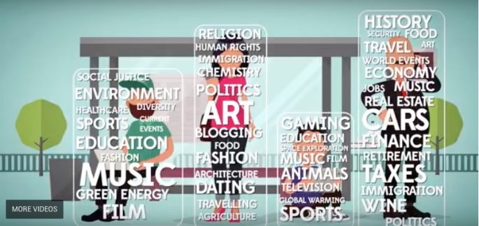
Filter bubbles
When we are only exposed to information that we like or agree with, it can create filter bubbles.

Slide 7
Discussion: Filter Bubbles
What might happen to our understanding of people, issues, and events if we only see news or information we like or agree with?
What impact might ‘filter bubbles’ have on discussions of divisive political issues?
Should we make an effort to avoid ending up in a filter bubble? What steps might we take to become exposed to different perspectives?

Slide 8
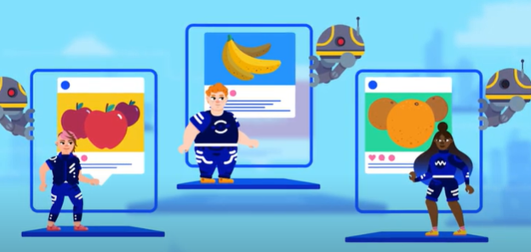
Divisions and confirmation bias
When people are in filter bubbles, it can make it more difficult to connect with others who like different things, or have different political views.
It can also make people more likely to believe information that supports their existing beliefs.

Slide 9
Discussion
What is the benefit of thinking critically about online information? To you as an individual? To society as a whole?
What are the opportunities and challenges with getting news and information from online platforms?
Do you think the average person understands how online platforms work? What can we do to inform others so they become as knowledgeable as we are?

