Slide 1
SLIDE DECK 4:
Informed Citizenship

Slide 2
Online Platforms
Online platforms include search engines and social media sites.
Because they control the flow of information we see online, platforms have a lot of power.

Slide 3
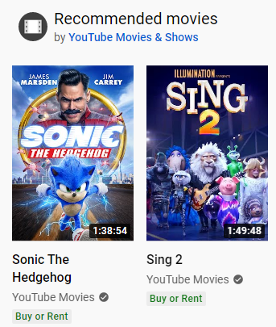
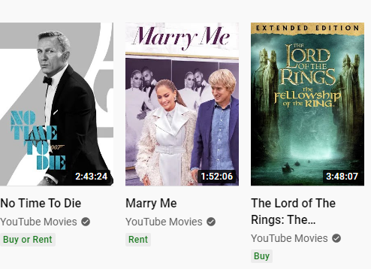
Algorithms
Algorithms are programs that tell computers or online platforms how to perform tasks, such as sorting information.

Slide 4
Discussion: Algorithms
Have you ever seen information or advertisements online that were based on your previous internet searches?
Can you share an example?
How do algorithms personalize your internet experience?

Slide 5
Holding your attention
Online platforms want to keep you online as long as possible by displaying posts that are popular, new or interesting to you.
The more time you spend on a social media site, the more ads you see, and the more money the online platform makes.

Slide 6
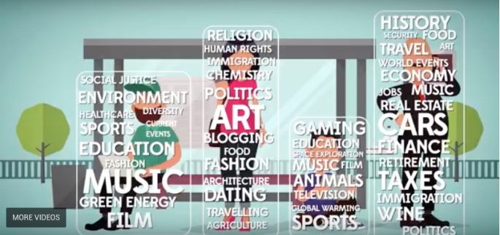
Filter bubbles
When we are only exposed to information that we like or agree with, it can create filter bubbles.

Slide 7
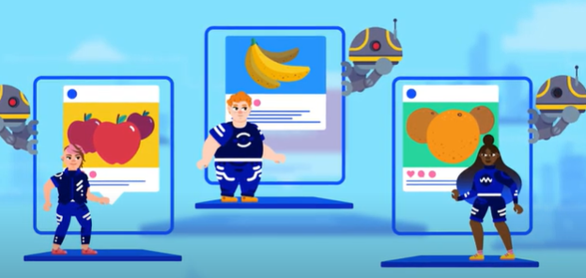
Discussion: Filter Bubbles
What happens if we only see information we
like or agree with?
How could it influence our thinking about people, issues or events?

Slide 8
Discussion
Why is it important to think critically about online
information?
What are the opportunities and challenges with getting news and information from online platforms?
How can we make sure we are informed citizens
and consider different viewpoints?

