Slide 1
SLIDE DECK 4: Levels of Government

Slide 2
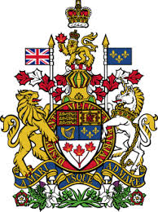
Trivia
What type of government do we have in Canada?
A
AA
B
A
Federal state
B
Parliamentary democracy
C
Constitutional monarchy
D
All of the above

Slide 3
Trivia
What type of government do we have in Canada?
A
AA
B
D
All of the above
Federal state | We have a central government (federal) and municipal governments (provincial).
Parliamentary democracy | We elect members to represent us in our parliament and legislatures. The political party with the most elected representatives forms government.
Constitutional monarchy | King Charles III, as King of Canada, is our head of state. The authority of the monarch is limited by our constitution.

Slide 4
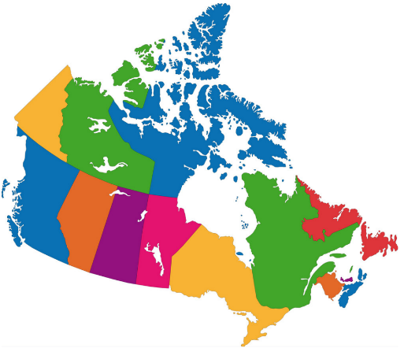
Trivia
How many levels of government do we have?
A
AA
B
A
2
B
3
C
4
D
13

Slide 5
Trivia
How many levels of government do we have?
A
AA
B
Each level has its own group of elected representatives.
Federal
Provincial/Territorial
Municipal
Some First Nations, Inuit, and Métis communities have their own systems of governance. They share certain responsibilities with other levels of government.
B
3

Slide 6
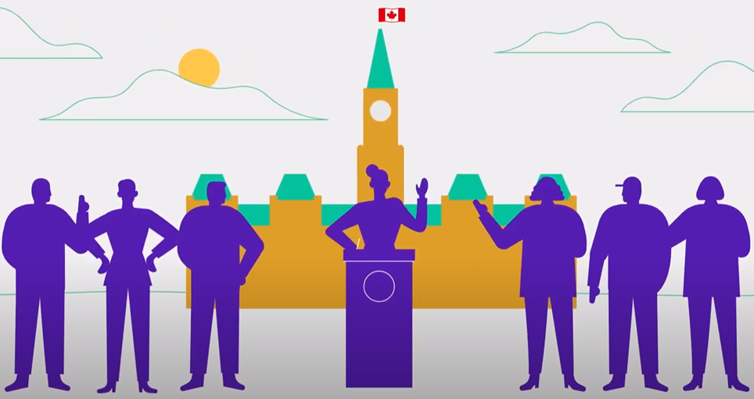
Trivia
What is the title given to the elected representative at the federal level?
A
AA
B
A
Senator
B
Councillor
C
Member of Parliament
D
Member of the Legislative Assembly

Slide 7
Trivia
What is the title given to the elected representative at the federal level?
A
AA
B
At the provincial level, the elected representatives is called a Member of Provincial Parliament (MPP).
At the municipal level, the elected representative is called a councillor or alderman.
C
Member of Parliament (MP)

Slide 8
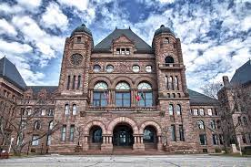
Trivia
Where is the Legislative Assembly of Ontario located?
A
AA
B
A
Ottawa
B
Toronto
C
Kingston
D
London

Slide 9
Trivia
Where is the Legislative Assembly of Ontario located?
A
AA
MPPs gather at the Legislative Assembly to discuss issues and pass laws.
Our federal representatives gather in Ottawa at the House of Commons.
Municipal representatives gather at their city or town hall.
B
Toronto

Slide 10
Trivia
What is the title of the leader of the provincial government?
A
AA
B
A
President
B
Prime Minister
C
Mayor
D
Premier

Slide 11
Trivia
What is the title of the leader at the provincial level?
A
AA
B
At the federal level, the title given to the leader is prime minister.
At the municipal level, the title given to the leader is mayor or reeve.
Mayors are elected directly by the people, whereas the premier and prime ministers are not.
D
Premier

Slide 12
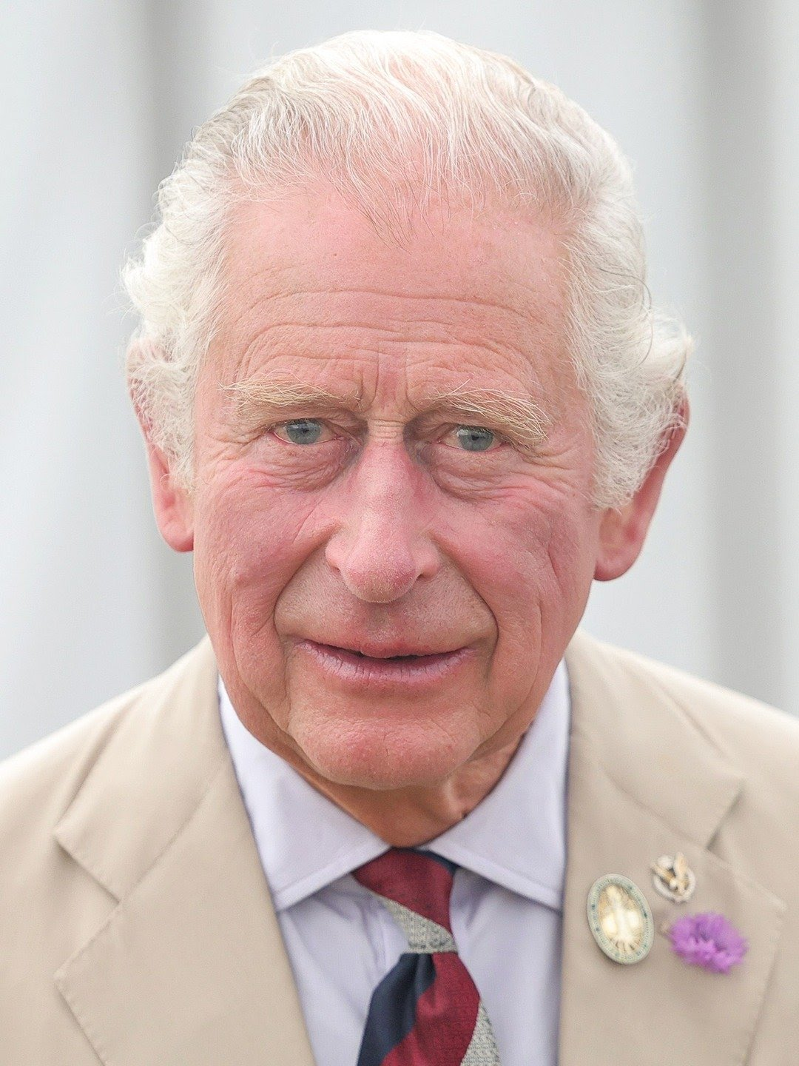
Trivia
What is the title of the sovereign’s representative at the provincial level?
A
AA
B
A
Director General
B
Governor General
C
Lieutenant Governor

Slide 13
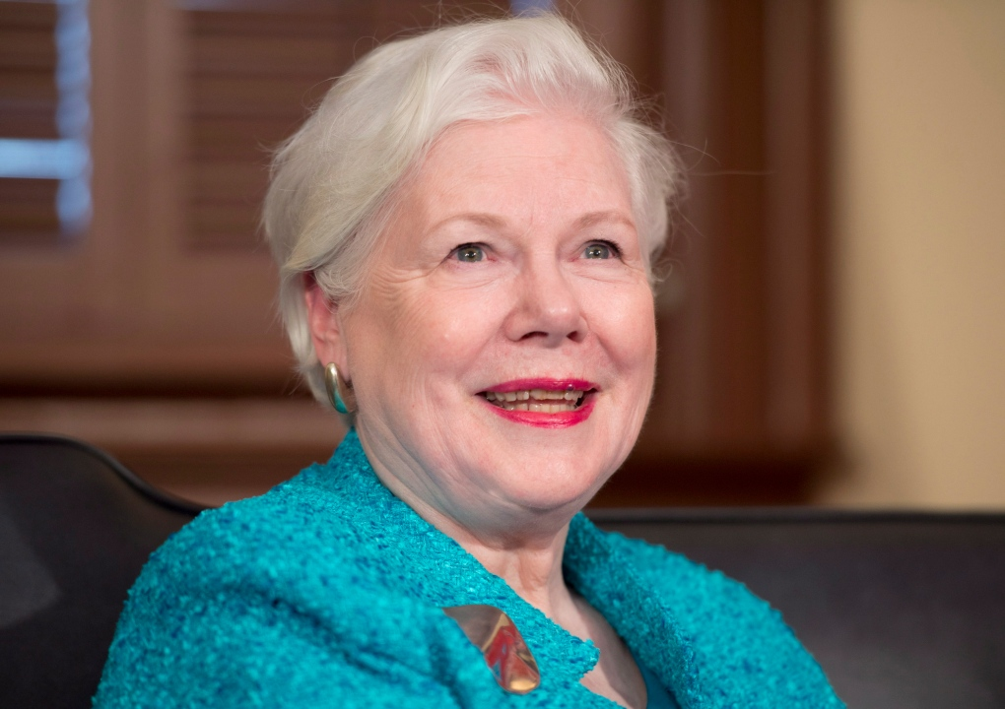
Trivia
What is the title of the sovereign’s representative at the provincial level?
A
AA
B
The sovereign’s representative at the federal level is the Governor General.
They have similar roles, such as opening and closing parliament, calling an election, and reading the throne
speech.
There is no representative at the municipal level.
C
Lieutenant Governor

Slide 14
Whose responsibility is it?
Federal, provincial or municipal government?
Water supply and treatment
National defence
Natural resources
Driver’s licensing and highways
Education
Citizenship and passports
Hospitals and healthcare
Road maintenance
Local parks
Indigenous lands and rights
Criminal law
International trade
Local police and fire protection

Slide 15
Whose responsibility is it?
Federal, provincial or municipal government?
Water supply and treatment
National defence
Natural resources
Driver’s licensing and highways
Education
Citizenship and passports
Hospitals and healthcare
Road maintenance
Local parks
Indigenous lands and rights
Criminal law
International trade
Local police and fire protection

