Slide 1
SLIDE DECK 5: My Municipality

Slide 2
Guiding questions
What are the features of municipalities?
How has the physical environment shaped my community?
What actions can be taken to improve my community and why?

Slide 3
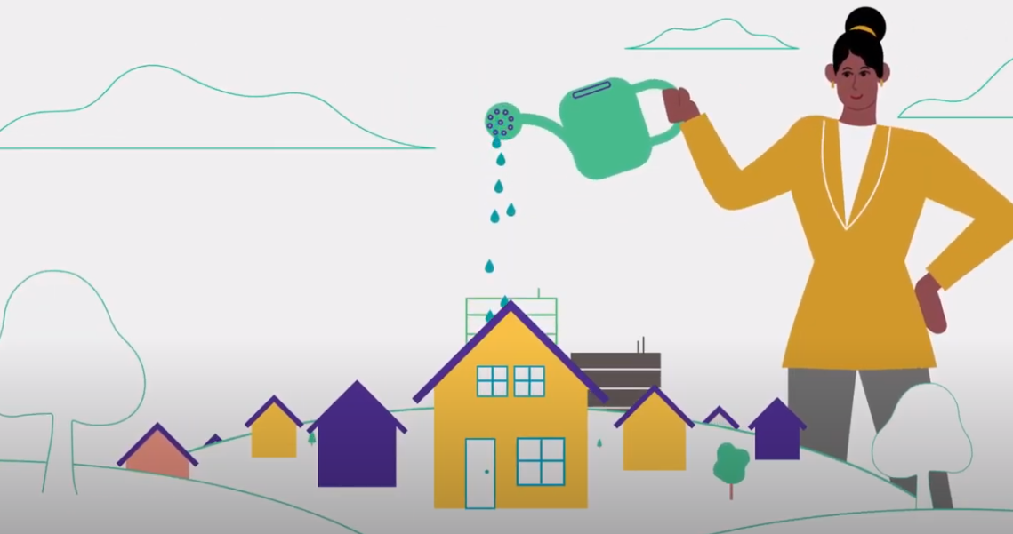
Local governments
Municipalities are responsible for providing essential local services to their communities.
They are the most local level of government in Canada.

Slide 4
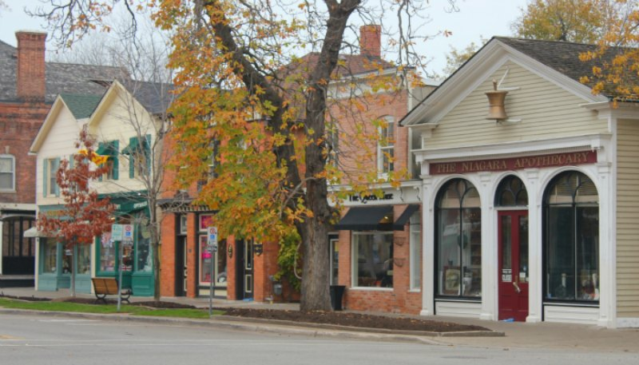
Municipalities in Ontario
Ontario is separated into 444 different communities called municipalities.
A municipality can be called a city, town, village, township, county or region.
Each municipality is responsible providing local services and managing the growth and well-being of their community.

Slide 5
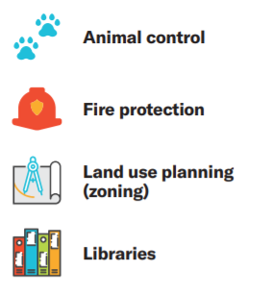
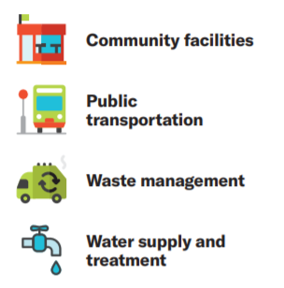
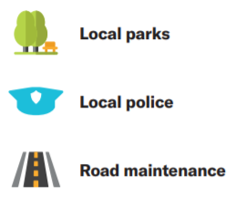
Municipal government responsibilities

Slide 6
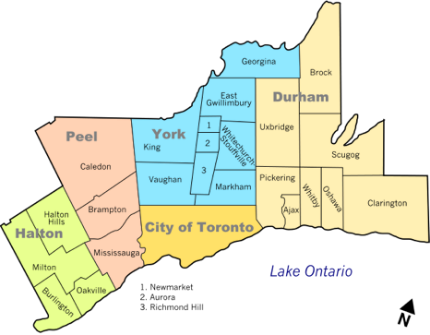
Key Features of Municipalities
1) A specific geographic area with boundaries
2) The power to tax
3) An elected council

Slide 7
Key Features of Municipalities
A specific geographic area with boundaries
2) The power to tax
3) An elected council

Slide 8
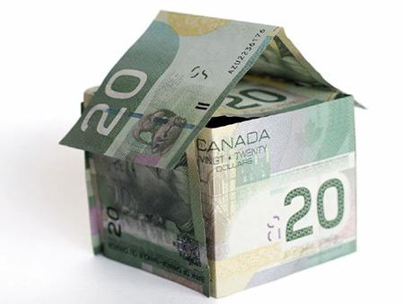
Property Taxes
If you own property, you will pay a certain percentage of its value in taxes every year to your municipality. These are called property taxes.
The money collected from property taxes helps pay for local services and some goes to the education system.

Slide 9
Types of Municipalities
There are three types of municipalities in Ontario.
One level system:
A single-tier municipality has one government and local council and it operates on its own.
Two level system:
A lower-tier municipality has a local council and government (similar to a single-tier municipality).
An upper-tier municipality has a regional council and government, and provides services for two or more lower-tier municipalities.

Slide 10
Single-tier Municipalities
There are 173 single-tier municipalities in Ontario. Some examples include:

Slide 11
Lower-tier and Upper-tier
There are 241 lower-tier municipalities and 30 upper-tier municipalities. For example, the Region of Peel is an upper-tier municipality for three lower-tier municipalities.

Slide 12
Local Councils
Each local council (single-tier or upper-tier) is made up of a head of council, known as the mayor or reeve, and other council members, known as councillors or aldermen.
Mayors and reeves are elected by all voters in the municipality. This is called a at-large system.
Councillors and aldermen can be elected either at-large or by a ward system of voting (where the municipality is broken down into smaller sections).

Slide 13
The Role of Council
Council members govern their municipality through the following activities:
Listening to the concerns and ideas of their constituents (people living in their community)
Attending meetings
Reviewing reports from municipal officials
Creating, debating and voting on by-laws (rules) they believe will improve their municipality.

Slide 14
Discussion
Can you identify any problems or challenges in our community?
Do you see any opportunities for improvement?
What actions could be taken to make a positive change in our community?
How can you be an active community member?

