Slide 1
SLIDE DECK 5: Municipalities

Slide 2
What municipality do you live in?
Do you like living in your municipality? Why?

Slide 3
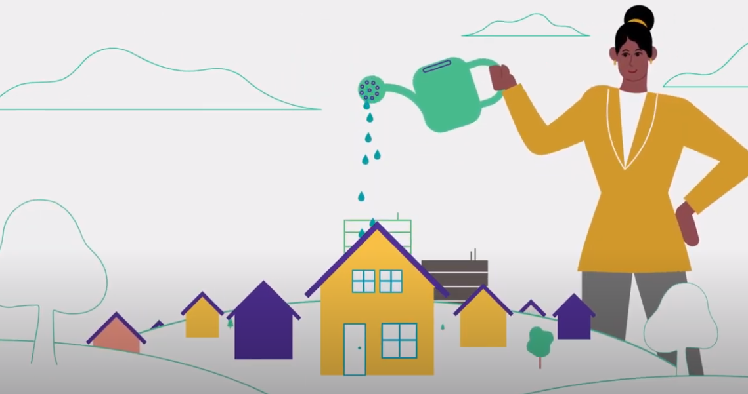
Municipalities
Municipalities are responsible for providing essential local services to their communities.
Responsible for the planning, growth and well-being of their community through legislation, by-laws and policies.

Slide 4
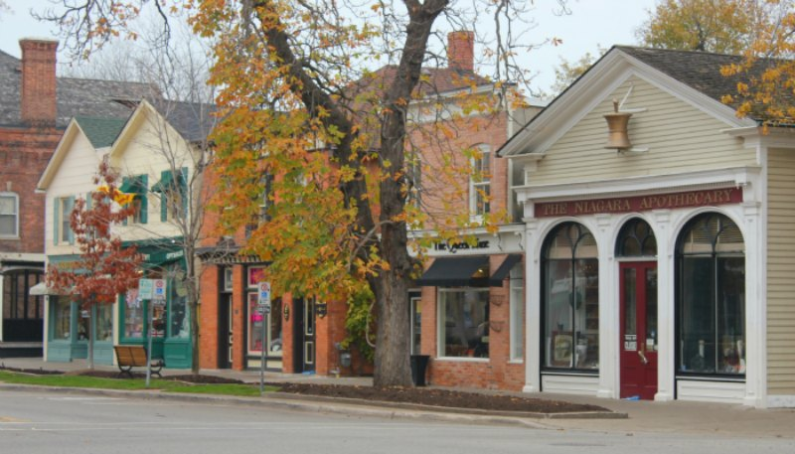
Municipalities in Ontario
Ontario is separated into 444 different communities called municipalities.
A municipality can be called a city, town, village, township, county or region.
Each municipality is responsible delivering local services and managing the growth and well-being of their community.

Slide 5
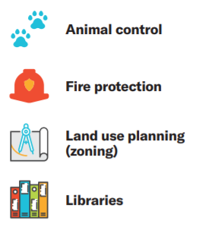
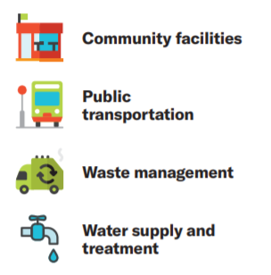
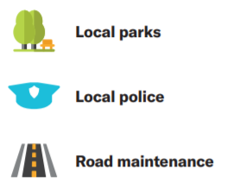
Municipal responsibilities

Slide 6
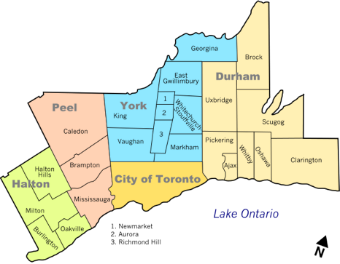
Key Features of Municipalities
Municipalities share several main features:
1) A defined geographic area
2) The power to tax
3) An elected council

Slide 7
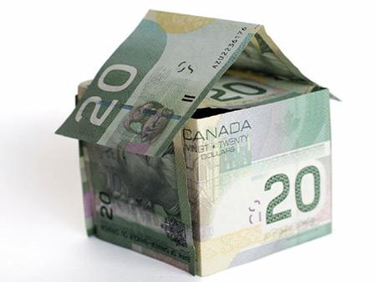
Property Taxes
Property taxes are the main source of revenue (income) for municipalities.
If you own property, you will pay a certain percentage of its value in taxes every year – a portion goes to the municipality to help pay for local services and a portion goes toward the education system.

Slide 8
Types of Municipalities
Municipalities in Ontario are either part of a single-tier or two-tier system.
A single-tier municipality has one government and local council and it operates on its own.
A two-tier system involve two layers of government and two councils.
A lower-tier municipality has a local municipal council and government (similar to a single-tier municipality).
An upper-tier municipality has a regional council and government, and provides services for two or more lower-tier municipalities.

Slide 9
Single-tier Municipalities
There are 173 single-tier municipalities in Ontario. Some examples include:

Slide 10
Lower-tier and Upper-tier
There are 241 lower-tier municipalities and 30 upper-tier municipalities. For example, the Region of Peel is an upper-tier municipality for three lower-tier municipalities.

Slide 11
Local Councils
Each local council (single-tier or upper-tier) is made up of a head of council, known as the mayor or reeve, and other council members, known as councillors or aldermen.
Mayors and reeves are elected by all voters in the municipality. This is called a at-large system.
Councillors and aldermen can be elected either at-large or by a ward system of voting (where the municipality is broken down into smaller sections).

Slide 12
Local Councils
Each local council (single-tier or upper-tier) is made up of a head of council, known as the mayor or reeve, and other council members, known as councillors or aldermen.
Mayors and reeves are elected by all voters in the municipality. This is called a at-large system.
Councillors and aldermen can be elected either at-large or by a ward system of voting (where the municipality is broken down into smaller sections).

Slide 13
The Role of Council
Council members govern their municipality through the following activities:
Listening to the concerns and ideas of their constituents (people living in their community)
Attending meetings
Reviewing reports from municipal officials
Creating, debating and voting on by-laws (rules) they believe will improve their municipality.

Slide 14
Final thoughts
Why should we care about our community?
Why is it important to collaborate with others on addressing community needs?
Why is it important to have diversity in government and within groups tackling change in our communities?

