Slide 1
SLIDE DECK 6:
Municipal Elections

Slide 2
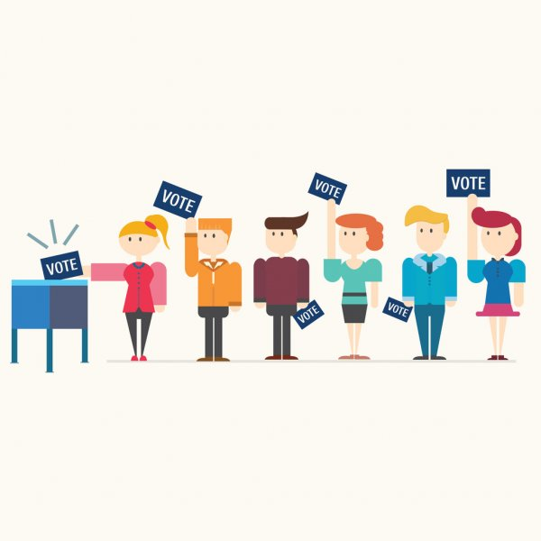
How are municipal council members chosen?
How can I learn about the election candidates?
Which candidate(s) do I support, and why?

Slide 3
The purpose of elections
Elections are contests of leadership, ideas, politics and power, where interested individuals campaign for our vote.
Municipal elections provide citizens with an opportunity to discuss and debate the future direction of their community and choose their political representatives.

Slide 4
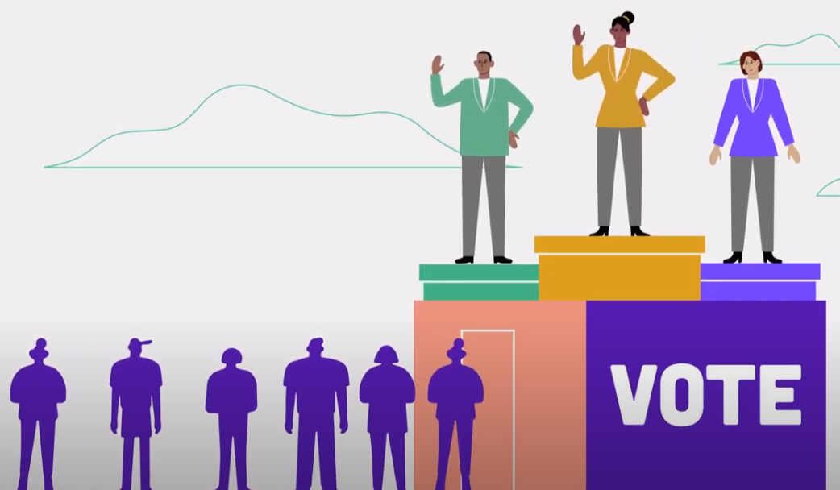
Municipal elections in Ontario
Municipal elections provide citizens with an opportunity to discuss the future direction of their community and choose their local representatives.
Local elections in Ontario must be held every four years, on the fourth Monday in October.
The next local elections will be held on Monday, October 24, 2022.

Slide 5
Electing Municipal Councils
Council members can be elected in two ways:
At-large – by all eligible voters in the municipality.
By ward – where the municipality is broken down into smaller geographic areas that elect one or more representatives for each ward.
The head of council (mayor or reeve) is elected at large in single-tier or lower-tier municipalities.

Slide 6
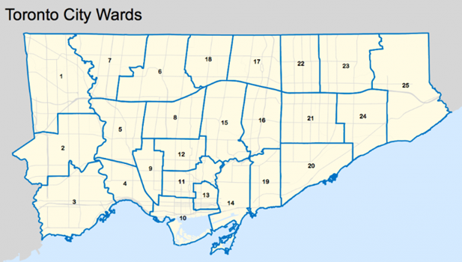
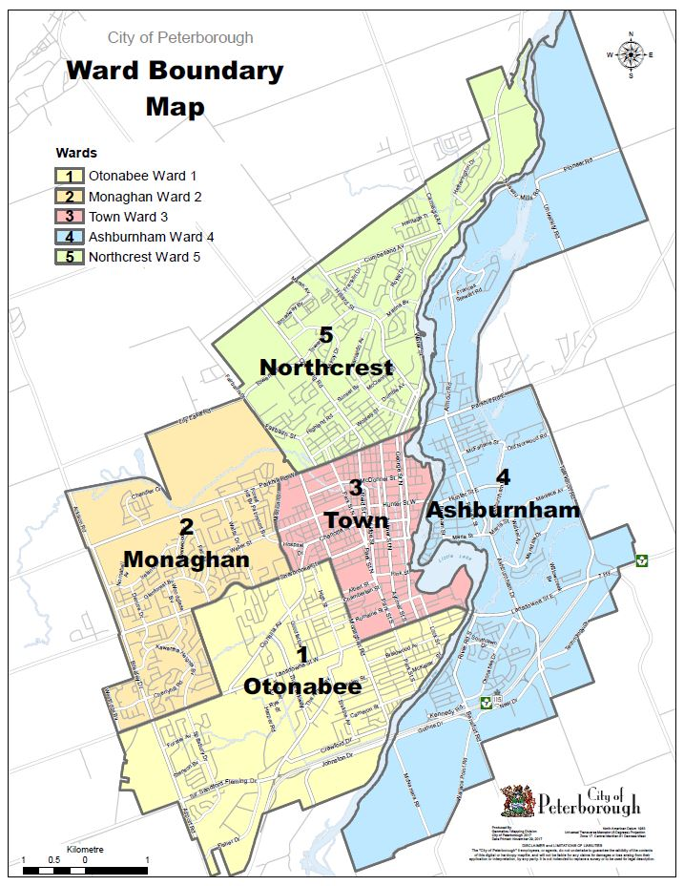
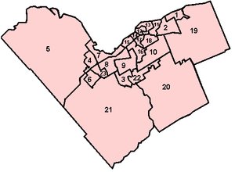
Examples of Ward Systems
Toronto
Peterborough
Ottawa

Slide 7
A voting system is the way in which voters are able to express their choices and how the winners are determined.
Different voting systems exist around the world.

Slide 8
First-Past-the-Post
Ontario uses a system called First-Past-the-Post (FPTP) for municipal elections.
Voters can make their choice(s) for as many candidates as there are positions.
For example:
Six councillors = Select six candidates
One mayor = Select one candidate

Slide 9
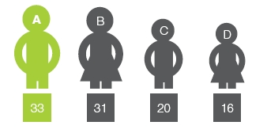
First-Past-the-Post
A successful candidate must receive the most votes in order to be elected in their area.
In a single-member race (i.e. mayor), only one candidate wins because there is only one position.
In a multi-member race, where five councillors are elected at large, it is the five candidates with the most votes that win a seat on council.

Slide 10
Acclamation
The number of candidates running for a position can range from one to more than ten.
If a candidate has no opponents, or if the number of candidates match the number of council seats to be filled, the candidate(s) win automatically and there is no election. This is called acclamation

Slide 11
Candidates
A candidate is an individual who competes for the job of elected representative.
Candidates campaign during elections to share their ideas and try to convince fellow citizens to vote for them.
At the municipal level, there are no political parties. Candidates run independently.

Slide 12
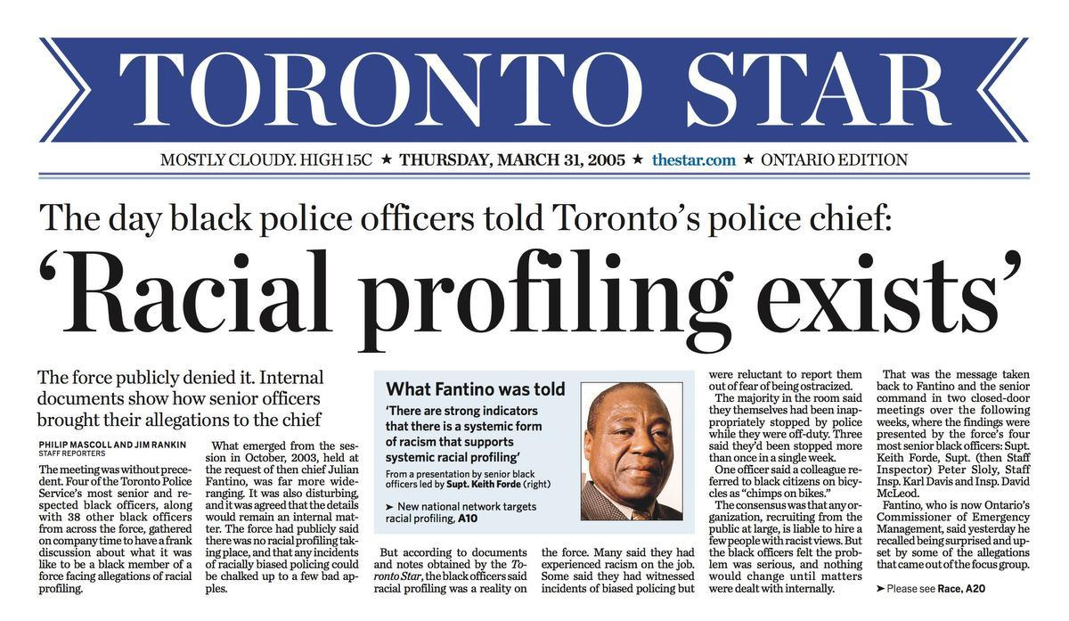
Getting to know the candidates
There are many ways to learn about the election candidates:
Candidate websites or social media pages
Candidate campaign literature or advertisements
Election coverage in the news (local newspapers, media websites, news broadcasts)
In-person or virtual town halls or debates
As a result of the COVID-19 pandemic, there will be a much greater focus on virtual outreach and social media campaigns.

Slide 13
Final thoughts
Which candidate do you prefer and why?
Which candidate do you think will best address the issues that matter most to you?

