Slide 1
SLIDE DECK 7: School Trustees

Slide 2
What are school boards?
How do the decisions
made by school boards affect me?

Slide 3
School Boards
Ontario’s school boards operate the province’s publicly funded schools. They administer the funding they receive from the provincial government in their designated geographic area.

Slide 4
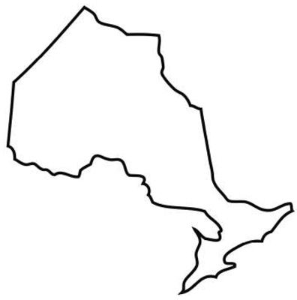
Ontario school boards
There are four types of publicly funded school boards in Ontario:
31 English public boards
29 English Catholic boards
4 French public boards
8 French Catholic boards.

Slide 5
School Trustees
Each school board has a group of locally elected representatives known as school trustees.
On their own, trustees have no individual authority, it is the board of trustees that makes decisions as a whole.

Slide 6
The Role of School Trustees
Trustee responsibilities include:
Setting an educational vision and goals
Setting goals for student achievement
Approving textbooks and learning materials
Determine the number, size and location of schools
Creating and monitoring school policies

Slide 7
The Role of School Trustees
Trustees are responsible for communicating with their constituents and bringing their concerns to the board for discussion.
The board of trustees makes decisions as a whole. Board decisions are made by voting, where motions are passed if they have majority support.

Slide 8
How are school trustees elected?
School trustees are elected every four years during municipal elections.
Some school boards include more than one municipality.
Some school boards divide the board into smaller areas, called wards.

Slide 9
Final Thoughts
How would you explain the role of school trustees to your family members?
What is most important to you when evaluating the trustee candidates, and deciding who to vote for?

