Slide 1
SLIDE DECK 7: School Trustees

Slide 2
What is the name of our school board?
What is the role of school trustees?
How can I learn about and evaluate the school trustee candidates?

Slide 3
School Boards
Ontario’s school boards operate the province’s publicly funded schools. They administer the funding they receive from the provincial government in their designated geographic area.

Slide 4
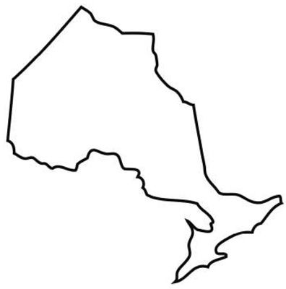
Ontario school boards
There are four types of publicly funded school boards in Ontario:
31 English public boards
29 English Catholic boards
4 French public boards
8 French Catholic boards.

Slide 5
School Trustees
Each school board has a group of locally elected representatives known as school trustees.
On their own, trustees have no individual authority, it is the board of trustees that makes decisions as a whole.

Slide 6
The Role of School Trustees
Trustee responsibilities include:
Setting an educational vision and goals
Setting goals for student achievement
Approving textbooks and learning materials
Determine the number, size and location of schools
Creating and monitoring school policies

Slide 7
The Role of School Trustees
Trustees are responsible for communicating with their constituents and bringing their concerns to the board for discussion.
The board of trustees makes decisions as a whole. Board decisions are made by voting, where motions are passed if they have majority support.

Slide 8
The Role of School Trustees
Trustees are responsible for communicating with their constituents and bringing their concerns to the board for discussion.
The board of trustees makes decisions as a whole. Board decisions are made by voting, where motions are passed if they have majority support.

Slide 9
Final Thoughts
Which candidate(s) do you think would make the best school trustee and why?
What advice would you give your family members about learning about the school trustee candidates?

