Slide 1
SLIDE DECK 8: The Voting Process

Slide 2
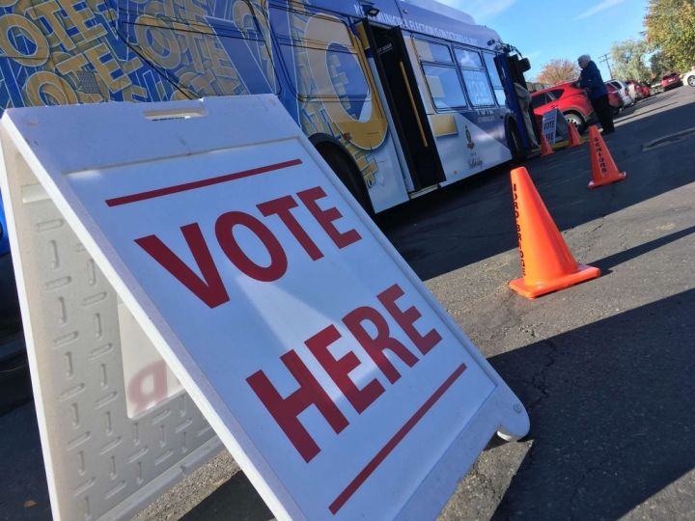
How do I vote in municipal elections?

Slide 3
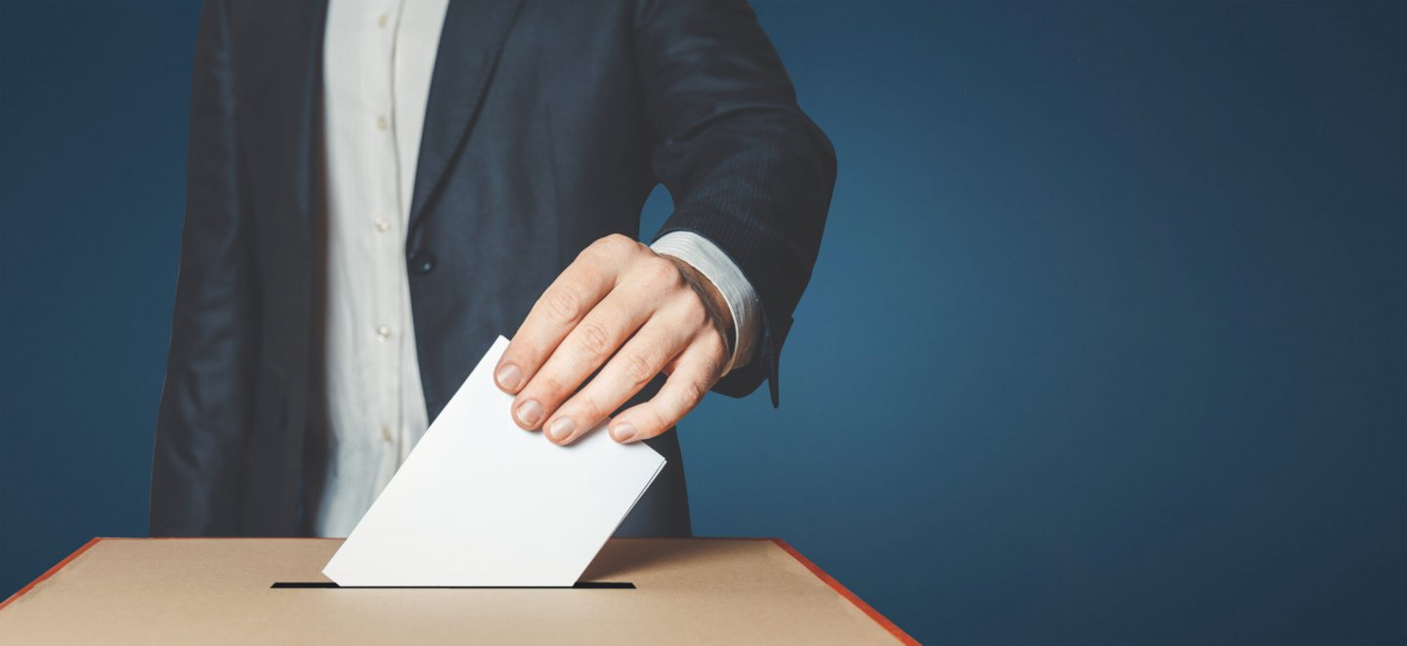
Voting by secret ballot
Voting in municipal elections is done by secret ballot.
Voters mark their ballot behind a privacy screen and fold their ballot to hide their choice.

Slide 4
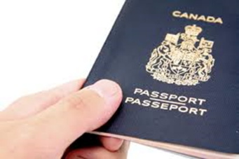
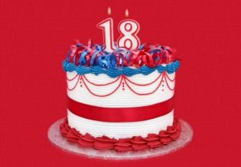
Who is qualified to vote?
You are eligible to vote in Ontario municipal elections if:
You are a Canadian citizen
You are aged 18 or older
You qualify to vote in the municipality

Slide 5
Who organizes municipal elections?
The provincial government sets out common rules that all voters and candidates must follow.
However, municipalities are responsible for conducting the elections for their municipal council and school boards.
Every municipality has a municipal clerk who is in charge of running the election.

Slide 6
What are different ways a person can vote?
Each municipality is responsible for conducting their election and determining the methods used.
Options can include:
Paper ballots
Online voting
Voting by mail
Voting by phone

Slide 7
Where do I vote?
You can find your voting place on your municipality website and through documentation mailed to voters.
Electors who are away, busy or unable to vote on voting day, have the option of participating in advance voting.

Slide 8
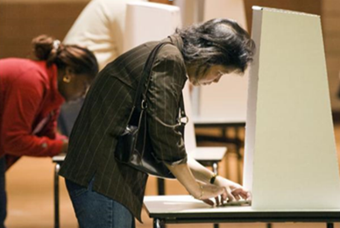
What is the process for voting?
Once you confirm your eligibility, you are given a ballot.
Go behind a voting screen and mark your ballot.
Hand your folded ballot back to the poll clerk.
Your ballot is recorded and counted.

Slide 9
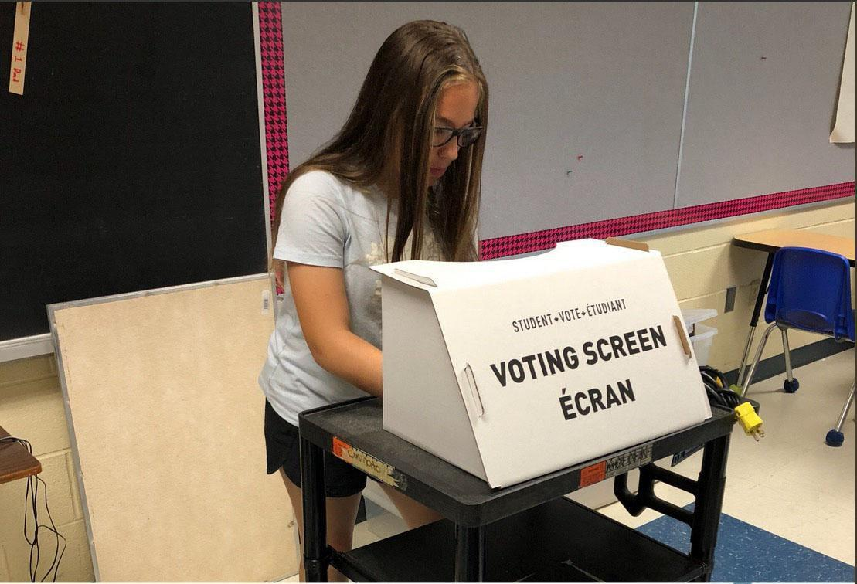
How do I mark my ballot?
A ballot lists the names of the candidates running for each position in your municipal elections.
As long as you appropriately mark the ballot according to the number of choices, your votes will be counted.

Slide 10
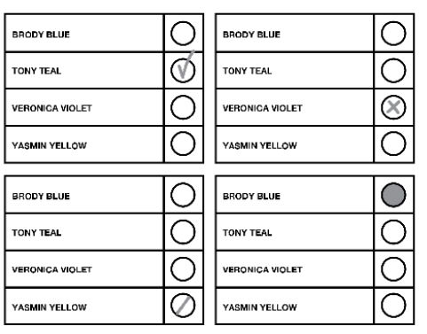
Valid ballots
A valid ballot clearly indicates the preference of the voter.
You may vote for more than one candidate if there is more than one person elected in the race.

Slide 11
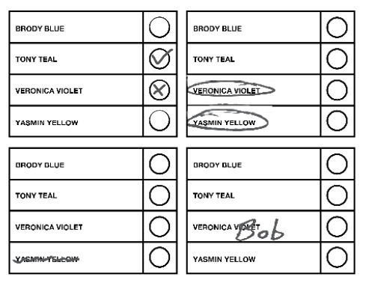
Rejected ballots
A rejected ballot is a ballot that cannot be counted because the voter’s choice is not clear.

Slide 12
Discussion
• Do you think voting is easy or challenging?
• Do you feel ready to vote in the Student Vote
election?
• Will you vote in elections when you turn 18 years old?

