Slide 1
SLIDE DECK 8: The Voting Process

Slide 2
Voting by secret ballot
Voting in local elections is done by secret ballot.
Voters mark their ballot behind a privacy screen and fold their ballot to keep their choice private.

Slide 3
Who organizes municipal elections?
The provincial government sets out common rules that all voters and candidates must follow.
However, municipalities are responsible for conducting the elections for their municipal council and school boards.
Every municipality has a municipal clerk who is in charge of running the election.

Slide 4
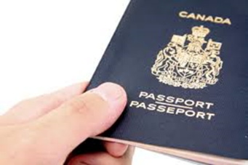
Who is qualified to vote?
You are eligible to vote in Ontario municipal elections if:
You are a Canadian citizen
You are aged 18 or older
You qualify to vote in the municipality

Slide 5
What is the voters’ list?
Each municipality creates and posts their own voters’ list based on provincial data.
A voter’s name must be on the voters’ list in order to cast a ballot. While a voter’s name can be added on voting day, it is helpful to do this in advance.
In some municipalities, being on the voters’ list ensures you receive a voter information card, which indicates where and when you can vote.

Slide 6
What are different ways a person can vote?
Each municipality is responsible for conducting their election and determining the methods used.
Options can include:
Paper ballots
Online voting
Voting by mail
Voting by phone

Slide 7
Where do I vote?
You can find your voting place on your municipality website and through documentation mailed to voters.
Electors who are away, busy or unable to vote on voting day, have the option of participating in advance voting.

Slide 8
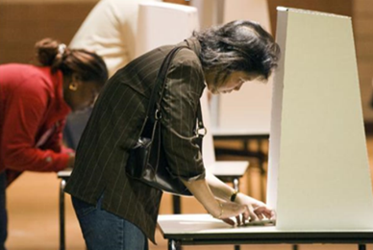
What is the process for voting?
Once you confirm your eligibility, you are given a ballot.
Go behind a voting screen and mark your ballot.
Hand your folded ballot back to the poll clerk.
Your ballot is recorded and counted.

Slide 9
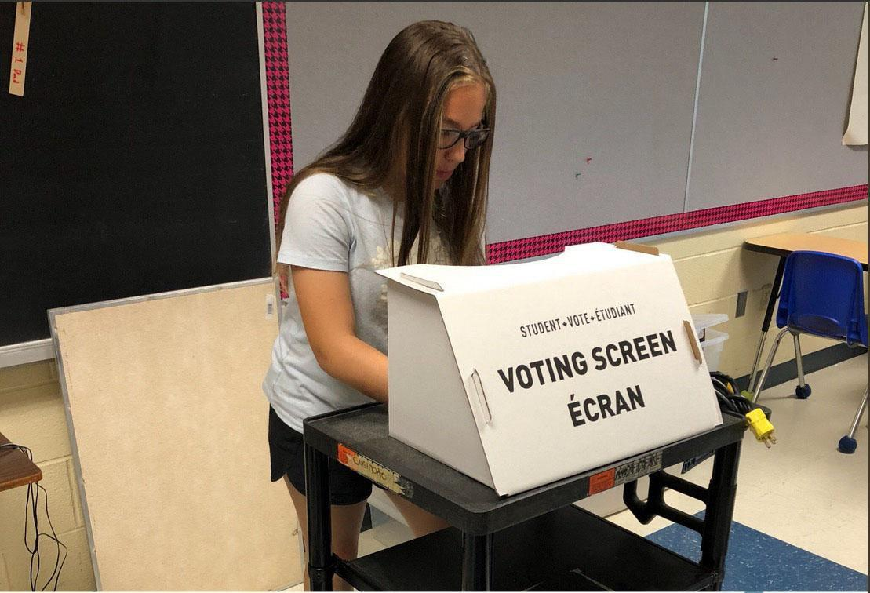
How do I mark my ballot?
A ballot lists the names of the candidates running for each position in your municipal elections.
As long as you appropriately mark the ballot according to the number of choices, your votes will be counted.

Slide 10
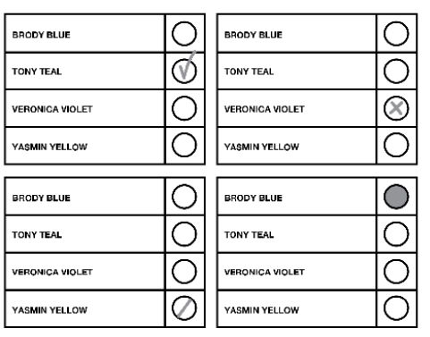
Valid ballots
A valid ballot clearly indicates the preference of the voter.
You may vote for more than one candidate if there is more than one person elected in the race.

Slide 11
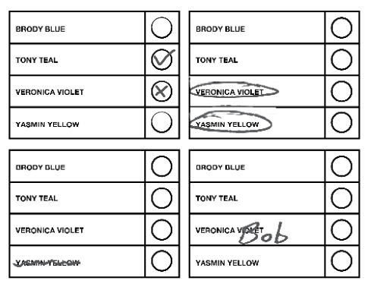
Rejected ballots
A rejected ballot is a ballot that cannot be counted because the voter’s choice is not clear.

Slide 12
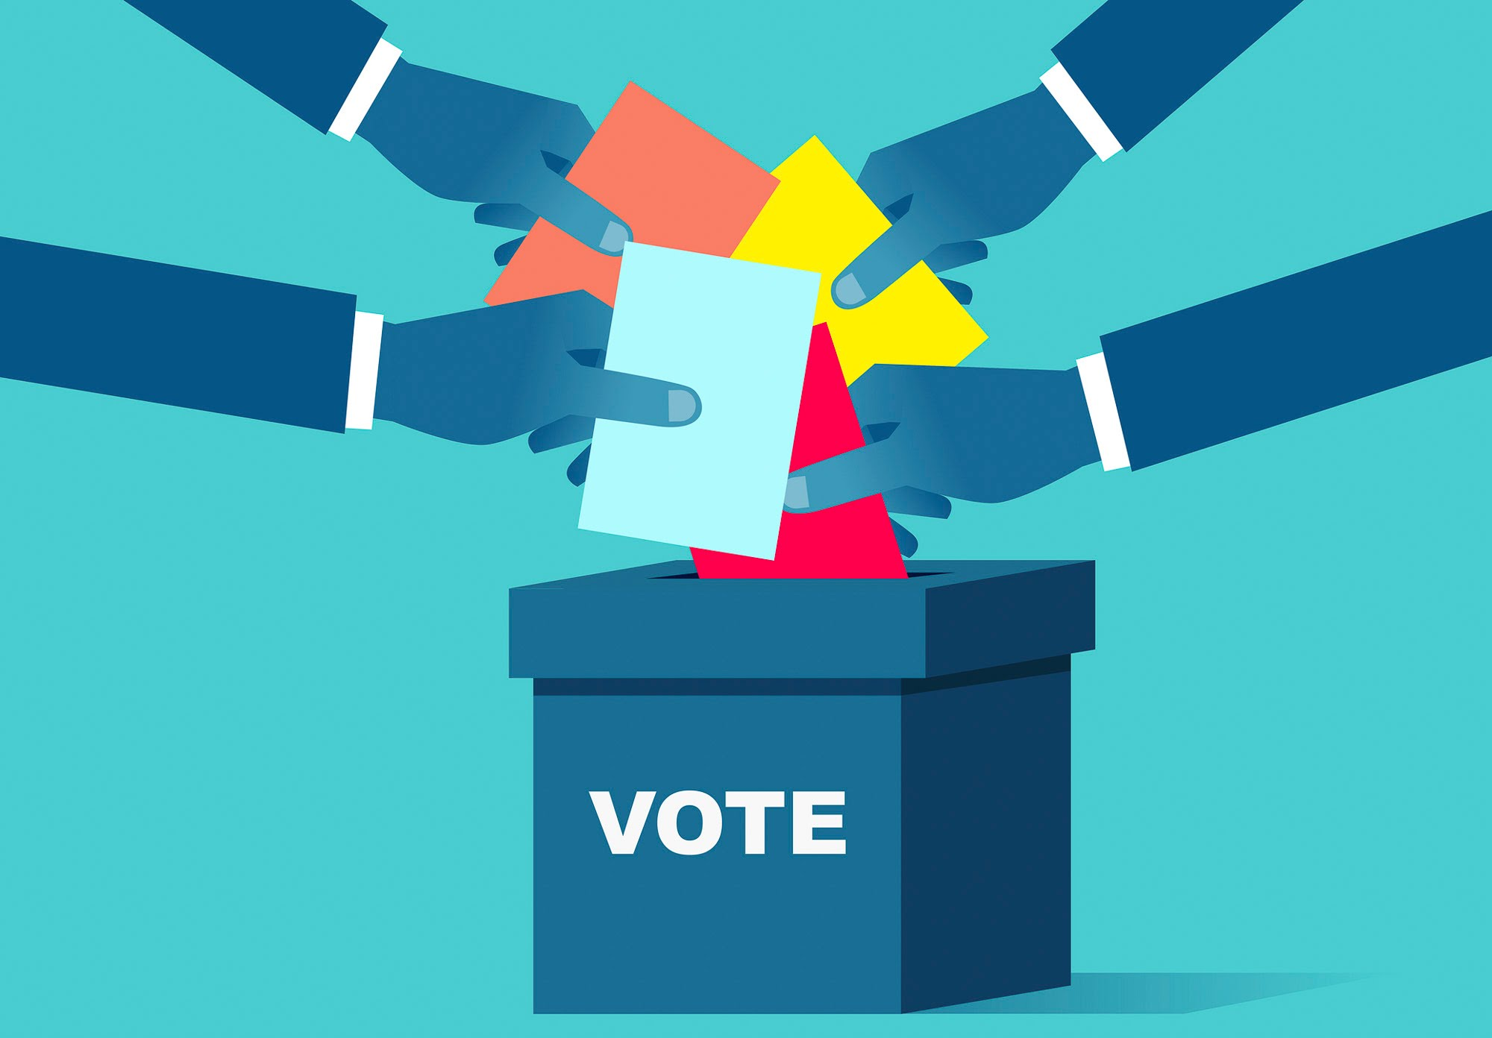
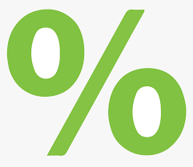
Voter turnout
Voter turnout is the percentage of eligible electors or registered voters that cast ballots in an election.

Slide 13
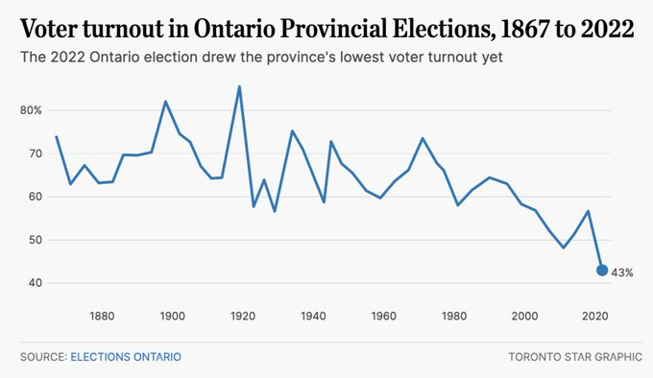
Ontario voter turnout

Slide 14
Discussion
How has voter turnout changed over time?
What factors do you think may lead to an increase in turnout?
What groups do you think might have lower voter turnout? What barriers might they face?

Slide 15
Barriers to voting
Motivational Barriers
“Getting to the door”
Access Barriers
“Getting through the door”

Slide 16
Motivational barriers

Slide 17
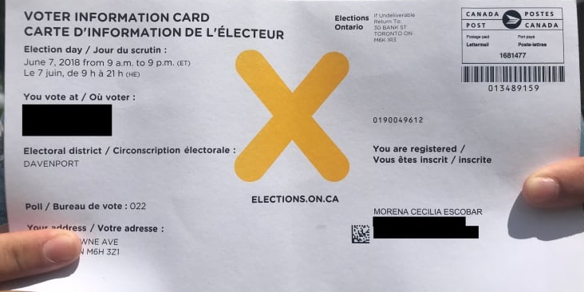
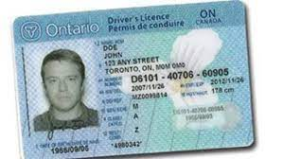
Access barriers
Knowing when, where, and how to vote
Voter ID
Site/method accessibility
Language/literacy

Slide 18
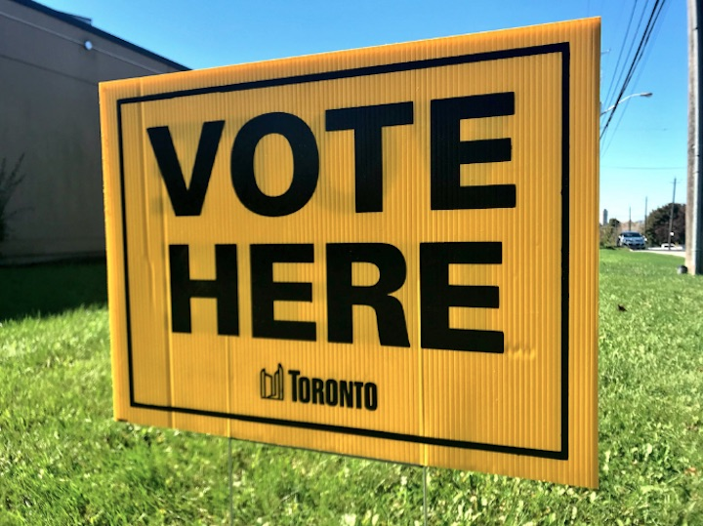
Reflection
How do you think that motivational and access barriers could affect your decision or ability to vote in the future?

Slide 19
Discussion
Should eligible citizens vote in municipal elections?
Does voting matter?
Do you plan to vote in the future? Why?

